Slide 1
NHL Draft Analysis
Jordan Gregor
Data science 201

Slide 2
NHL entry draft
Annual event in NHL
Young prospects are chosen by different teams
A primary way teams bring new talent into organization
It is possible for a player to go undrafted

Slide 3
Data set information
Dataset includes:
Player Information
Player stats for 2017-2018 season
Personal player information (ie. birthday, age, hometown)
Only listed players who played in 2017-18 season
891 Records
Originally contained 204 columns

Slide 4
Project objectives
Answer questions such as:
Which draft class is “most successful”?
What is the average amount of time between a player’s draft year and debut year?
Analyze different draft classes using players’ career stats
Demonstrate knowledge of class objectives

Slide 5
Data dictionary
Draft Year – Year player was selected in entry draft
Draft Round – Which round of the draft the player was selected
Overall – When the player is picked in the draft
Hand – Whether the player is right or left handed
Debut – Year player played their first game in the NHL
Salary – How much USD a player makes a year

Slide 6
Data dictionary
Position – What position the player plays, ie. Forward, left wing, right wing, defence
GP – Games played
G – Goals scored
A – Assists
PTS – Number of goals and assists combined

Slide 7
Initial analysis
Data Cleaning
Delete unnecessary columns
Replace blank cells with N/A
Clarify data in some columns
Conduct countifs on Draft year and Debut year
Multiple 5 number summaries

Slide 8
Draft year frequency

Slide 9
Debut year frequency

Slide 10
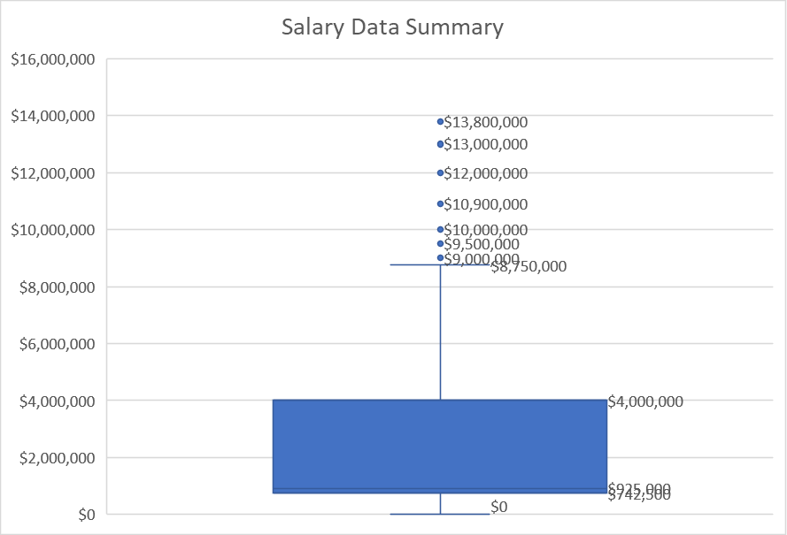
Five number summaries

Slide 11
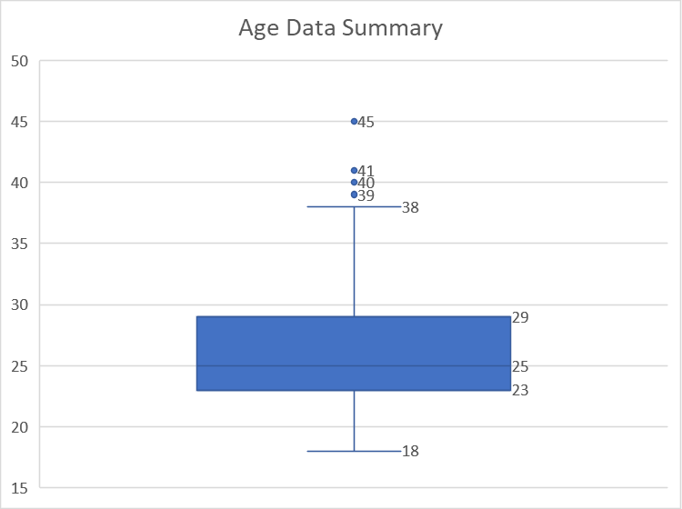
Five number summaries

Slide 12
conclusion
Dataset is viable for further analysis
Further exploration will look at:
Stand out draft classes
Success of undrafted players
Average time spent in developmental leagues after draft

