Slide 1
Trending YouTube Videos
By Kevin Cox

Slide 2
The Dataset
From Kaggle
  Cites YouTube
59.8MB
40950 records
16 fields

Slide 3
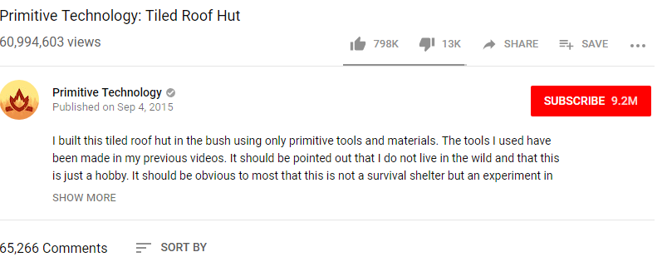
Fields
Video ID
Title and Uploader
Upload and trending dates
Tags and Categories
Likes, Dislikes, and Comments
Disabled Comments and/or Ratings
Removal/Error

Slide 4
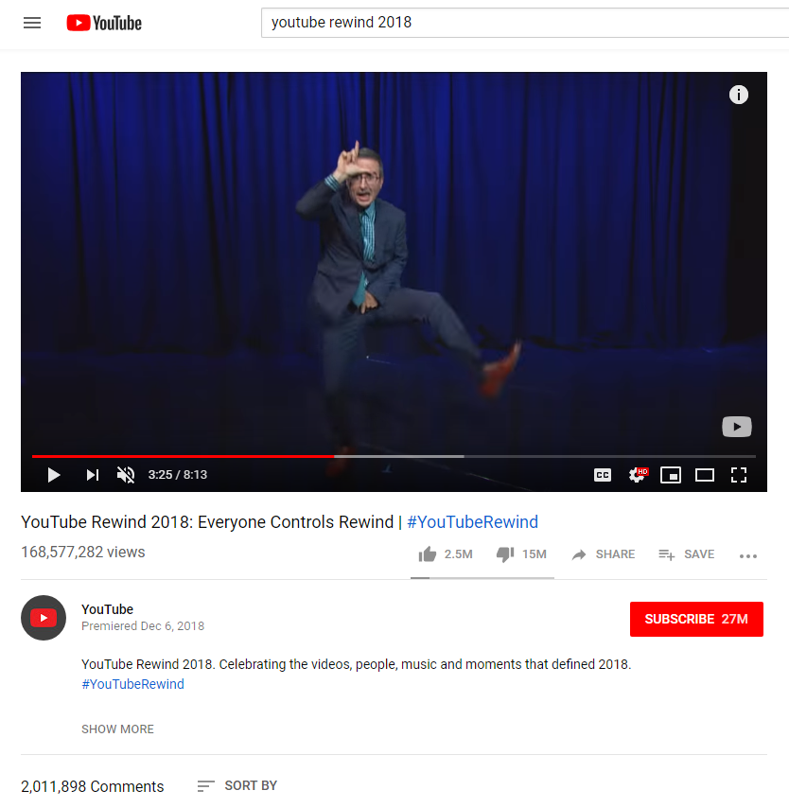
Areas of Investigation
What videos are most likely to be trending?
  Category
  Channel
Likes/Dislikes

Slide 5
Course Objectives
Use of spreadsheet functions
Use of spreadsheets for further analysis
Use of charts or graph
Use of scripting language
Use spreadsheets to identify inconsistent and missing info

Slide 6
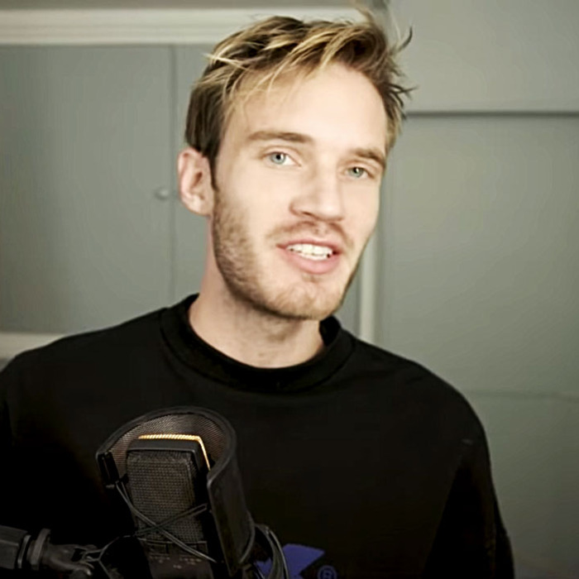

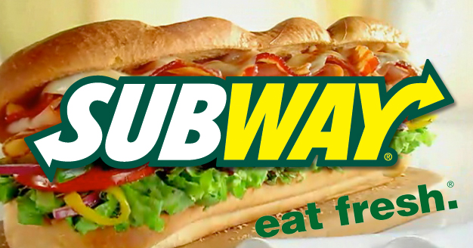
Questions

