Slide 1
NYC Homelessness 2013-2019
Johnathan Wiggins

Slide 2
Question
Who here has ever been homeless?

Slide 3
Project Overview
When is homelessness the highest in the year?
In this Presentation
Overview of my dataset
Problems with the data
Analysis of the data
Findings with the data
Future work

Slide 4
Data Overview
From Kaggle
Originally collected by NYC’s Shelter System
CSV Format
2168 Records
13 original fields
5 additional fields created
286 KB

Slide 5
DATA OVERVIEW (CONT.)
Date of census
Month
Year
Total Adults in Shelter
Total Children in Shelter
Total Individuals in Shelter
Single Adult Men in Shelter
Single Adult Women in Shelter
Total Single Adults in Shelter
Families with Children in Shelter
Adults in Families with Children in Shelter
Children in Families with Children in Shelter
Total Individuals in Families with Children in Shelter
Adult Families in Shelter
Individuals in Adult Families in Shelter

Slide 6
Problems With the Data
Issue #1- The date field
Issue #2- Not a full daily log
Found that while it looks like a full daily log
ITS NOT
Date of Census
2019-09-28T00:00:00.000
2019-09-27T00:00:00.000
2019-09-26T00:00:00.000
2019-09-25T00:00:00.000
2019-09-24T00:00:00.000
2019-09-23T00:00:00.000

Slide 7
ANALYSIS OF THE DATA

Slide 8
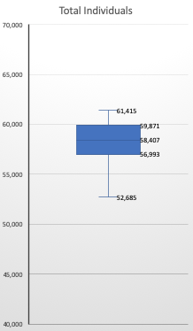
Total Individuals Field
Counts
Data | 2167
Any Entry | 2167
Blank | 0
NULL | 0
Max | 61415
Q3 | 59871
Q2 (median) | 58407
Q1 | 56997
Min | 49462
Average | 57752
Standard Deviation | 2837

Slide 9
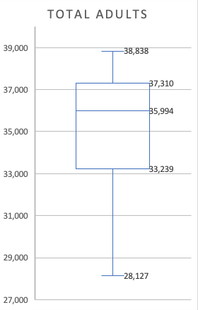
Total Adults Field
Counts
Data | 2167
Any Entry | 2167
Blank | 0
NULL | 0
Max | 38838
Q3 | 37310
Q2 (median) | 35994
Q1 | 33240
Min | 28127
Average | 34949
Standard Deviation | 2918

Slide 10
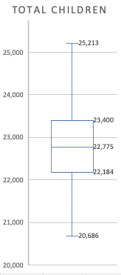
Total Children Field
WHAT?!
Counts
Data | 2167
Any Entry | 2167
Blank | 0
NULL | 0
Max | 25490
Q3 | 23400
Q2 (median) | 22775
Q1 | 22184
Min | 20686
Average | 22803
Standard Deviation | 950

Slide 11
Average Individuals by Month
 | 2013 | 2014 | 2015 | 2016 | 2017 | 2018 | 2019
January |  | 51470 | 58528 | 58140 | 60218 | 60443 | 61110
February |  | 52144 | 58233 | 58182 | 60077 | 60713 | 60838
March |  | 52234 | 57671 | 57847 | 59562 | 60279 | 60300
April |  | 52681 | 56996 | 57827 | 58875 | 59732 | 59005
May |  | 53098 | 56634 | 57896 | 58733 | 59180 | 58326
June |  | 53602 | 56223 | 57791 | 58288 | 58767 | 58044
July |  | 54305 | 55966 | 58076 | 58357 | 58970 | 58148
August | 49686 | 54834 | 56466 | 59042 | 58915 | 59414 | 58832
September | 50286 | 55839 | 57064 | 59591 | 59806 | 60246 | 59519
October | 50833 | 57153 | 57346 | 59963 | 60274 | 60826
November | 51123 | 58182 | 57767 | 60492 | 60242 | 60950
December | 51015 | 58745 | 57855 | 60391 | 60316 | 60833

Slide 13
Average Adults by Month
 | 2013 | 2014 | 2015 | 2016 | 2017 | 2018 | 2019
January |  | 29260 | 33552 | 34734 | 36794 | 37667 | 38682
February |  | 29634 | 33649 | 34903 | 36812 | 37940 | 38648
March |  | 29686 | 33514 | 34947 | 36644 | 37724 | 38402
April |  | 29958 | 33274 | 35036 | 36398 | 37515 | 37831
May |  | 30214 | 33149 | 35139 | 36380 | 37221 | 37488
June |  | 30442 | 33072 | 35148 | 36165 | 37035 | 37286
July |  | 30859 | 33010 | 35254 | 36177 | 37149 | 37258
August | 28341 | 31178 | 33278 | 35734 | 36552 | 37475 | 37581
September | 28643 | 31740 | 33637 | 36035 | 36944 | 37909 | 37970
October | 28919 | 32454 | 33962 | 36367 | 37196 | 38255
November | 29014 | 33056 | 34308 | 36756 | 37303 | 38413
December | 28977 | 33419 | 34450 | 36790 | 37459 | 38441

Slide 15
Average Children by Month
 | 2013 | 2014 | 2015 | 2016 | 2017 | 2018 | 2019
January |  | 22210 | 24976 | 23406 | 23424 | 22776 | 22429
February |  | 22510 | 24584 | 23279 | 23266 | 22773 | 22191
March |  | 22549 | 24157 | 22900 | 22918 | 22555 | 21897
April |  | 22724 | 23721 | 22790 | 22477 | 22216 | 21174
May |  | 22884 | 23484 | 22757 | 22353 | 21959 | 20837
June |  | 23160 | 23151 | 22643 | 22123 | 21732 | 20758
July |  | 23447 | 22956 | 22822 | 22179 | 21821 | 20891
August | 21346 | 23656 | 23188 | 23308 | 22362 | 21939 | 21251
September | 21643 | 24099 | 23427 | 23556 | 22862 | 22336 | 21549
October | 21914 | 24699 | 23384 | 23596 | 23078 | 22571
November | 22109 | 25126 | 23459 | 23737 | 22939 | 22537
December | 22039 | 25326 | 23405 | 23601 | 22857 | 22392

Slide 17
What Did I Find?
During the winter months
Population in shelters increases
During the summer months
Population in shelters decreases

Slide 18
Future Work
I would like to find data to see if the missing dates support the findings
Try and find if there is data with LGBTQIA+ markers to see if there is any correlation with them as well

Slide 19
Questions?

