Slide 1
Traffic Infractions
Ethan Sabo

Slide 2
The Dataset
The dataset give basic information on the people who received traffic infractions in the year 2017.
The information of the data set has been provided by https://data.ny.gov/widgets/q4hy-kbtf.
There are 10 fields in the data set
After cleaning the data set there are 354528 rows.

Slide 3
Data Set Issues
The only issues with the data set was that the file was overly large.
I solved this problem by only using the most recent information I could find for this data set. (I also removed the year on the data set because we knew it was only 2017)
The only other issue with the data set was their were blanks, so I simply removed them.

Slide 4
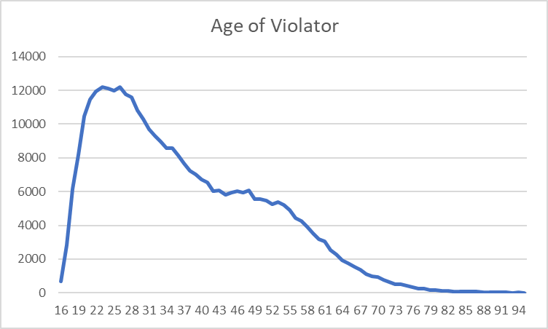
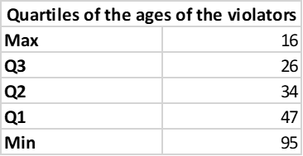
Drivers who receive the most Tickets
I have discovered in this dataset that the most likely to receive traffic infractions are young drivers.

Slide 5
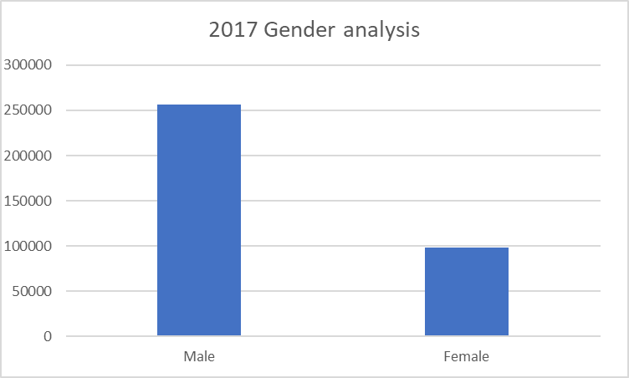
More on Who Received the Most Tickets
Men are considerably more likely to receive citations to woman.
Men are considerably more likely to receive citations to woman.

Slide 6
How I Found This
Using basic functions in excel like countif and a pivot table helped me identify this information.

Slide 7
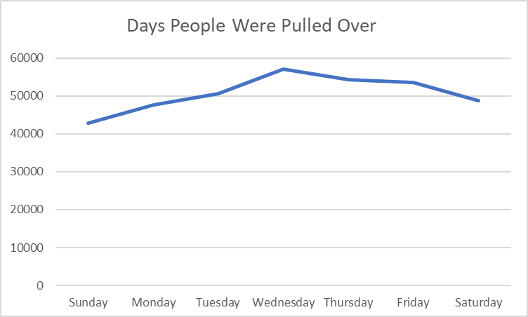
Days With the Most Citations
The middle week days are the most common days to have citations.

Slide 8
I Find That
In conclusion middle age females receive significantly less citations then young men.

Slide 9
Future Work
Perusing a adventure in to the data available to the public by law enforcement will defiantly be what data I will be playing with in the future.

