Slide 1
Edinboro University Alumni
By: Jenny Norton
DSCI101 T-TH

Slide 2
Project Overview
Analysis of Edinboro University alumni records
Alumni – a group of Edinboro University graduates
My questions:
Which majors donate more
Which gender donates more
In each major, which gender donates more

Slide 3
Data Overview
Data obtained from the University Advancement Office
Exported from Blackbaud’s Raiser’s Edge as a CSV file
All living alumni with Associate’s degrees, Bachelor’s degrees and some unknown degrees
Master’s degrees and Teacher Certifications excluded
File contained 57,376 records and is 6.78 MB

Slide 4
Data Dictionary
ID - number
Name - text
ConsCode - text
Class of - categorical
Degree - categorical
Major - categorical
Lifetime Giving - number
Gender - categorical
Birth Date - date
Age - number
Month - number
Day - number
Year - number
Generation - categorical

Slide 5
Problems with the Data
Name and ID fields were cleared for security
123 blanks in Class of field replaced with NA
6,943 blanks in Degree field replaced with NA
6,651 blanks in Major field replaced with NA
4,769 blanks in Birth date and Age fields replaced with NA

Slide 6
Birth date field was split into Month, Day and Year
Generation category created using the Year field
Generation | Birth Year
Uncategorized | 1900-1943
Baby Boomer | 1944 - 1964
Gen X | 1965 - 1979
Millennial (Gen Y) | 1980 - 1994
Gen Z | 1995 - 2015

Slide 7
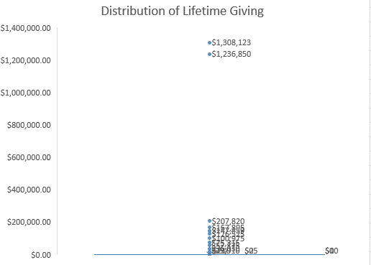
Analysis of Lifetime Giving
57,376 records; only 15,272 donors
Max lifetime giving $1,308,122.90
Average lifetime giving $210.26
Two outliers above $1.2 million
Most donors under $200,000
This is a mess but shows the outliers and majority of donors under $200K

Slide 8
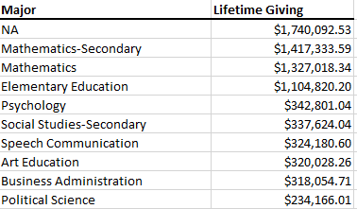
Analysis of Lifetime Giving by Major
Created a pivot table of Lifetime Giving by Major
Top 10 majors by Lifetime Giving

Slide 10

Analysis of Gender by Lifetime Giving
Created a pivot table of Lifetime Giving by Gender
Appears men give more but it used to be a “man’s world”

Slide 11
Analysis of Lifetime Giving by Major and Gender
Created a pivot table of Lifetime Giving by Major and Gender
Mathematics-Secondary and Mathematics top male donors
Elementary Education top female donors
Major | Male | Female | Grand Total
NA | 10.57% | 3.85% | 14.42%
Mathematics-Secondary | 11.57% | 0.18% | 11.75%
Mathematics | 10.84% | 0.16% | 11.00%
Elementary Education | 3.33% | 5.83% | 9.16%
Psychology | 2.16% | 0.69% | 2.84%
Social Studies-Secondary | 2.65% | 0.15% | 2.80%
Speech Communication | 1.31% | 1.38% | 2.69%
Art Education | 1.29% | 1.36% | 2.65%
Business Administration | 2.23% | 0.40% | 2.64%
Political Science | 1.51% | 0.43% | 1.94%

Slide 12
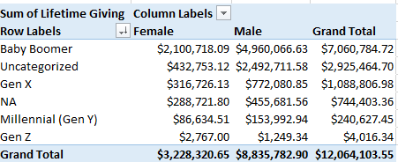
Analysis of Lifetime Giving by Generation
Baby Boomers have highest lifetime giving but they’ve been giving a lot longer
Millennial (Gen Y) shows males giving more
Gen Z just starting to donate

Slide 13
Conclusions
32% of donations are from the Mathematics-Secondary major, the Mathematics major and the Elementary Education major
14% of donations are from unknown majors
I expected finance or computer science related majors would have been higher

Slide 14
Appears men donate more than women
Found out in the past all gifts recorded on the man’s record
Cannot answer this question in good faith
Same issues with regard to which gender donates more by major
Some majors showed females donated more, such as Elementary Education and Health and Physical Education

Slide 15
Future Work
Review missing information in class year, degree, major and birth date fields
Use year books and online search companies to fill in missing information
Query for additional information that shows lifetime giving by decade
Monitor if majors who give the most shifts over next 5 to 10 years

Slide 16
The End
Thank you!
Any questions?

