Slide 1
Data analytics Final Presentation
Kat Kinnear

Slide 2
The question
What city has the most rapes recorded in 2015 and how does it affect future homeowners?

Slide 3
The dataset/ Project overview
2015 crimes in Metropolitan areas
Focused on rapes primarily
Future living
381 records
1.6MB
Workbooks
Excel file, not CSV
Data world, Gary Hoover, originally from FBI Bureau of stats
Concentration: Rape field
Why?
Single, independent white woman looking where to live!

Slide 4
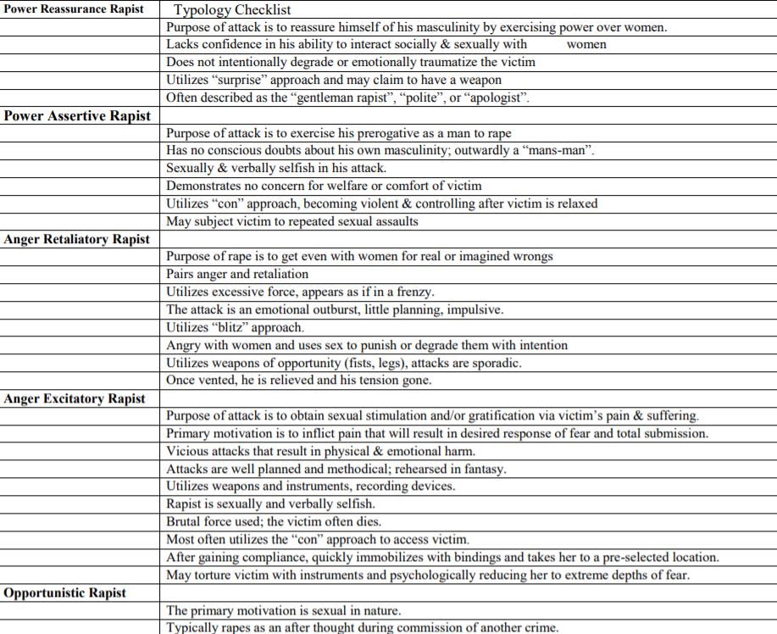
Background about rapes
5 Types
Close to home case in 1986-99
35-39yr old offenders

Slide 5
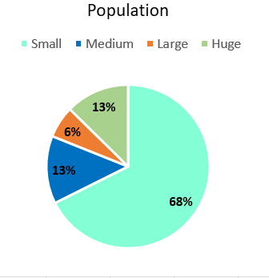
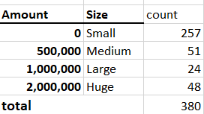
Cleaning AND impact
No major problems impacted investigation
Deleted worksheets that were not needed
Sorting
by largest to smallest cities
Population size: Per 100k people
Chart of all the populations
68% of cities of the population is HUGE
13% of cities of the population is MEDIUM
13% of cities of the population is SMALL
6% of cities of the population is LARGE

Slide 6
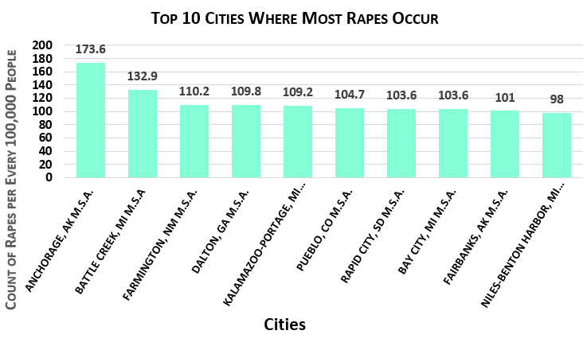
Discoveries
Surprised by the amounts of Rapes in 2015
Estimated 90,185 total rapes reported to law enforcement in 2015
Sorting and population size lead to the discovery of top ten cities where the most rapes occur
ANSWER: Anchorage, Alaska!!!

Slide 7
More research info about rape
4/10 Rapes are in the victim’s home
Rapes are not reported because of the relationship to the victim, fear, could end career, etc.
Sex offense victims in 2012 (FBI):
67,345 female
12,100 male
Convicted sex offenders in 2012 (FBI):
4,394 female
70,930 male
Relationship of victim to rapist before the incident | %
Current or former intimate partner | 26%
Another relative | 7%
Friend or acquaintance | 38%
Stranger | 26%
From US Bureau of Statistics ^

Slide 8
Conclusions
I found out that Anchorage Alaska had the most reported rapes in 2015
Was surprised because of how cold it can get in Alaska, so motivation for the rape in the cold, must’ve really wanted to commit the crime
A total of 1,100 rapes were reported in Alaska in 2018, as well as 88 attempted rapes. The rate of 161.9 sexual assaults per 100,000 people has now reached nearly four times the national rate. That’s equivalent to a rape in Alaska about every seven hours.

Slide 9
Future work
Would play around with the data more
Maybe do an analysis for other major crimes
Narrow down what cities that most crimes occur
Move there to put more criminals away for a job, or to a quieter area to raise a family?

Slide 10



Questions?

