Slide 1
Leading causes of death in the united states
A STUDY OF THE DEATH CAUSES DATASET
BY JAMES GALLACE
TR DSCI 101

Slide 2
PROJECT OVERVIEW
Are there trends in causes of deaths?
In this presentation
Overview of the death causes dataset
Problems with the dataset
Analysis techniques
Findings
Future Work

Slide 3
DATA OVERVIEW
From Kaggle
Originally from Leading causes of death in us
CSV Format
13,260 records
5 fields
About 800KB

Slide 4
DATA FIELDS
Year
Cause
State
Death Count
Age Adjusted Death Rate

Slide 5
PROBLEMS WITH THE DATA
There is United States included in the State field
One of the Causes is All Causes
Some fields have no death count
Count of deaths is misrepresented

Slide 6
Analysis of Year
Deaths per year barely change
Count of All Data | 12,742
Count of Numbers | 12,742
Count of Blanks | 0
Count of NA | 0

Slide 7
Analysis of Cause
The 7 largest causes
Count of All Data | 12,742
Count of Numbers | 0
Count of Blanks | 0
Count of NA | 0

Slide 8
Analysis of State
State death Percentages show Population
Count of All Data | 12,742
Count of Numbers | 0
Count of Blanks | 0
Count of NA | 0

Slide 9
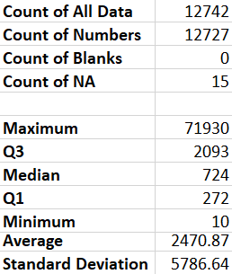
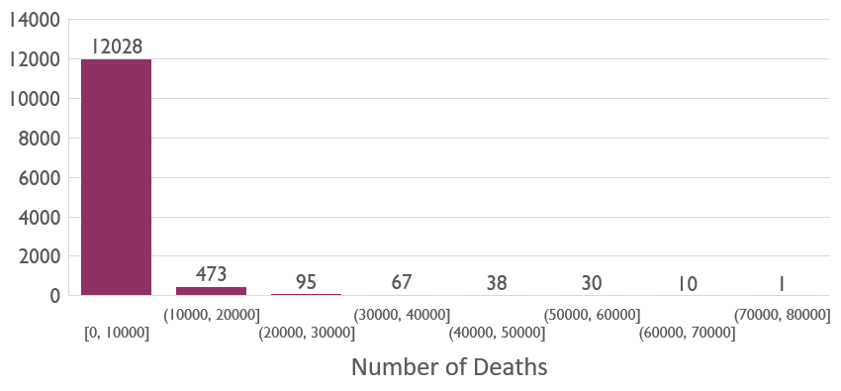
Analysis of Death
Count of deaths misrepresent the data

Slide 11
9/11 Terrorist Attacks

Slide 13
Future work
I would like to figure out why the deaths by Unintentional Injuries per year and the rate of deaths per year both decreased by over 50% in 2009
I would like to find more years of data and more causes to see if there were more trends that were not as apparent with a smaller sample

Slide 14
Questions?

