Slide 1
2019 NFL combine
Drake Fleet

Slide 2
Project overview
How can you identify a good performer
In this presentation
Overview of the 2019 NFL Combine data set
Problems with the Data
Analysis technique
Findings
Future Work

Slide 3
Data overview
From Kaggle
CSV Format
276 Records
16 Fields
78 KB

Slide 4
Data Fields
Year
Name
College
Position
Height
Weight
Hand Size
Arm Length
Wonderlic
40 Yard
Bench Press
Vert Leap
Shuttle
3cone
60 yard shuttle

Slide 5
Problems With the data
Some fields were left blank
There were many fields that I had to make N/a’s for
Fields that were left completely empty were hidden
Replaced 9.99’s on 40 yd to N/A as well

Slide 6
Analysis of Bench

Slide 7
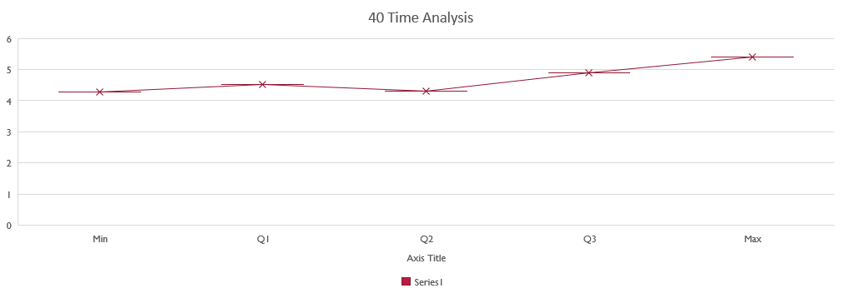
Analysis of 40

Slide 8
Future Work
I feel as if I could have went into even more depth and take their combine results and breakdown where the contestants were drafted or even if they were even drafted. I still feel as if my project was a success but I feel as if I didn't get as in depth with the project as I could have with relating it to the schools which was an issue with me. I feel as If I could have compared the Combine to where guys were drafted too or even if they were drafted

Slide 9
Questions

