Slide 1

Pittsburgh Accidental OD of 2018
Researched By: Colton Beck

Slide 2


The Big Why…

Slide 3

My Research Question:

Slide 4

Problems:

Slide 5
The Top Ten Drugs Found in the Dataset:
Fentanyl
Heroin
Cocaine
Alcohol
Acetyl Fentanyl
Alprazolam
Tramadol
Despropionyl Fentanyl 4-ANPP
Clonazepam
Oxycodone

Slide 6
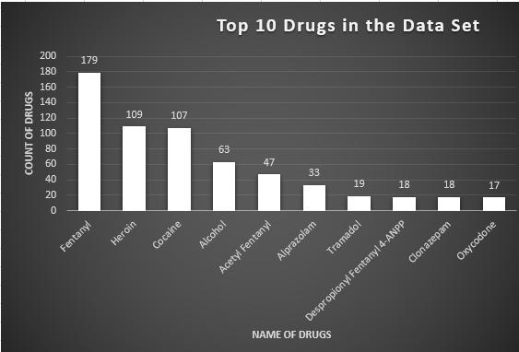

Slide 7
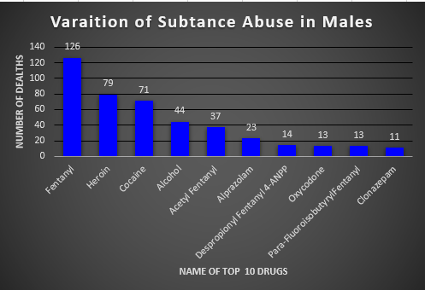
Males: Top Ten Drugs
Fentanyl
Heroin
Cocaine
Alcohol
Acetyl Fentanyl
Alprazolam
Despriopionyl Fentanyl 4-ANPP
Oxycodone
Para-Fluoroisobutyryl Fentanyl
Clonazepam

Slide 8
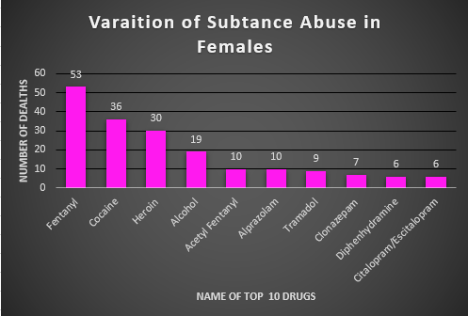
Females: Top Ten Drugs
Fentanyl
Cocaine
Heroin
Alcohol
Acetyl Fentanyl
Alprazolam
Tramadol
Clonazepam
Diphenhydramine
Citalopram/Escitalopram

Slide 9
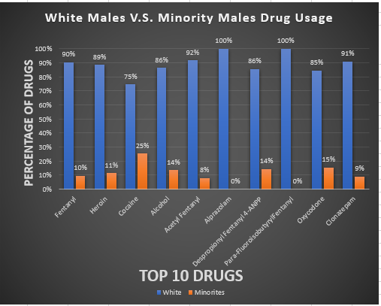
Male: Majority compared to the Minority
Male: Majority compared to the Minority

Slide 10
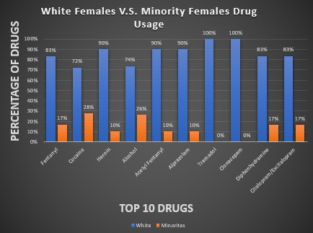
Female: Majority compared to the Minority

Slide 11

Future Work:

Slide 12

Questions:

