Slide 1
World Happiness Report 2016
Jacob Swope

Slide 2
Intro
The report was designed to look at countries happiness levels
Determines why some countries are happier than others
Looks at things like freedom, economy, family values

Slide 3
Data
Relatively clean
Hosted at Kaggle
Originally from the World Happiness Report
2016 because it was most complete, and an interesting year
157 records

Slide 4
Data Problems
Very few
Only “cleaning” was changing zeros to NA values
Kaggle provided accurate descriptions of fields
Added a Happiness Score Category

Slide 5
Basic Analysis of Data
Five Number Summaries - alot of them
Data Counts on Happiness Score Category and Region

Slide 6
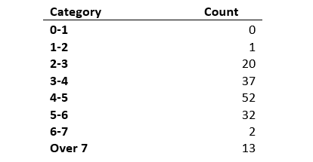
Happiness Score Category
Created by me to look at data a bit easier
Pretty standard expectations
More over 7 than expected
Used VLOOKUP

Slide 7
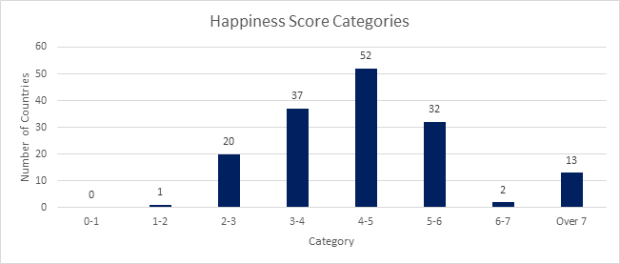
Happiness Score Category contd.

Slide 8
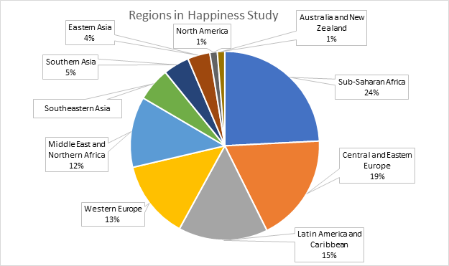
Regions
Breakdown of Regions
Sub-Saharan Africa most
represented

Slide 9
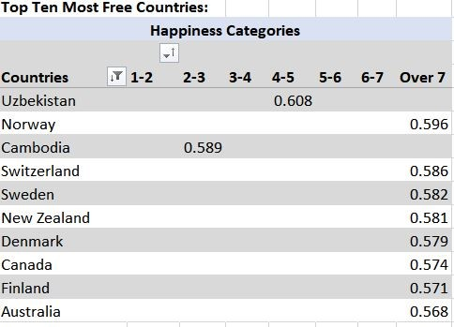
Freedom
Pivot Table for top 10 freest countries
Also shows the Happiness Score Category
US not in top 10, actually ranked 40

Slide 10
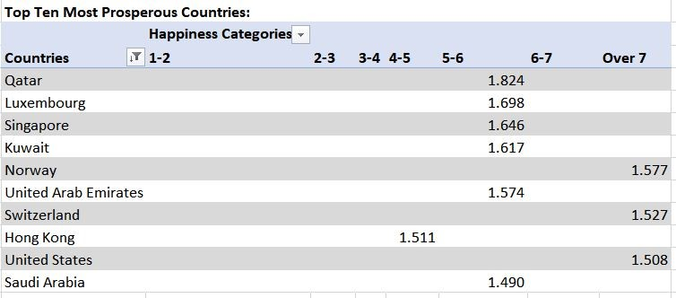
Economy
Same Pivot Table as before, swapping freedom for economy
US number 9

Slide 11
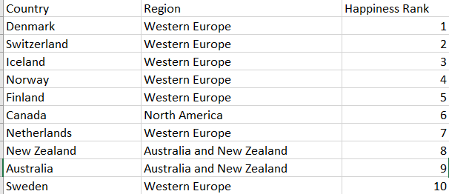
Overall Findings
Many top countries in each category not top overall
Universal healthcare and healthy economy a common factor
Western European countries
US 14th

Slide 12
Failures
Lots of five number summaries
Small variation of graphs
Each record was unique due to the nature of the study

Slide 13
Future Work and Ways to Improve
Geographical background
Political understanding
Population size

