Slide 1
Offense Wins Games
By. Ismael Ortiz

Slide 2
Reasons
Baseball is a sport that I enjoy and personally I felt I could find the stats incorporated with it
There is a lot of statistics involving the game of baseball
Many people say defense is the best offense but in baseball it is vise versa.
Different sports require different techniques and baseball is no different

Slide 3
Question/ Overview of project
Are players only rated by how they perform at the plate or by how they are defensively.
I started by focusing strictly on offense
Once I figured that, I figured I would go to MLB.com which automatically calculated all the stats for all the players that are in major league baseball.
I chose the best 100 offensive players.

Slide 4
Overview of Data
The data was presented by all of the best players based on batting average. What I had to do was separate the best players at their positions instead of having them placed all together. As shown below.

Slide 5
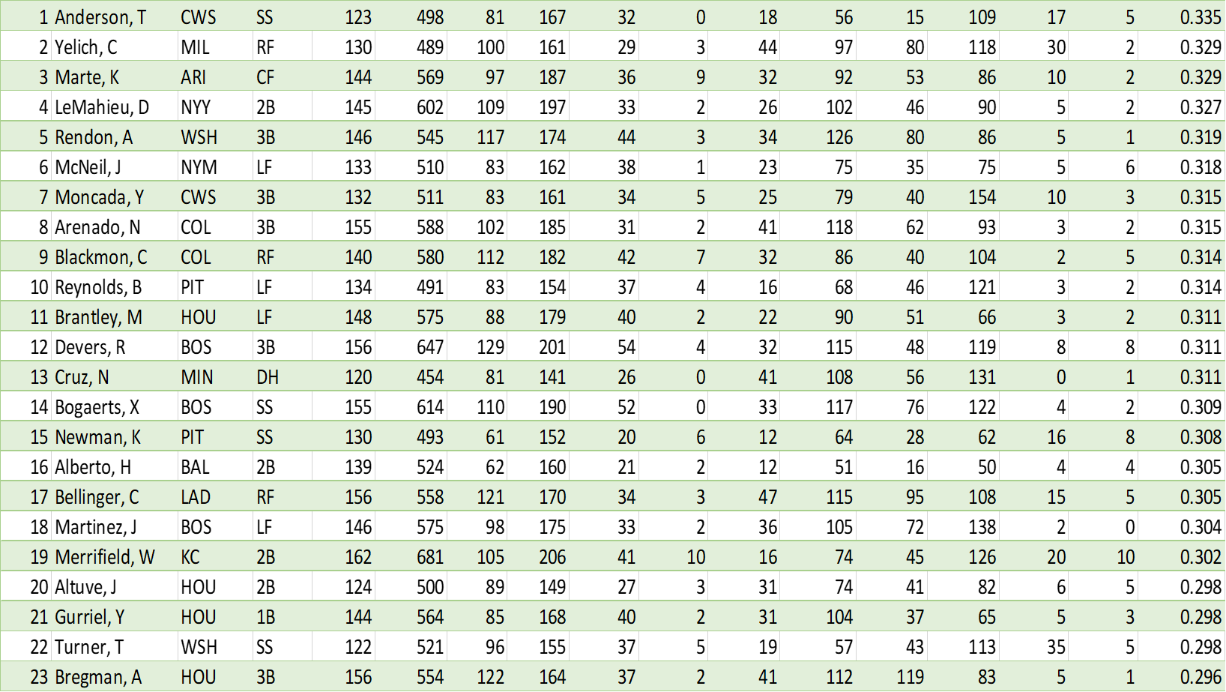
Top 100 players

Slide 10
Part 2 Combinations
After I chose the top 100 players’ I placed all of them into an excel worksheet
Added in an advanced filter to separate the infielders from the outfielders.
Once accomplished, I did sub separations by taking the best player at each infield position based on their batting average.
I acquired the best players at 1st, 2nd, 3rd, Shortstop and catcher.
After figuring out who was the best batter at each position, I selected them at their position and placed them into a chart

Slide 11
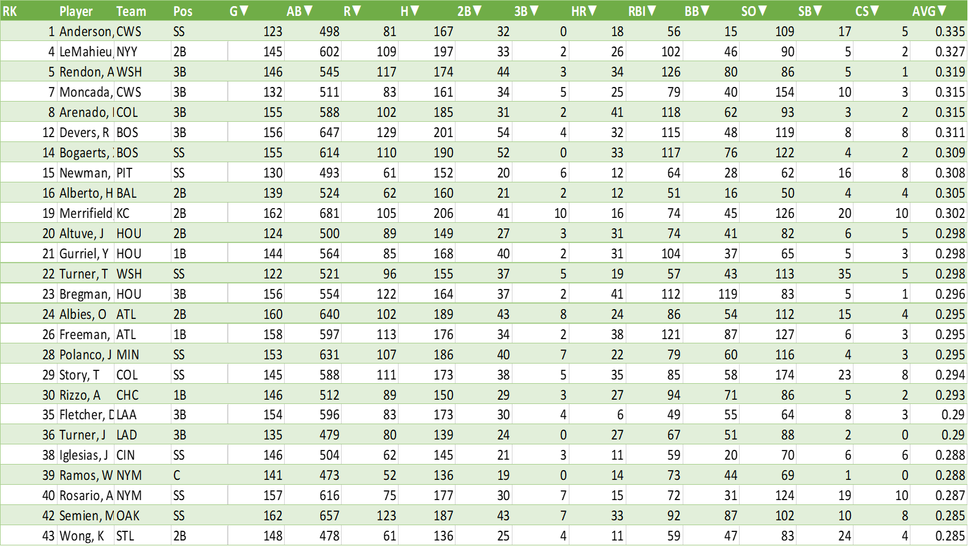
Overall Infield

Slide 14
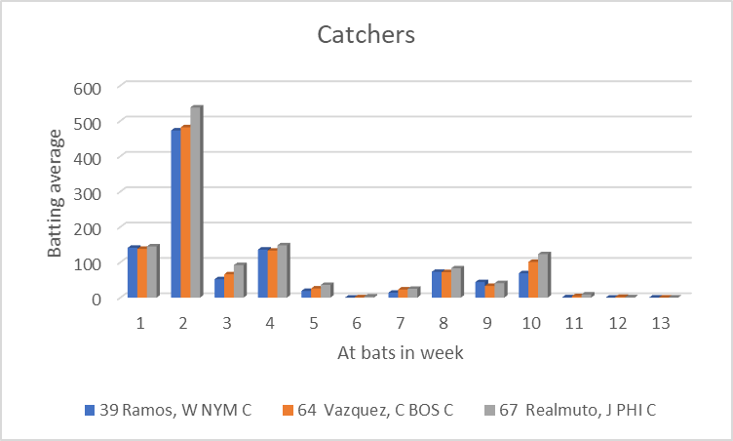
Catchers

Slide 15
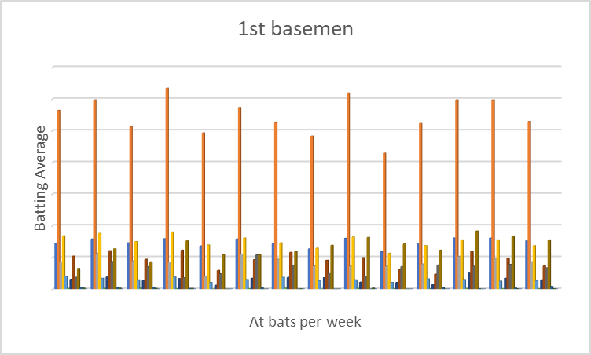
1st basemen

Slide 16
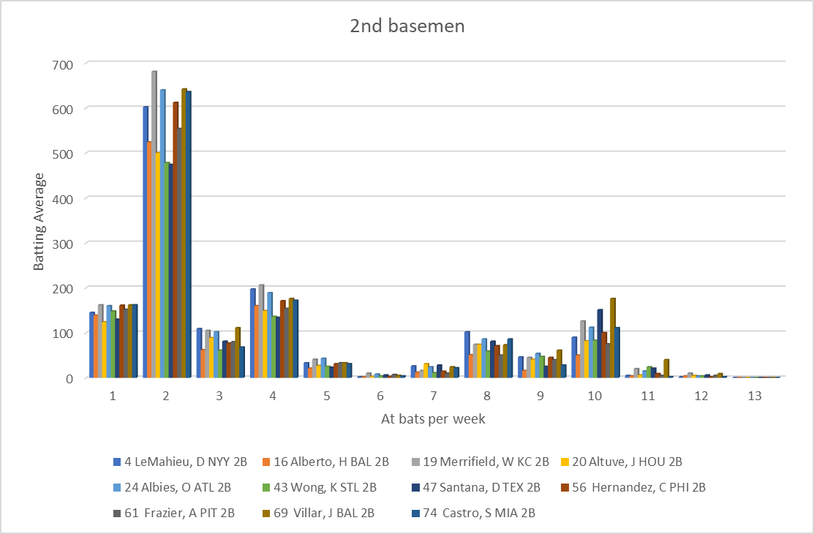
2nd basemen

Slide 17
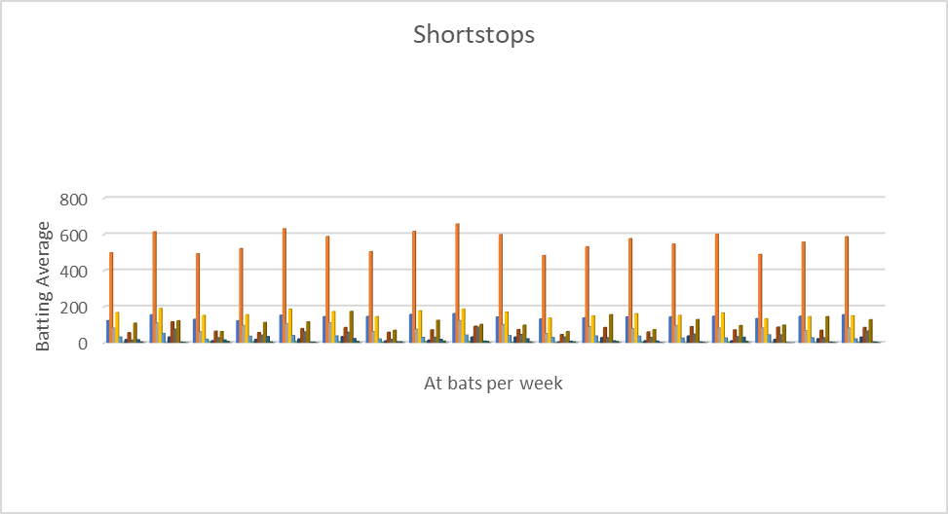
Shortstop

Slide 18
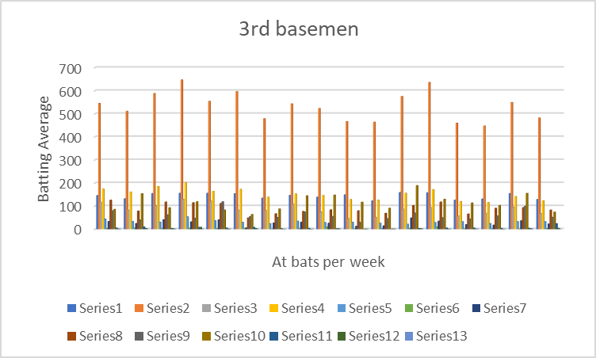
3rd basemen

Slide 19
Part 3 Outfield Combinations
After I was done with the infield I did the same thing with the outfield players
It was a little easier taking the outfielders offensive stats though do to the fact that there are only three positions in the outfield Leftfield, Centerfield, and right field
The Mlb has very little outfielders who made the top 100.

Slide 20
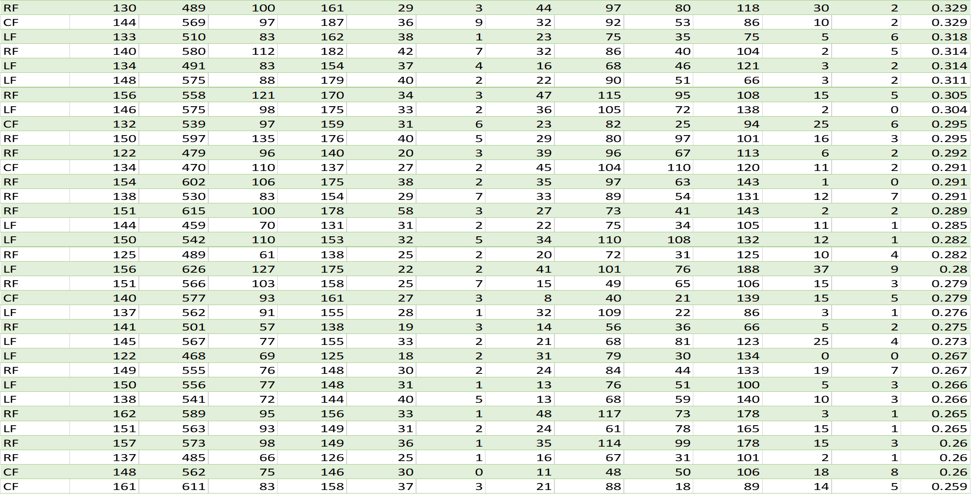
Overall Outfield

Slide 21
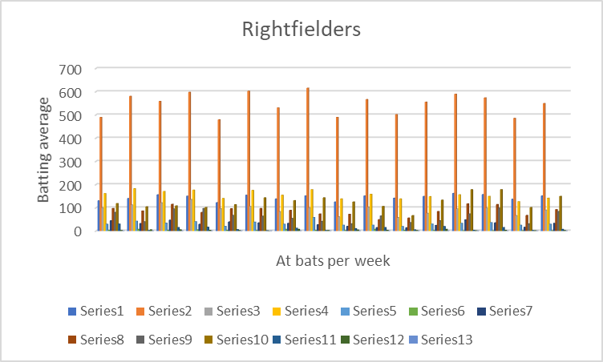
Rightfield

Slide 22
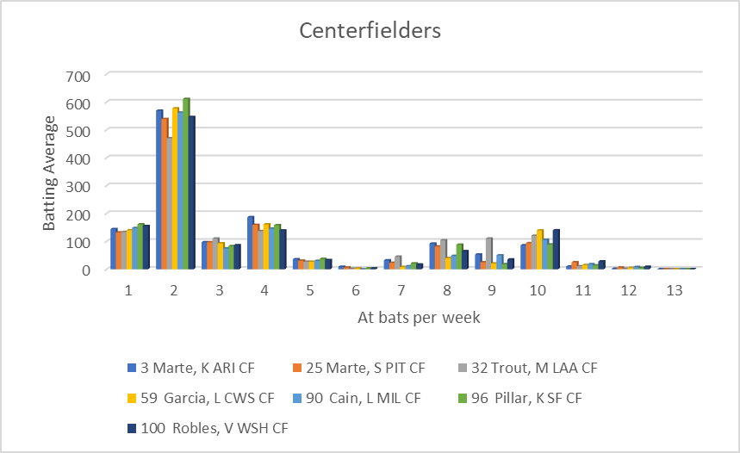
Centerfield

Slide 23
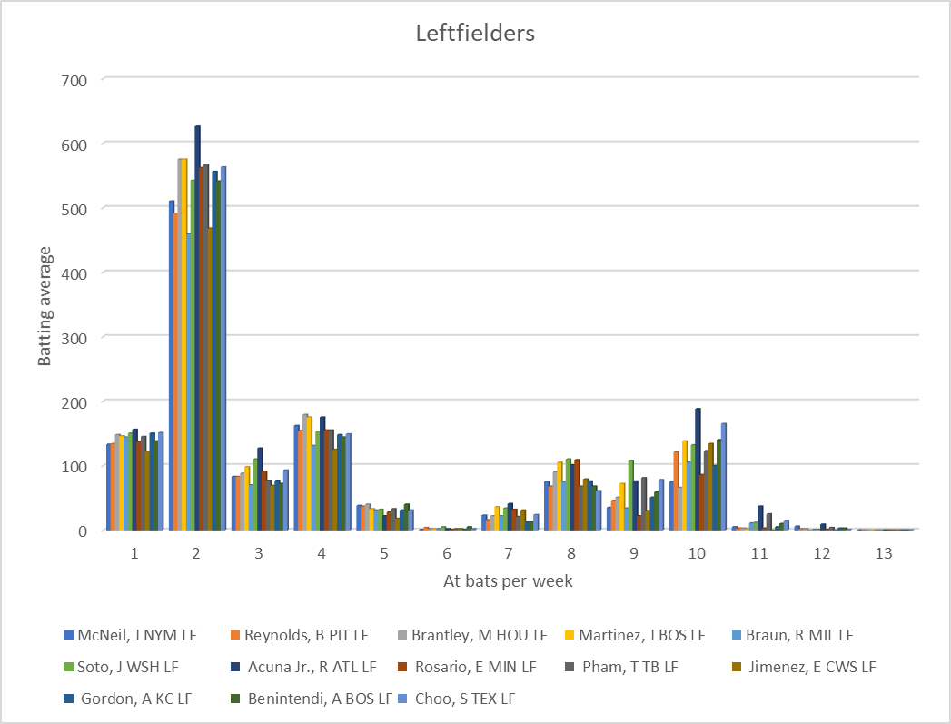
Leftfield

Slide 24
Failures/ Problems
While I was dealing with this dataset I have not encountered any failures with the data or my findings.
Along with there being no failures while I was going over the data I could not find any problems with any of my findings

Slide 25
Future Work
If any future work is going to be done with this data set, I will do something similar to what I did with the offense but instead I will focus more on the defensive side of the players in the top 100.

Slide 26
Conclusion
After looking at all the data on the offensive side of things I figured that my question can not be answered until I look at the players defensive. After looking at that information I will then be able to determine whether players are ranked by both offensive and defense or by one or the other.

