Slide 1
Dropouts In Pennsylvania by county
Jace neiderhiser

Slide 2
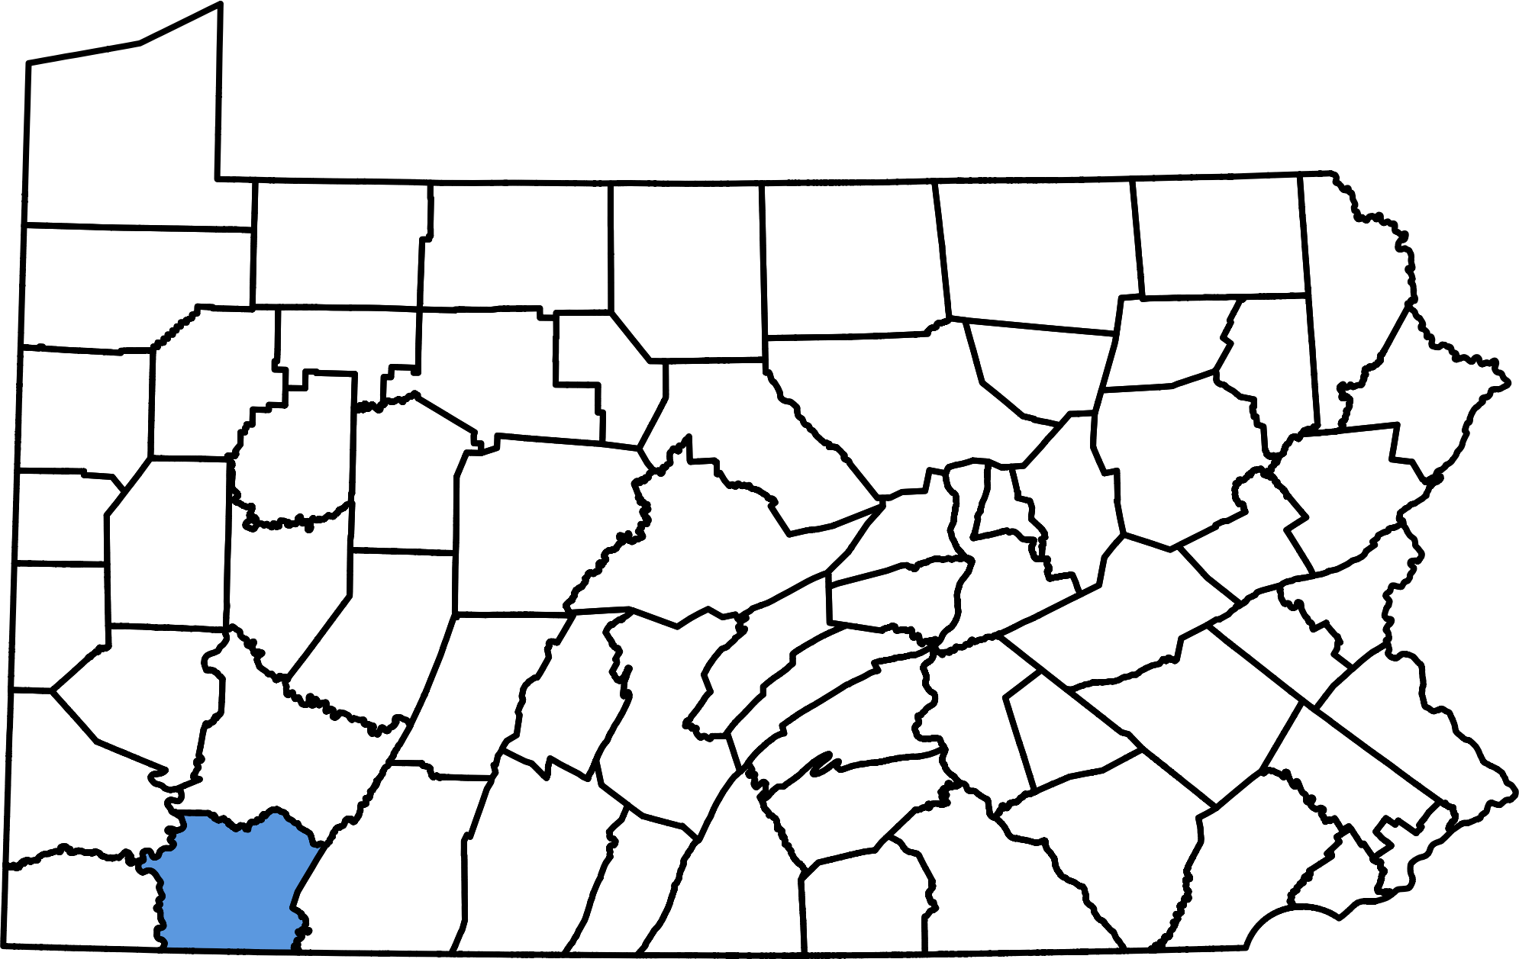
Overview
What are dropout rates of schools in Fayette County?
How does these rates compare to neighboring counties?

Slide 3
Intro
Data from Pennsylvania Department of Education
Limited fields
Filtered by removing small schools

Slide 4
Issues with data
Small schools gave weird results
Not a lot of fields

Slide 5
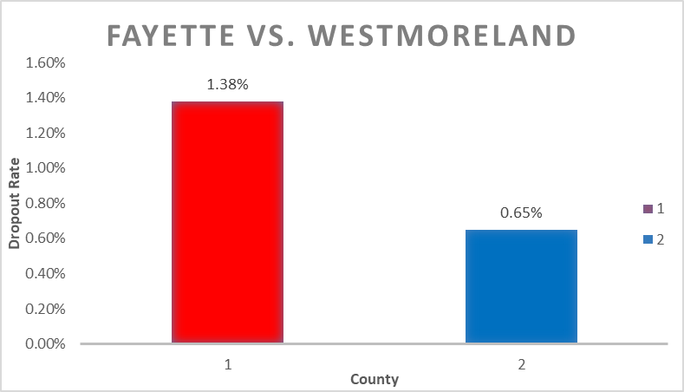
Results
Fayette has more dropouts even though it’s smaller
There are certain schools that contribute larger numbers of dropouts

Slide 6
discovery
Average of dropouts in Fayette
Average of dropouts in Westmoreland
This showed that Fayette has more dropouts

Slide 7
conclusions
Certain schools that are smaller in Fayette have more dropouts than larger schools
Fayette has higher dropout rates than Westmoreland even though its smaller

Slide 8
Future work
Compare dropouts from high populated areas like Pittsburgh and Philly

