Slide 1
100 Worst aviation accidents
Ola Mróz

Slide 2

Project overview
What is the most dangerous part of the flight?
Which airplane manufacturer/model was involved in the highest number of deadliest accidents?
What is the most common category of aviation accidents?
Which category of the accident proved to be the most dangerous?
Where do deadliest accidents happen the most?
In what day and month have the most people died?

Slide 3
Project overview
In this presentation
  Overview of the 100 Worst Aviation Accidents data set
  Analysis technique
  Conclusion
  Future work

Slide 4
Data overview
Original dataset “100 Worst Aviation Accidents”.
Data from Aviation Safety Network website
100 records
8 fields before data cleaning
10 fields after data cleaning
Original data set 28KB

Slide 5
Data fields
Fatalities
Date
Type of Aircraft
Airplane Model
Location
Category
Nature
Phase
Number of Other Causalities
Number of Survivors

Slide 6
Data cleaning
No problematic fields or missing information
No blank fields
Removed original fields: “Registration” and “Picture”
Added fields: Nature”, “Phase”, “Number of Other Causalities” and “Number of Survivors”
Edited fields: “Date”, “Type” and “Operator”

Slide 7
Airplane Type Analysis
Analysis of the aircraft type and model.
Type of Airplane | Count
Boeing | 45
Airbus | 15
McDonnellDouglas | 15
Tupolev | 8
Lockheed | 7
Ilyushin | 6
Antonov | 1
DC-9-81 | 1
Convair | 1
BAC | 1

Slide 8
Airplane Type Analysis
Focus on Boeing aircrafts as the type of airplane involved in most accidents.
Boeing Model | Count
747 | 13
727 | 12
737 | 7
767 | 4
707 | 4
757 | 3
777 | 2

Slide 9
Date analysis
Row Labels | Number of Fatalities
Sep | 4823
Aug | 2452
Jul | 2272
Mar | 1940
Dec | 1812
Nov | 1798
Jun | 1480
May | 1366
Jan | 1095
Oct | 982
Feb | 959
Apr | 805
Analysis of the dates of accidents.
Focus on months.

Slide 10
Date analysis

Slide 11
Day of the week analysis
Analysis of number of accidents based on the day of the week.
Date | Number of the Day of the Week | Day of the week
September 11, 2001 | 2 | Tuesday
September 12, 2001 | 3 | Wednesday
August 12, 1985 | 1 | Monday
March 3, 1974 | 7 | Sunday
March 27, 1977 | 7 | Sunday
June 23, 1985 | 7 | Sunday
November 12, 1996 | 2 | Tuesday

Slide 12
Day of the week analysis
Analysis of the number of accidents based on the day of the week.
Number of the day of the week | Day of the week
1 | Monday
2 | Tuesday
3 | Wednesday
4 | Thursday
5 | Friday
6 | Saturday
7 | Sunday
Day | Count
Sunday | 20
Tuesday | 19
Wednesday | 18
Monday | 15
Saturday | 10
Thursday | 9
Friday | 9

Slide 13
Day of the week analysis

Slide 14
Accident location analysis
Analysis of accidents based on geographical location.
Top 10 locations with the highest number of accidents.
Location | Sum of Fatalities
USA | 4200
Spain | 1367
Atlantic Ocean | 963
Japan | 946
Indonesia | 873
Nigeria | 787
Iran | 733
Saudi Arabia | 718
India | 683
France | 676

Slide 15
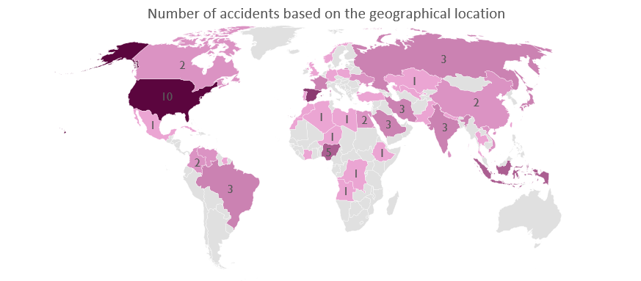
Accident location analysis

Slide 16
Fatalities analysis
Analysis of number of fatalities based on phase of the flight and accident category.
 | En route | Approach | Initial climb | Takeoff | Landing | Taxi | Unknown
A1 | 8334 | 4422 | 1651 | 972 | 711 | 335 | 141
C1 | 2217 |  | 155
H1 | 2846

Slide 17
Fatalities analysis
Analysis of the number of fatalities based on the phase of the flight and nature of the flight.
 | En route | Approach | Initial climb | Takeoff | Landing | Taxi | Unknown
Domestic Scheduled Passenger | 5475 | 1559 | 302 | 583 | 377
Int'l Non Scheduled Passenger | 1288 | 875 | 561 | 248 | 176 | 335 | 141
International Scheduled Passenger | 5657 | 1673 | 155 | 141 | 158
Domestic Non Scheduled Passenger | 405 | 315
Military | 572 |  | 551
Cargo |  |  | 237

Slide 18
Other Casualties and Survivors Analysis
Analysis of the number of other casualties and survivors based on the flight phase.
Flight Phase | Number of Survivors | Number of Other Casualties
En route (ENR) | 196 | 2756
Initial climb (ICL) | 17 | 406
Takeoff (TOF) | 41 | 339
Taxi (TXI) | 61 | 248
Approach (APR) | 142 | 23
Landing (LDG) | 39 | 16
Unknown (UNK) | 3 | 0

Slide 19
Other Casualties and Survivors Analysis

Slide 20
conclusion
The type of the plane that has been involved in the most accidents in the data set: Boeing
The most dangerous phase of the flight: En route
The most dangerous category of aviation accidents: Accidents
Most accidents happen in: September
Safest day of the week to fly: Thursdays and Fridays
IMPORTANT: THIS DATASET WAS LIMITED TO 100 WORST ACCIDENT.

Slide 21
Future work
Calculate a probability of surviving an accident
Calculate a probability of being a casualty of an airplane accident
Look into the fatalities in the accidents based on the seats in the aircraft.
  Where is the safest place to sit on the plane?
  Based on their seat where a person is most likely to die? (if a connection between deaths and seats exists).

Slide 22
Questions?

Slide 23
Thank you!

