Slide 1
Missing Migrants
By: Samantha Martz
DSCI 101 MWF

Slide 2
Overview of Project
Dataset is the Missing Migrants
Migrants are asylum-seekers, refugees or immigrants
The questions I wanted to answer:
  How many people have been died?
  Where is the most common place they have been died?
  What time of year are the migrants most likely died?
  Have deaths of migrants gotten worse over the last 5 years?

Slide 3
Data Overview
Data obtained from Kaggle
  Originally from The Missing Migrants Project
Data from 2014-2019
CSV Format
  5333 migrants recorded
  20 Fields
  1.41MB

Slide 4
Problems with the Data
Only problem was blank cells
  Cleaned the data by replacing blank cells with N/A
  Hide data fields I did not use

Slide 5
Data Analysis Techniques
A lot of 5 number summaries
Count functions
Pivot Table
Made count tables
Made charts

Slide 6
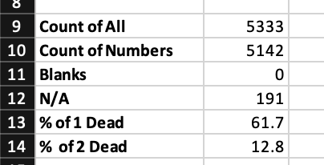
Year Reported
I performed count functions
How many one, two, three, etc. victims were found dead
  1 victim is the most w/ 3293
  2 victims is 685
I found the percent's that 1 victim is dead, 61.7%, and 2 victims were dead, 12.8%.

Slide 7
Year Reported
The trend of reported dead migrants
2018 has the most with 1506
Trend is going up each year
Skewed for 2019 due to
no data after March 2019

Slide 8
Months Reported
I performed count functions
Highest victim month is Oct.
  537 dead
Lowest month is April
  319 dead

Slide 9
Migration Route
Had to fill in blanks with N/A
Chose the Top 7
More then 50% are
unknown route locations
Central America to US
is second highest at 29%
Mediterranean areas
are at 18%

Slide 10
Region of Incident
Where the death of the
migrant took place
Most frequent areas
US-Mexico Border
  1337 dead
North Africa
  1239 dead
Mediterranean
  984 dead

Slide 11
Conclusion
Questions answered:
  How many people have been died? 5333
  Where is the most common place they have been died? US-Mexico Border
  What time of year are the migrants most likely died? October
  Have deaths of migrants gotten worse over the last 5 years? Yes, the trend is going up each year.

Slide 12
Future Works
Find out where the migrants originally came from.
Search out the data from the last 8 months
See if more male or female were more likely to die

