Slide 1

By Sam Martin

Slide 2





introduction
Name: Charmander
Type1:
Type2: None
Name: Charizard
Type1:
Type2:
Evolve

Slide 3


data cleansing
Removed mega evolutions
Removed altered forms.
Changed mythical pokemon to Lengendary

Slide 4


Generations
Generation 1
#1-151
Generation 6
#650-721

Slide 5




How many Pokémon of each type exist?
How many single types?
How many dual types?

Slide 6
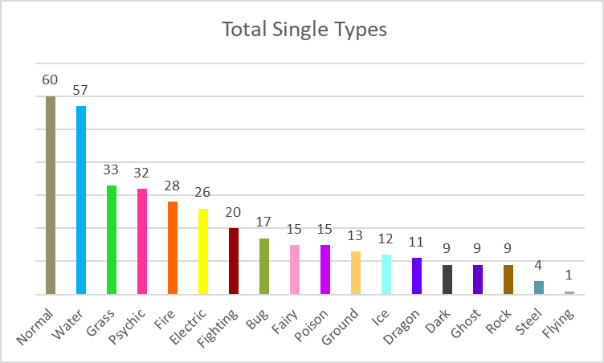
50% of all Pokémon have only 1 type

Slide 7
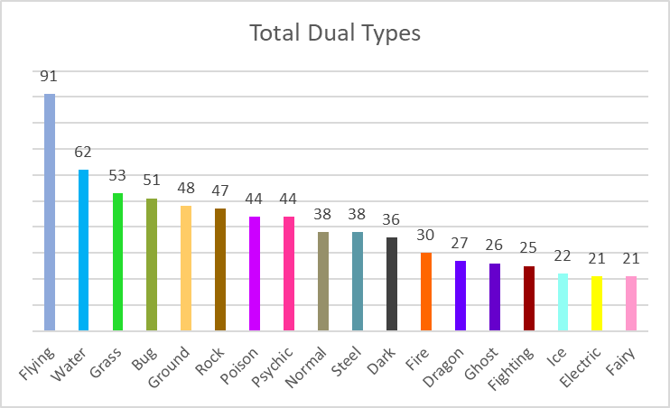
50% of all Pokémon have 2 types

Slide 8
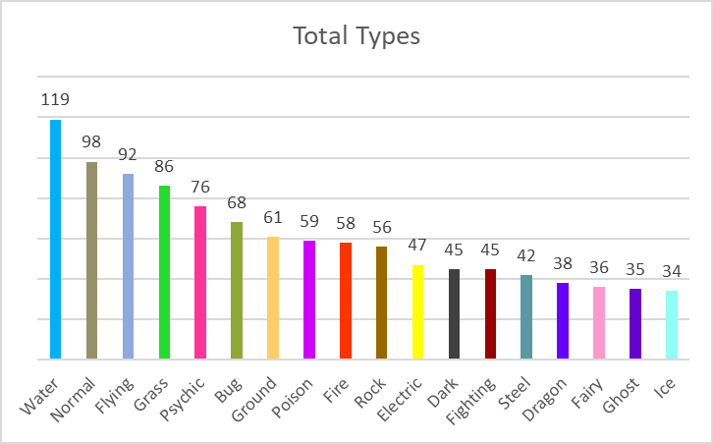

Slide 9
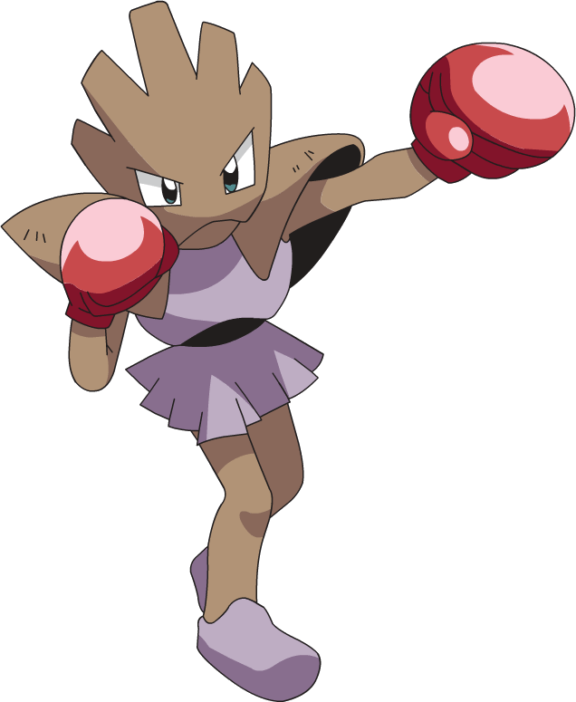

Does a Pokémon's Type affect their stats?
Attribute Base Range
HP 50 1-255
Attack 105 5-190
Defense 79 5-230
Special Attack 35 10-194
Special Defense 110 20-230
Speed 76 5-180
Total 455 180-780

Slide 10
HP
ATK
DEF
SP ATK
SP DEF
SPEED

Slide 11
HP
ATK
DEF
SP ATK
SP DEF
SPEED

Slide 12


Are new generations stronger or Weaker?

Slide 13
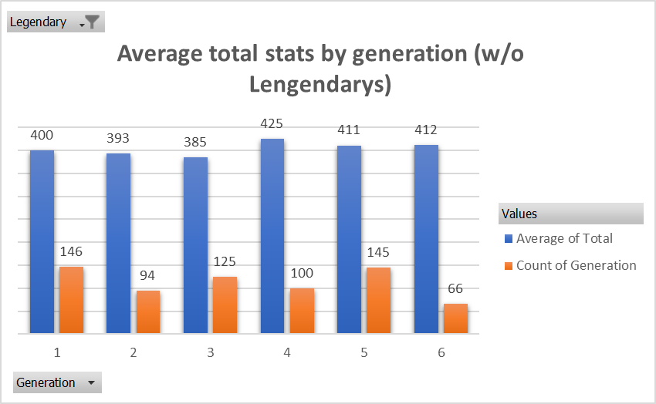

Slide 14
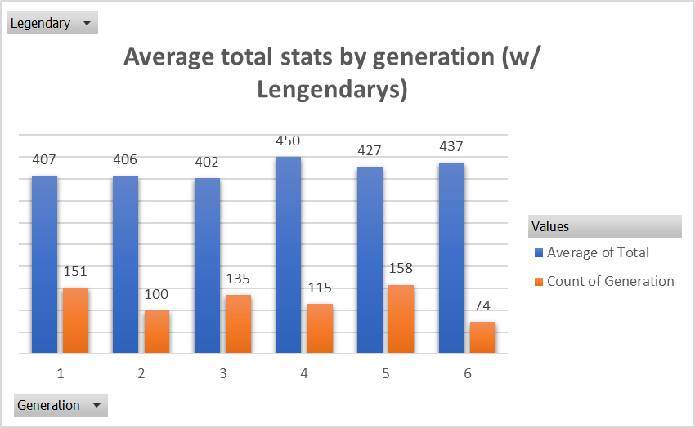
+7
+13
+17
+25
+16
+25
+5
+10
+13
+6
+15
+8

Slide 15

Questions?

