Slide 1
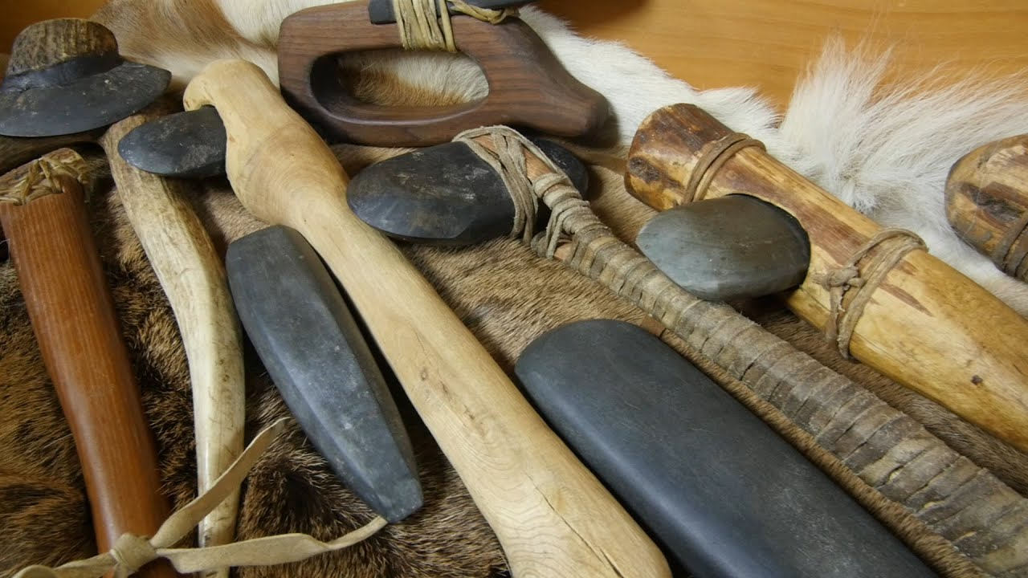
Stone Tool Data Set Project
BY
Nathan Maleski

Slide 2
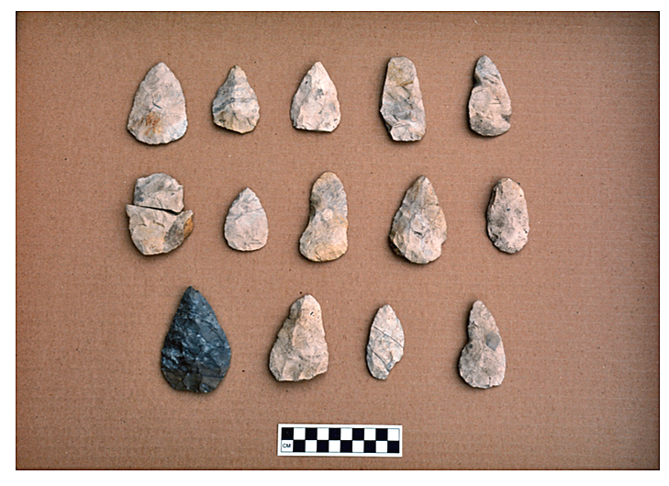
Overview
What are Lithics ?
What are the different Types?
What were they used for ?

Slide 3
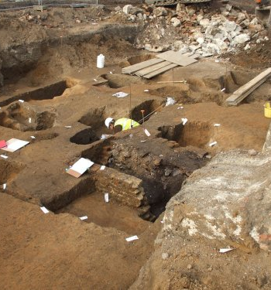
Introduction
Stone tools found at dig site
The damage they have
If they were burnt
The Type of Lithic they are
Excavation level
Anthropology Department of Edinboro University of Pennsylvania
Dr. Stacy Dunn

Slide 4
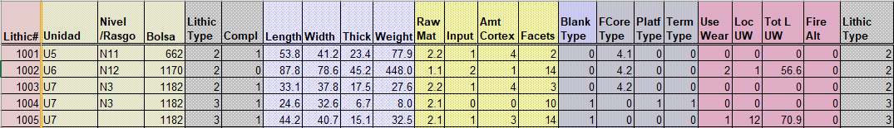
Data Problems/Cleaning
Two of the same
NA
Very little wrong
Deleted Extra Column
Changed Blanks in the Nivel/Rasgo catagori

Slide 5
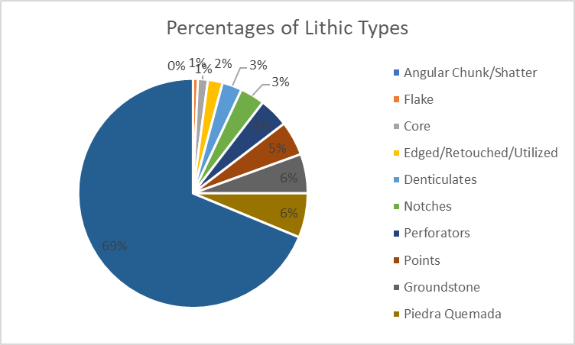
Discoveries
The Percentages of the Lithics
This gives a lot of data about the people

Slide 6
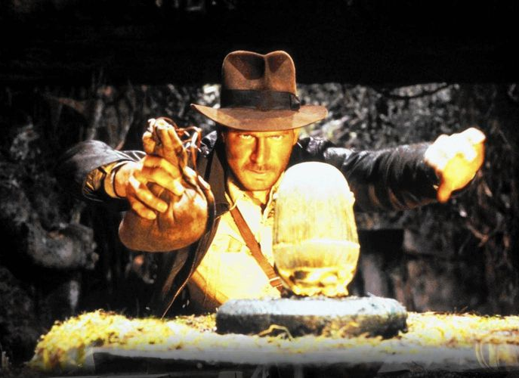
Conclusion
Great addition for anthropological data
Better Understanding

Slide 7
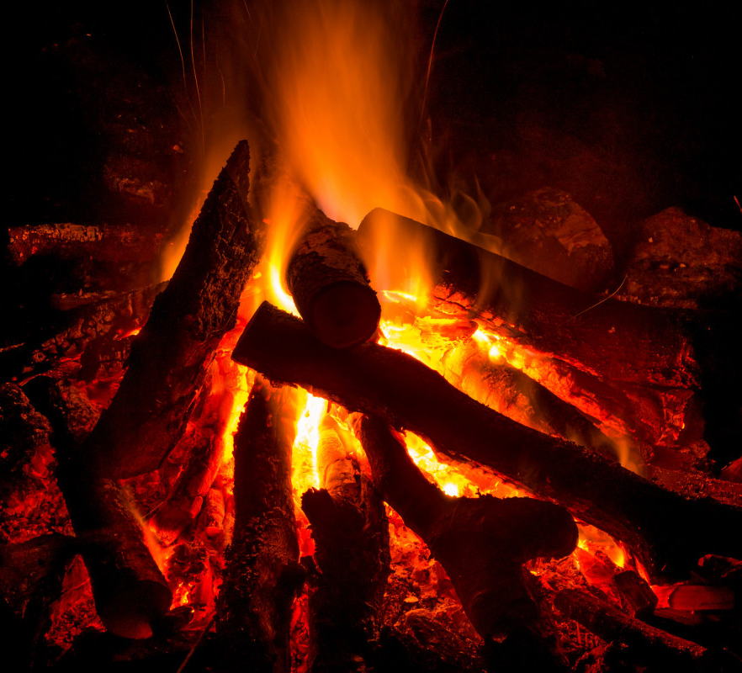
Future Work
Fire damage how it effected the tools

