Slide 1
homicide Reports 1980-2014
By:Brooke Lickenfelt

Slide 2
Project Overview
Analyze homicides committed by gun in Westmoreland, county from 1980-2014
See if there is a trend of gun murders by decade
The two data columns being analyzed are year and weapon (gun)
Have total gun homicides increased, decreased, remained constant, or fluctuated over the decades since 1980?

Slide 3
Data overview
638,455 reporting/rows of murder or manslaughter in united states.
24 columns of who, what, when, where, and if these homicides were solved.
Murder accountability project
Most complete database currently available in the u.s.
Includes murders from the FBI supplementary homicide reports
Kaggle.com
Good condition

Slide 4
Problems with data
City was entered into the column when it was actually counties, fixed it. Impacted by understanding the correct data
Simplified all weapons down to one weapon(gun) by using control F. impacted by specifically making it to guns
Age column were of age 0, inaccurate, turned into blanks. Did not impact analysis
Rhode island spelled incorrectly, changed spelling. Did not impact analysis
Data was incomplete, had to take educated guesses, impacted because I did this in decades, and there was no information from 2015-2019.

Slide 5
Data analysis discoveries
Decade Span | Decade Totals
1980 thru 1989 | 45
1990 thru 1999 | 46
2000 thru 2009 | 35
2010 thru 2014 | 34
Age Group Totals | 160

Slide 6
Data analysis
=COUNTIF(RANGE,"GUN")

Slide 7
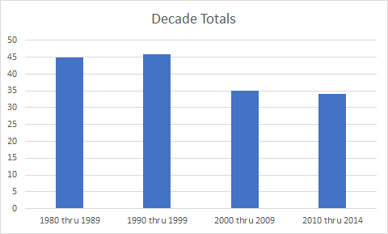
Data analysis

Slide 8
Conclusion
During the decades of 1980- 1989 and 1990-1999 murders by guns were about the same at an average of 45.
From 2000-2009 it dropped drastically by 25% with only 35 murders
2010-2014, it increased to 34, almost as much as a ten year period in 2000-2009, in only five years.
gun murders in Westmoreland County, Pennsylvania have increased to almost the same total in five years as they amounted to in the previous decade .
The trend in this decade is that murders are being committed by guns twice as often as the decade before

Slide 9
Future work
Broader geographical spectrum
Work with data set more when 2015-2019 comes out(will make my data more accurate.)
Homicide by relationship with victim
Top murderous counties
Departments with top homicides
Average age for Perpetrators
Average age for victims

