Slide 1

WoW Demographics
By: Jaret Lennon

Slide 2

Project Overview
Data was taken from 100 volunteers of mixed gender and sexuality
This data was used in order to determine if a person's gender and sexuality effects a persons in game characters gender

Slide 3
Data Overview
The data used consisted of 14 columns along with 100 rows
The data contained things such as the time taken, a persons in game character information, and their personal information such as their gender, and sexuality

Slide 4
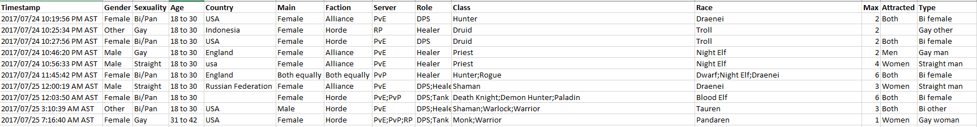

Slide 5
Problems with data
The only problem that could be found with the data that may have effected the results of my findings was the disproportionate number of different genders of those who participated in the data
The data shows that those who participated to be in the data were predominantly female which could influence results
58 of the 100 who participated were female, 28 male, and 14 other

Slide 6
Data analysis technique
To analyze the data the first thing done was to remove all unnecessary data
This includes the time stamp, and any unnecessary character information
Only use data that involves gender and sexuality
Next was to create a PivotTable to organize the data

Slide 7
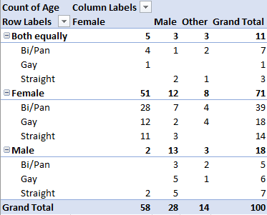
The data was separated by the persons real gender, their sexuality, and their in-game character gender

Slide 8
Findings
When analyzing the filtered data it shows that 71 of the 100 people who participated in the data played a female character in game, 18 played male characters, and 11 played both equally
51 of the 58 females played female characters only, even though there was a large difference in sexuality
For males it was split, 13 played male characters, 12 played female, and 3 played both evenly

Slide 9
Conclusions
From the data both a person's gender and sexuality can influence a persons in game gender
Women are more likely to choose a female character based on their own gender rather than their sexuality
Men are more likely to choose a female character if they are Bi/pansexual, but if are gay or straight are more likely to choose a male character

