Slide 1
Denver crime dataset
A study of crimes in Denver, Colorado
By Matthew Hogan
Dsci 101 mwf

Slide 2
Project overview
The amount of crime in Denver, Colorado, from 2014 until present
In this presentation:
Overview of the Denver crime dataset
Problems I had with the data
Analysis technique
Findings
Future work
Conclusion

Slide 3
Data overview
From Kaggle
Originally from https://www.denvergov.org/opendata/dataset/city-and-county-of-denver-crime
517,696 Records
9 fields
Over 46,000KB

Slide 4
Data fields
OFFENSE ID
OFFENSE CODE
OFFENSE TYPE ID
OFFENSE CATEGORY ID
REPORTED DATE
INCIDENT ADDRESSES
DISTRICT ID
NEIGHBORHOOD ID

Slide 5
Problems with the data
Many pointless fields
Unreadable/Massive Graphs
All known bad data and blank fields replaced with NA

Slide 6
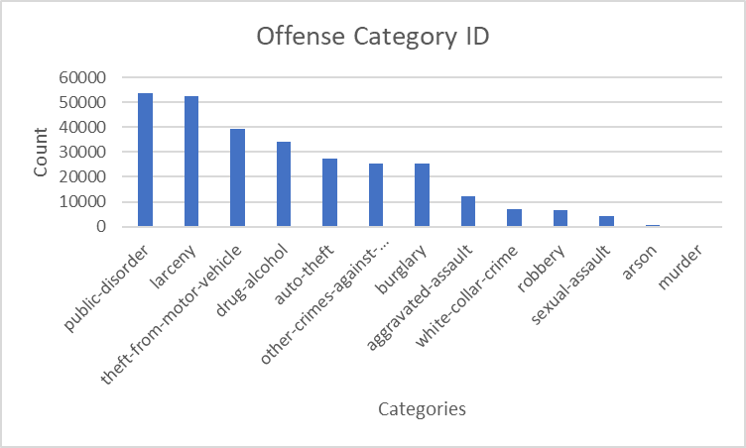
Analysis of offense category id
15 different categories of Crime
Filtering for the graph
I filtered out 2 category's due to them having a much higher count compared to the other 12
The categories included all-other-crimes, and traffic-accident

Slide 7
Amount of crime in each category
traffic-accident 134,587
all-other-crimes 93,586
public-disorder 53,855
larceny 52,547
theft-from-motor-vehicle 39,229
drug-alcohol 33,968
auto-theft 27,559
other-crimes-against-persons 25,512
burglary 25,497
aggravated-assault 12,331
white-collar-crime 7,055
robbery 6,716
sexual-assault 4,286
arson 651
murder 316

Slide 8
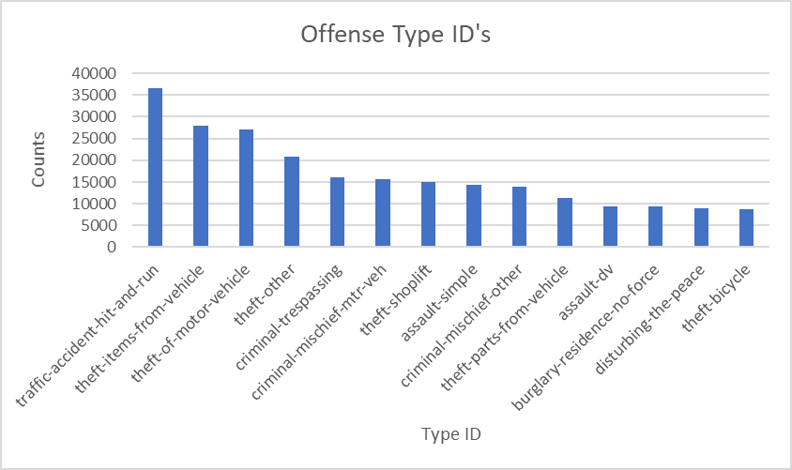
Analysis of offense type id
202 different types of crime
Crimes relating to Traffic/Vehicular incidents were the most popular in the dataset

Slide 9
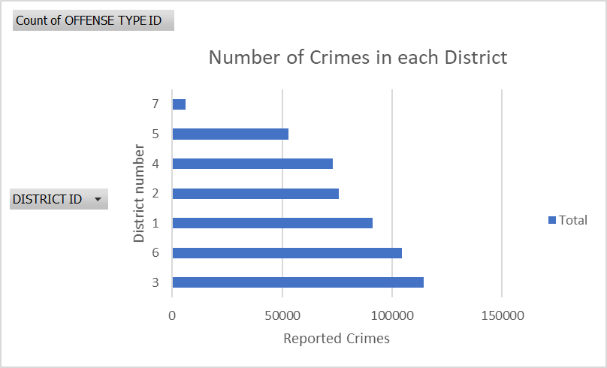
Most dangerous district in Denver

Slide 10
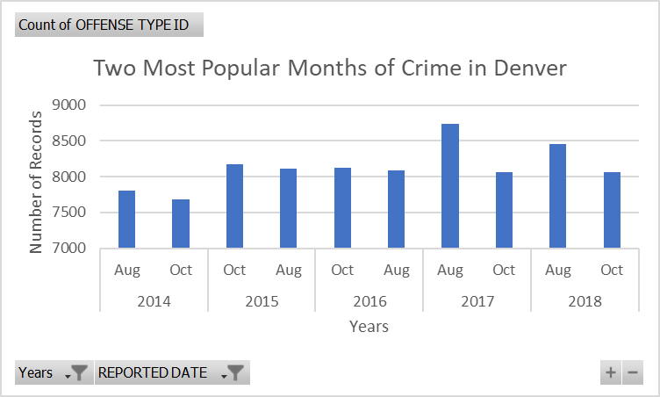
Don’t visit Denver in august
The month of August has the most records of crime in the dataset adding up to be 41,194
The Graph
Shows only the two months with the most crime in the dataset
October had a total of 40,098 records

Slide 11
Future work
INCIDENT ADDRESS field issues
When it came time to analyze the INCIDENT ADDRESS field my computer would crash/malfunction every time, in the future I would like to completely analyze this field
Discover more ways to utilize Pivot Tables
Gain more skill and knowledge of cleaning data
Create more graphs

Slide 12
Conclusions
Discovered that the month of August had the most crimes in the dataset
Found out District 3 had the most crimes
Calculated how many different types of crime there were
Determined the amount of crime in each offense category

