Slide 1
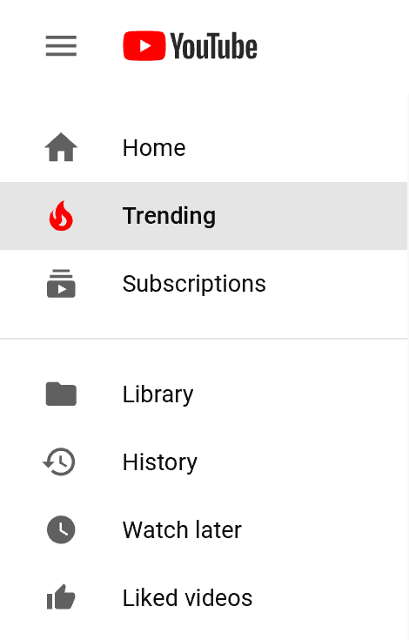
What makes a YouTube video trending?
Discovering the dataset
by Grace Dimmer

Slide 2
Project Overview
Why trending YouTube Videos?
What factors cause YouTube videos to become trending?
Can a user alter what they publish to make their video(s) more susceptible to becoming trending?
This presentation contains…
  Overview of the data
  Problems correlating with the data
  Analysis techniques
  Findings and conclusions from analyses
  Future Work

Slide 3
Data Overview
Fields used
  Title
  Channel Title
  Category ID
  Tags
  Views
  Likes
  Dislikes
  Comment Count
  Comments Disabled
  Ratings Disabled
  Video Error or Removed
Fields not used
  Video ID
  Trending Date
  Publish Time
  Thumbnail Link
  Description
Fields added
  Category Name
  Percentage
The dataset “Trending YouTube Video Statistics” was downloaded through Kaggle, primarily generated from YouTube’s Application Programming Interface (API)
Raw data in CSV format
  40,881 records
  16 fields and 2 added
  514 MB

Slide 4
Problems
Category ID given but specific categories unknown
Tags, thumbnail link, video ID, and description fields are mass text data and specifically unique to each video
Videos with ratings/comments enabled, yet no ratings/comments by users
Some problems could not be fixed
  Cannot be used in pivot table effectively
  YouTube changes their process in deciding which videos become trending and their criteria
  Missing fields of interest
    Subscriber count
    Active account
    Video length

Slide 5
Analysis
Used advanced filtering to find unique values for channel title and category ID
  Then used =countif() to count the amount of times each value occurred in the field
Mostly used advanced filtering to find specific entries
  When comment count =0 and comments disabled =FALSE
  When likes/dislikes =0 and ratings disabled =FALSE
  When Video Error or Removed =TRUE
  When tags =[none]
  Videos with most and least likes, dislikes, comments, views, etc.
Basic functions to find percentages, 5 number summaries and counts
Get data from web to insert corresponding categories to category ID
Added percentage field to show how much of the ratings for each video are likes
VLOOKUP to add category field to show the specific category for each video

Slide 6
Findings
Likes and Dislikes
  Only 5 videos with no likes when ratings were enabled, two of which had an error or were removed
  Most disliked video is also most viewed video (YouTube Rewind 2017) and in the entertainment category
  Most liked video in music category, posted by BTS. In fact, top 5 most liked videos were posted by the K-pop band
Comments
  63 videos with no comments and comments enabled – amounts to less than half a percent of all videos
  Only one video states TRUE for video error or removed – that and two others do not have likes
  Most commented video is also most liked video, posted by BTS
Category ID
  Most popular category is entertainment, making up 1/3 of the whole dataset
  The categories shows, non-profits & activism, and movies amount to 0%; not included in pie chart

Slide 7
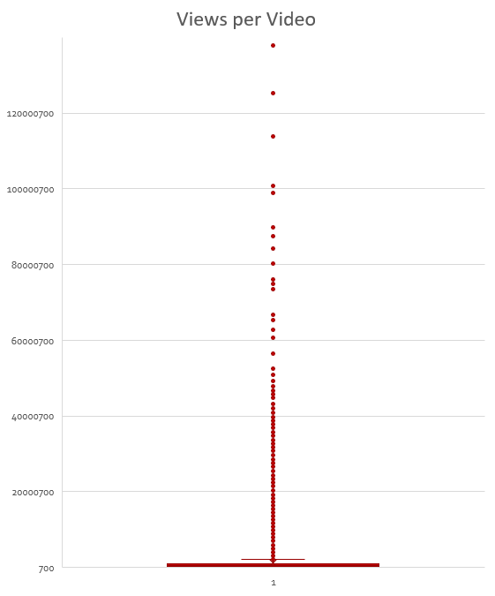
Views
  Most viewed video posted by YouTube spotlight, a channel managed by the platform itself, at 137,843,120 views
  Top 4 most viewed videos are the Rewind 2017 videos
  Least viewed video also in entertainment category and has 733 views
  With range of 137,842,387, data is very spread out
    Whether you get millions or hundreds of views, you have a chance

Slide 8
Video Error or Removed
  27 videos stated TRUE – less than a tenth of a percent of all videos
  Only two have no likes and no dislikes, another has some likes but no dislikes
Tags
  2,385 videos have no tags, making up 6% of the data
Channel Title
  No channel held a percentage out of all the videos
  Pretty evenly distributed

Slide 9
Conclusions and Future Work
If you post an entertaining video, it gets views in the high hundreds at least, and gets more likes than dislikes, you are likely increasing the chances of your video becoming trending.
  You’ll probably want some comments too
Something like having a lot of subscribers may also increase your chances, but that information was not provided
Investigate what YouTube should make the criteria for trending videos
Add more fields and information upon further investigation
  Subscriber count
  Video length
  If channels are still active

