Slide 1
Analysis of Movie Biopics
By: Nick DeRoss
DSCI 101

Slide 2

Overview
In my semester project I preformed data analysis on a worksheet about movie biopics produced in English speaking countries from 1900 – 2018 and to see…
Which Country has produced the most biopics?
Are most Biopics about any certain profession?
Which Actors/Actresses have appeared in the most biopics?

Slide 3
Introduction to the dataset
The dataset is from FiveThirtyEight’s GitHub depository, under the section “Biopics”, it was originally used in an article about the movie “Straight Outta Compton”
The original dataset consists of 761 records composed of 14 fields each. Each record contains
Movie’s Title
IMBD page URL
Country of Origin
Year of Release
U.S Box Office Grossing (if applicable)
Subject Type
Lead Actor / Actress
Race / Gender of Lead Actor/Actress

Slide 4


Data Cleaning
Decided to remove specific racial data
Specifically race_known and person_of_color
Replaced Blanks in race field with a “-” for easier manipulation
Removed IMBD link
Sorted by unique due to some titles being listed twice
Cleaned up headers

Slide 5
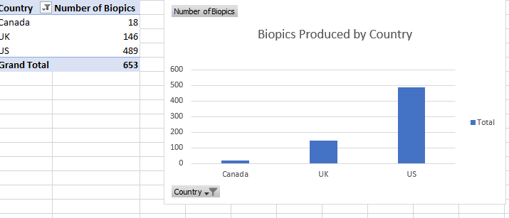


Country Of origin findings
The U.S has produced the most biopics out of all the English-speaking countries

Slide 6
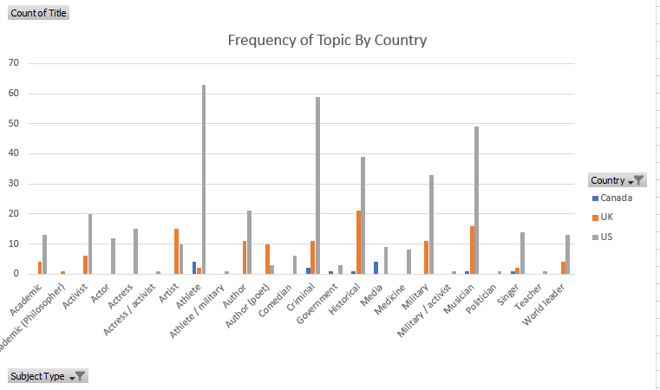
Topic By Country Analysis

Slide 7
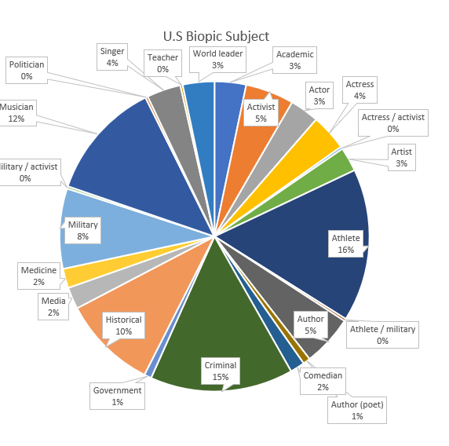

U.S TOPIC BREAKDOWN
Most produced biopic movies in the US
Athlete
Criminal
Musician

Slide 8
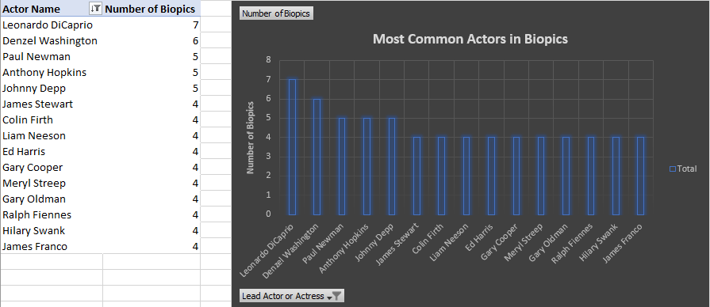
Lead Actor/Actress Findings
Leonardo DiCaprio has appeared in more biopics overall than any other actor.

Slide 9

How did I get there?
More Data cleaning necessary
Many actors have appeared in 1-2 biopics
Filtered data to include actors who have appeared in more than 3.
Decided to filter the top 5, to distinguish most interesting data
Replaced blank cells with “-”, filtered the value with a pivot table
Generated the histogram automatically using the data in the pivot table

Slide 10
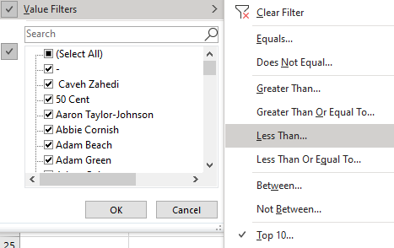
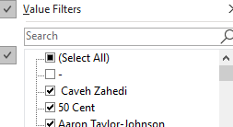




Slide 11
CONCLUSIONS
As stated before, Leonardo DiCaprio has appeared in the most biopics overall
Followed by Denzel Washington.
If an actor is in more than 2 biopics, the average number they will appear in is 4.
Actor Name | Number of Biopics
Leonardo DiCaprio | 7
Denzel Washington | 6
Paul Newman | 5
Anthony Hopkins | 5
Johnny Depp | 5
Colin Firth | 4
Liam Neeson | 4

Slide 12
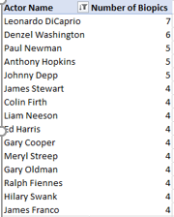
Full Table

Slide 13
Future Work
I would want to look at certain fields with respect to the Box Office earnings
Ex:
Which topic earned the most at the Box Office?
Box Office Earnings per country?

Slide 14

Notable Failures
Mostly nominal dataset
Box Office data format
Custom number formatting

Slide 15
Summary
Learned a lot about Excels more advanced functions
Learned how to go about analyzing a large dataset
Cleaning Data
Interesting to take in a dataset and generate my own conclusions about it, rather than see it in a secondary source

