Slide 1
Pittsburgh Incident Blotter Archive
Joseph Brown

Slide 2
Project Overview
Western Pennsylvania Data Center
  Managed by the University of Pittsburgh Center for Urban Research
Data is collected from the Pittsburgh Police Bureau and Department of Public safety

Slide 3
Project Overview
From wprdc.org
“The Police Blotter Archive contains crime incident data after it has been validated and processed to meet Uniform Crime Reporting (UCR) standards, published on a nightly basis. This data validation process creates a data publishing delay of approximately thirty days […] All data is reported at the block/intersection level, except for sex crimes, which are reported at the police zone level.”

Slide 4
Data Overview
3562 total records
15 total fields

Slide 5
Data Fields
Unique Incident ID
Incident Number
UCR Hierarchy
Incident Time
Incident Location
Cleared Flag
Incident Neighborhood
Incident Zone
Hierarchy Description
Offenses
Incident Tract
Council District
Public Works Division
X
Y

Slide 6
Problems With Data
Largest problem was blank information
  Addressed with the find and replace method from class
99 and 0 values
  Represented the same things but were not used consistently throughout the set.
  I decided to replace 0s in dataset with 99

Slide 7
Analysis (Technique)
Fields with most useful information
  Hierarchy (numerical)
  Incident Neighborhood (non-numerical)
  Hierarchy Description (non-numerical)
The best approach was to find unique field values of Incident Neighborhood and Hierarchy Description
  Once I had a frequency I created a five-number summary and graphed distributions

Slide 8
Analysis of Incident Neighborhood

Slide 9
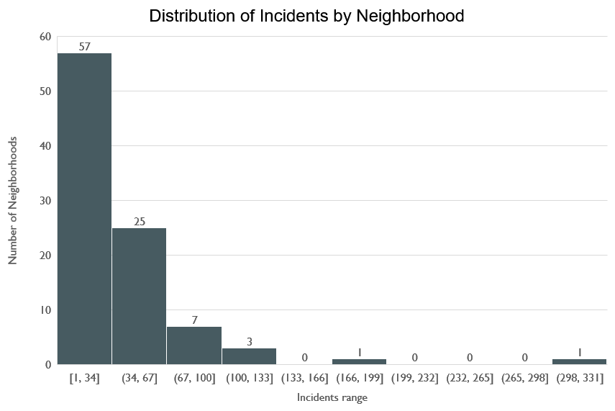

Slide 10
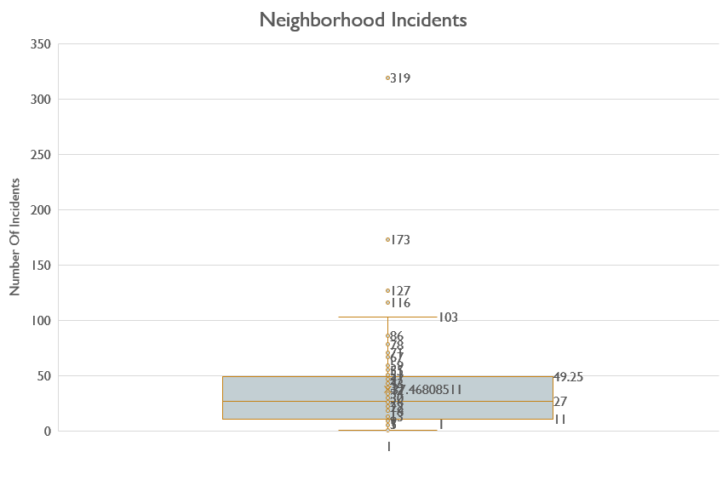

Slide 12
Analysis of Hierarchy Description

Slide 13
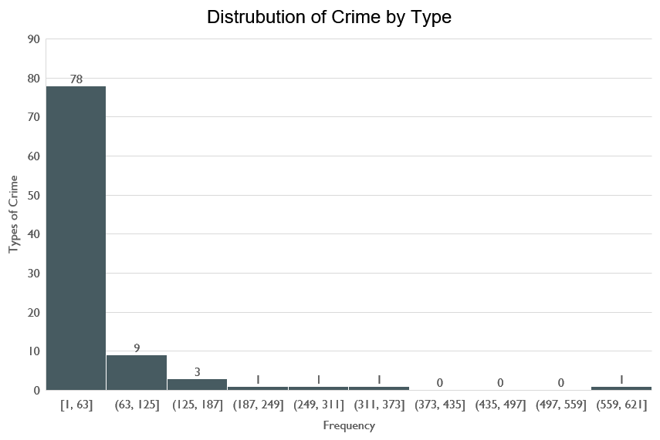

Slide 14
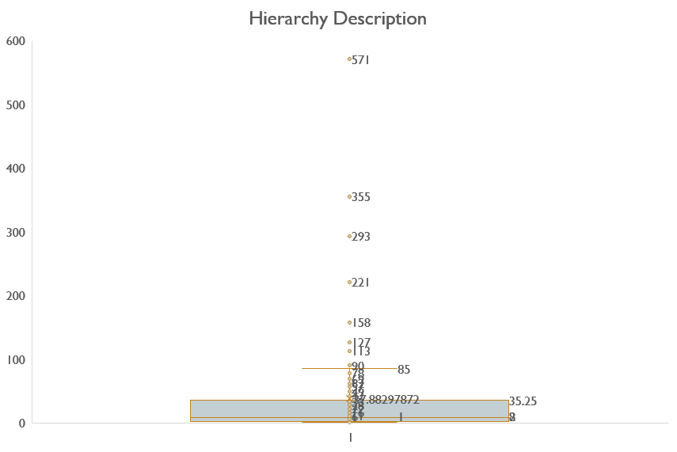

Slide 16
Conclusion
A deeper dataset could potentially dig more into the outlier neighborhoods with the help of population numbers or poverty level data.
You could interpret the Hierarchy data as Pittsburgh being a safe city when it comes to violence. Violent crimes were very low in this dataset.
Looking at the outliers of the data we see a lot of theft. We don’t have city averages of theft from other cities. So obtaining cities of comparable population data could be a logical next step in interpreting this data.

Slide 17
Questions?

