Slide 1
Analysis of Education, Trump and Ghosts
Jessica Barwell

Slide 2
The question
Level of education and political affiliation
Race and political affiliation
Perception of Donald Trump, race and level of education
And a few other things…

Slide 3
Overview of the data
Cards Against Humanity
September of 2017
Surveyed by telephone
Problems?
Can deceive researcher
Interpretation of questions
Validity?

Slide 4
Summary of the data
Total of 1000 records
20 columns
All participant data was included – blanks replaced with “NA”
Total download size was 487KB
However, the download included 2 additional surveys (only used 1)

Slide 5
Overview of the fields
Political affiliation
Income
Race
Level of education
Acceptability of peeing in the shower
Approval of Donald Trump
Climate change

Slide 6
Potential problems
Blank columns – condensed or deleted
Unknown data – deleted
Master’s vs. masters: replaced w/ “Masters”

Slide 7
Overview of income
Min: $5,000
Max: $500,000
Average: $89,590
Q1: $41,750
Q2: $74,500
Q3: $120,250

Slide 8
Counts - ages
90-99 : 7 participants (smallest)
45-54 : 211 participants (largest)

Slide 9
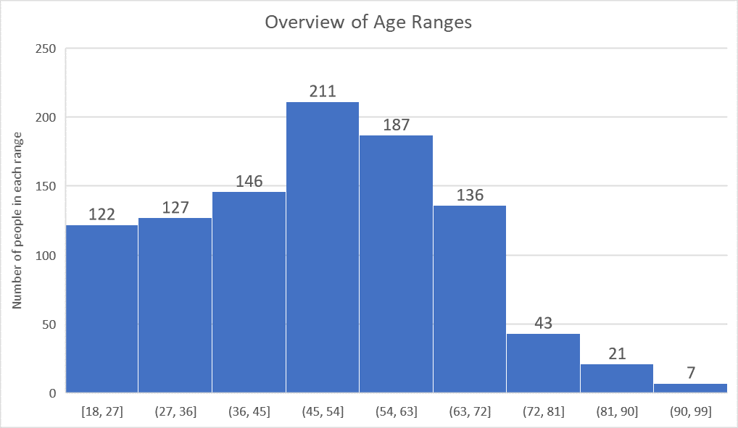

Slide 10
Counts - gender
Males: 483
Females: 487
“Other” : 28
NA: 2

Slide 11
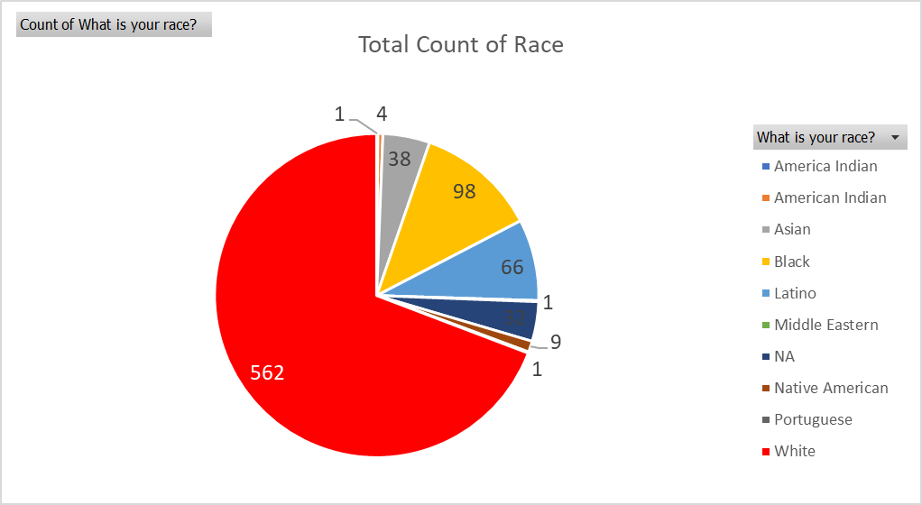

Slide 12
Race and level of education
Count of What is your race?
 | Associates | College degree | Doctorate | Graduate degree | Masters | Post graduate | Grand Total
Black | 1 | 31 |  | 18 | 1 |  | 51
Latino | 1 | 18 |  | 17 |  |  | 36
Native American |  | 4 |  | 1 |  |  | 5
White | 1 | 232 | 1 | 129 | 1 | 2 | 366
Grand Total | 3 | 285 | 1 | 165 | 2 | 2 | 458

Slide 13
Race and approval of Trump
Count of What is your race?
 | Neither approve nor disapprove | Somewhat Approve | Somewhat disapprove | Strongly Approve | Strongly disapprove | Grand Total
Black | 6 | 9 | 17 | 9 | 65 | 106
Hispanic |  |  |  |  | 1 | 1
Latino | 5 | 9 | 10 | 7 | 39 | 70
White | 33 | 102 | 51 | 190 | 246 | 622
Grand Total | 44 | 120 | 78 | 206 | 351 | 799

Slide 14
Political affiliation and climate change
Count of Political_Affiliation
 | Not Real At All | Real and Caused by People | Real but not Caused by People | Grand Total
Democrat | 15 | 221 | 28 | 264
Independent | 49 | 234 | 69 | 352
Republican | 61 | 71 | 61 | 193
Grand Total | 125 | 526 | 158 | 809

Slide 15
Political affiliation and believing in ghosts
Count of Political_Affiliation
 | No | Yes | Grand Total
Democrat | 162 | 108 | 270
Independent | 216 | 141 | 357
NA | 94 | 50 | 144
Republican | 129 | 75 | 204
Grand Total | 601 | 374 | 975

Slide 16
Political affiliation and peeing in the shower
Count of Political_Affiliation
 | Acceptable | NA | Unacceptable | Grand Total
Democrat | 93 | 23 | 158 | 274
Independent | 154 | 29 | 185 | 368
Republican | 83 | 23 | 102 | 208
Grand Total | 330 | 75 | 445 | 850

Slide 17
Race and peeing in the shower
Count of What is your race?
 | Acceptable | NA | Unacceptable | Grand Total
Black | 37 | 10 | 71 | 118
Hispanic |  |  | 1 | 1
Latino | 38 | 5 | 40 | 83
White | 264 | 69 | 350 | 683
Grand Total | 339 | 84 | 462 | 885

Slide 18
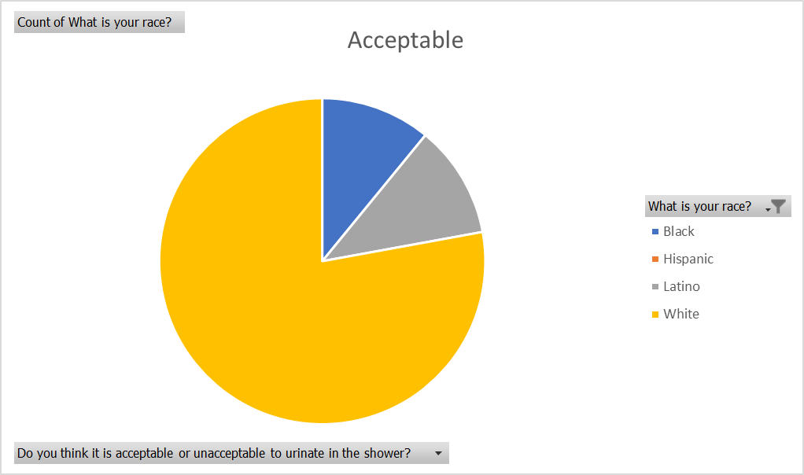

Slide 19
Future work
Correlational analyses on mentioned relationships
Are they significant?

