Slide 1
A Few Presentation Guidelines
DSCI 101
Fall 2019

Slide 2
Upcoming Due Dates
Homework 9: tomorrow
Homework 10: Dec 3
  But you should do this before you build your presentation
Methods Document and Workbook: Nov 24
Final Presentation: Dec 1

Slide 3
Other Important Items
Request a time slot for your presentation
  See the notes page: Presentations under Week 15
  Send an email requesting your top three or so spaces.
  Make sure that these are for your class
  First come first served.
Double check when I respond to make sure I got it right.

Slide 4
Other Important Items
Review the rubric on the assignment pages
For the report also review
  Week 8: The Next Phase of the Project
  Week 9: Summary of expectations for numeric fields.
  Week 10: Summary of expectations for text fields.
Remember, I expect a summary of all fields used in the project.

Slide 5
Presentations
If you modify your presentation after Dec 1 submission
  Please email me a corrected copy by the morning of your presentation (8:00 am)
I will link the presentations into the web page to make transition between speakers faster.
You need to attend all presentation sessions
  You will lose 10% by skipping a session.
  In addition, that would be very rude to your classmates.

Slide 6
Presentations
You have ten minutes
  For your presentation and questions.
  You should fill at least ½ of that time.
  You should allow some time for questions.
Look at the presentation page for guidelines.

Slide 7
Presentation: Overview
What is the basic subject?
What is your question?
Did you answer your question?
What is the answer?
Remember, most of the audience has no knowledge of your data.
Talk about any unique terms associated with your data.

Slide 8
Presentation: Data Overview
Where did the data come from?
What is the basic subject?
Describe size (rows and columns)
Give a basic overview of the fields you used.
  Just a general overview so the audience understands what you are working with.
  You will cover import fields in more depth later.
Remember, most of the audience has no idea what your dataset contains.

Slide 9
Presentation: Problems with Data
Describe any problems with your data.
  Describe what you did to solve these problems and why.
If there are no problems, simply state that.
You can discuss specific problems with the data field discussion (next).

Slide 10
Presentation: Description of Basic Fields
Describe several important fields.
  Give counts
  And the five number summary
  Or list of unique values and counts.
  Include a chart describing the data.
  Discuss any problems with the data.

Slide 11
Presentation: Data Analysis Techniques
Discuss additional techniques you used to analyze your data.
  For most of you I would expect a pivot table.
  For some, you may have used a more advanced technique, Discuss it.
Don’t stress out over this, just tell us what you did.
If you did something clever or novel, we want to hear about it.

Slide 12
Presentation: Findings
What did you discover?
Give us a chart, table, or something
Is this important?
  Did it confirm a hunch?
  Is it new information?
  Did it refute “common knowledge”?
  Was it a surprise?

Slide 13
Presentation: Future Work
What would you look at if you had more time?
  What other investigations on your data might you perform?
  What other data might you want to collect to further your investigation?
  What would you do differently if you had the chance?

Slide 14
Presentation: Required Components
At least one chart
  Readable
  Well labeled
A single transformation applied to all slides
At least one set of animations beyond just text appearing.

Slide 15
Animation
Not just text appearing
Have a chart appear with some text
Then have a shape point out some important factor.
Nearly 50% BAD, 100% Bald!

Slide 16
Presentation Guidelines
These are based on an article by Matthew A Christian
“Death by PowerPoint or Twelve Steps to Better E-Presentations”
Self published in 2002

Slide 17
Know your audience
We all should understand counts, five number summaries and pivot tables.
We don’t know the data
  If your data involves specialized knowledge, please share!
We don’t know statistics
  If you decided to use a test to verify your findings, please let us know.
We are probably curious about data sizes
  Fill us in on those details.

Slide 18

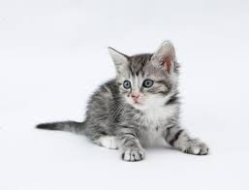
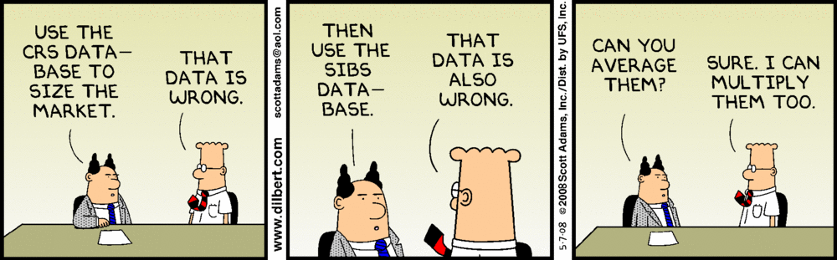
Content is King
Focus on your message
  Kittens are nice!
  Cartoons are funny!
  Balloons are great!
But make sure they contribute to the message.

Slide 19
Purchase a color wheel, and use it.
This is just wrong.
And so is this.
You should probably avoid red!
And orange is not the best.
Contrast is everything.

Slide 20
KISS: Keep it Simple Stupid!
Christian says three built points.
  I feel a few more is acceptable.
  But probably not more than 8
Simple statements
  Not paragraphs
Keep the animations simple and discrete.
And just one transistion.

Slide 21
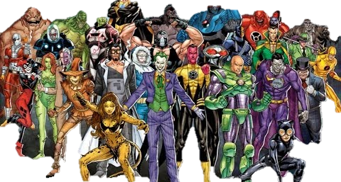

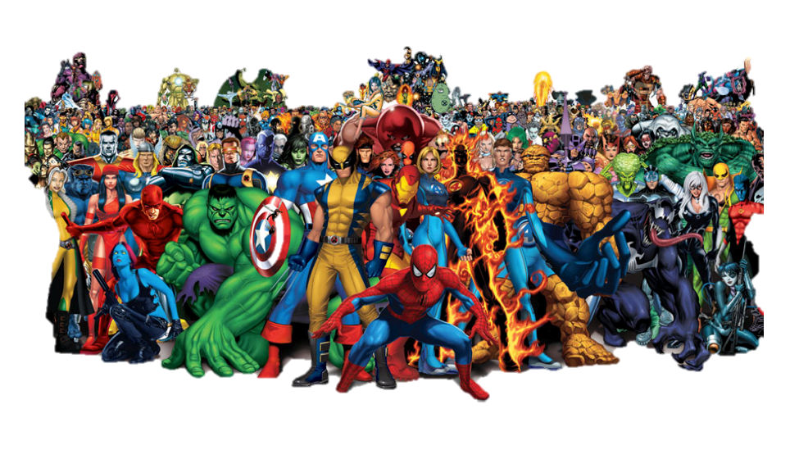
KISS: Not This
Context
  Super Heroes have been in popular culture for a long time and now more than ever. Since its creation, super heroes have not been very diverse, but that is changing rapidly. This dataset aims to provide an overview about heroes and their physical as well as power characteristics, helping researchers and curious minds identify trends and patterns.
Content
  This data was collected in June/2017 from superherodb and not updated since, so it may not be up to date. There are two datasets here. The first one lists the characteristics of every super hero found on my source, the second contains information about every superpower and lists if they are present in any given hero.
Acknowledgements
  This data was scraped from SuperHeroDb.

Slide 22
KISS: Not This!
Animations are nice
But don’t use the slow ones.
Or the Strange Ones
Don’t let the animations distract from the message

Slide 23
Fonts are like Donuts
No more than two or three at a time.
Stay away from the “fun” ones that are hard to read.
  They don’t help with the message.
  And they might just render incorrectly!

Slide 24
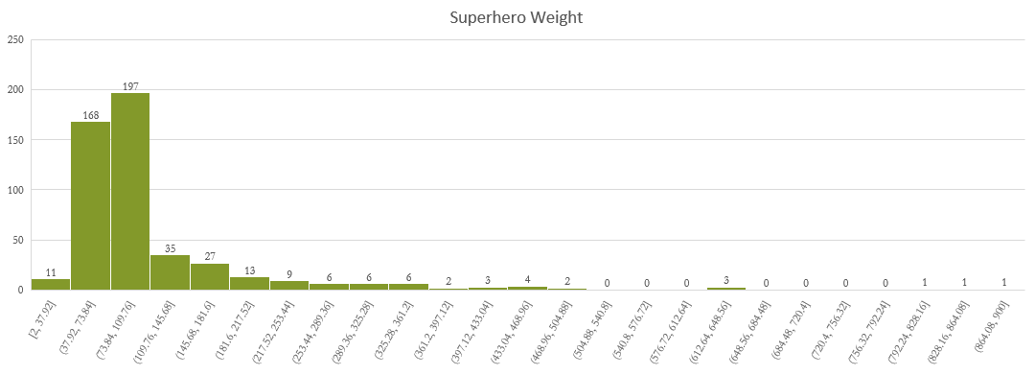
Careful With Charts

Slide 25
Careful with Charts.

Slide 26
And with Tables
 | bad |  |  | bad Total | good |  |  | good Total | NA |  | NA Total | neutral |  |  | neutral Total | Grand Total
Hair Color | Female | Male | NA |  | Female | Male | NA |  | Male | NA |  | Female | Male | NA
amber |  | 1 |  | 1 | 1 |  |  | 1 |  |  |  |  |  |  |  | 2
black | 1 | 7 |  | 8 | 4 | 6 | 1 | 11 |  |  |  |  | 4 |  | 4 | 23
blue | 13 | 35 | 1 | 49 | 63 | 101 | 3 | 167 | 2 | 1 | 3 |  | 5 | 1 | 6 | 225
blue / white |  |  |  |  |  | 1 |  | 1 |  |  |  |  |  |  |  | 1
bown |  |  |  |  |  | 1 |  | 1 |  |  |  |  |  |  |  | 1
brown | 5 | 30 |  | 35 | 10 | 72 | 4 | 86 |  |  |  |  | 5 |  | 5 | 126
gold |  | 1 |  | 1 |  | 2 |  | 2 |  |  |  |  |  |  |  | 3
green | 8 | 13 |  | 21 | 34 | 17 |  | 51 |  |  |  | 1 |  |  | 1 | 73
green / blue |  |  |  |  |  | 1 |  | 1 |  |  |  |  |  |  |  | 1
grey |  | 2 |  | 2 |  | 4 |  | 4 |  |  |  |  |  |  |  | 6
hazel |  |  |  |  | 3 | 3 |  | 6 |  |  |  |  |  |  |  | 6
indigo |  |  |  |  |  |  |  |  |  |  |  | 1 |  |  | 1 | 1
NA | 5 | 39 | 4 | 48 | 35 | 78 | 5 | 118 | 3 |  | 3 | 1 | 1 | 1 | 3 | 172
purple |  | 2 |  | 2 | 2 |  |  | 2 |  |  |  |  |  |  |  | 4
red | 1 | 21 | 1 | 23 | 2 | 13 | 4 | 19 | 1 |  | 1 | 1 | 2 |  | 3 | 46
silver |  |  |  |  |  | 1 |  | 1 |  |  |  |  |  |  |  | 1
violet | 1 |  |  | 1 | 1 |  |  | 1 |  |  |  |  |  |  |  | 2
white |  | 5 |  | 5 | 3 | 8 | 1 | 12 |  |  |  |  |  |  |  | 17
white / red |  | 1 |  | 1 |  |  |  |  |  |  |  |  |  |  |  | 1
yellow |  | 7 | 1 | 8 | 2 | 8 |  | 10 |  |  |  |  | 1 |  | 1 | 19
yellow (without irises) | 1 |  |  | 1 |  |  | 1 | 1 |  |  |  |  |  |  |  | 2
yellow / blue |  |  |  |  | 1 |  |  | 1 |  |  |  |  |  |  |  | 1
yellow / red |  | 1 |  | 1 |  |  |  |  |  |  |  |  |  |  |  | 1
Grand Total | 35 | 165 | 7 | 207 | 161 | 316 | 19 | 496 | 6 | 1 | 7 | 4 | 18 | 2 | 24 | 734

Slide 27
A Suggestion
The room is open.
Come in and try your Charts/Tables on the screen BEFORE you present.
Turn the projector on
Bring your slide up.
Take a look, can you read it?

Slide 28
Questions?
Thanks.

