Slide 1
Top Rated English Movies of This Decade
Hakeem Walters
DSCI101

Slide 2
Categories
X
Title
Rating
Total Votes
Genre

Slide 3
Ratings of Movies
Which genre out of the many that there are, draws in the most attention?
Top Picks:
Drama
Adventure
Action
Comedy
Biography

Slide 4
Data Source
List of the Top Movies- Sai Pranava on Kaggle
Provided by IMDB
CSV
36KB

Slide 5
Dataset
Original Amount of fields: 54
End Amount: 6
X: Number Field
Title: Rating:
Total Votes:
Genre 1 & 2:

Slide 6
Dataset Cont.
End Result:
Drama:63
Adventure: 39
Action: 33
Comedy: 22
Biography: 21

Slide 7
Genres
Action: 33
Adventure: 39
Drama:63
Western:2
Biography:21
Comedy:22
History:1
Romance:5
Fantasy:3

Slide 8
Cont.
Mystery:3
Sci-fi: 2
Animation:13
Thriller:4
Sport:1
War:1
Family:1

Slide 9
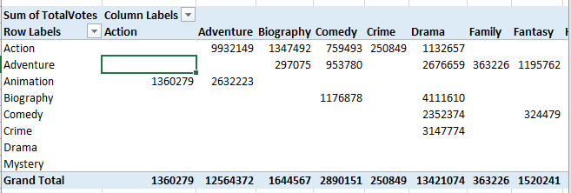

Slide 10
Meta-Slide
X: Where the movie was positioned in its original list setting which was alphabetically
Title: Name and year of release for the movie
Rating: Initial rating given by the site where the creator of the dataset got it from which was IMDB
Total Votes: How many people voted for this movie
Genre 1&2: Categories of which the movie falls under

Slide 11
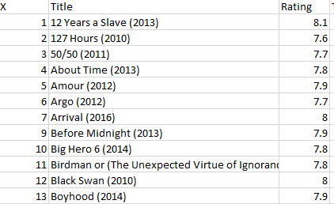
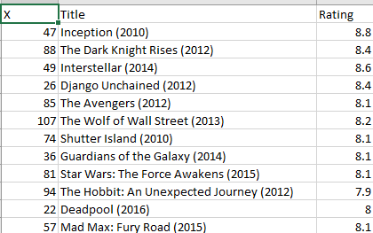
Field Alterations
For the X field I changed it up so that the dataset wasn’t sorted alphabetically anymore, and was instead sorted based on the rating field

Slide 12
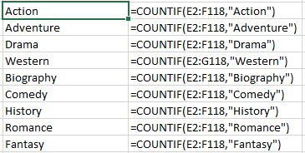
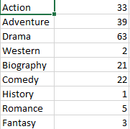
Field Alterations: Genre
For the genres I composed a list of the genres shown in the 2 fields and used countif to show how many of each of them were in the two fields.

Slide 13
Meta-Slide
With all the data I collected I was able to discern that out of all the presented movies on this list and the data remaining that Drama was the one most shown, most likely due to the fact that drama is one thing that is shown more often than not in most movies in general.
I found this by surfing through all available data multiple times even going over deleted data to come to a complete conclusion and by using countif as previously demonstrated

Slide 14
Problems
There were numerous problems with this data:
Most of the fields didn’t make any sense or have a clear reason for being there
Missing data
Inaccuracy
Nonsensical analysis
In short this dataset had way too many holes and in three cases the data didn’t match what was in the field at all

Slide 15
Discoveries
Unlike previously thought, drama has more of a pull than action or adventure does, since even they get more hype they’re still outshined by drama

Slide 16
Future Work
Make sure to find all the data and branch out to include the previous decade as well
Disclose any of the ones that have holes entirely

Slide 17
QUESTIONS?

