Slide 1
Which country Produces the best overall hitter in Major League Baseball on average?
Analysis by Lance Wagner

Slide 2
Is it not just the united states of America?
Initial thought would be the United States of America (USA)
America’s Pastime
Sheer Volume of Players
What About on Average?
Notable Competitors
Japan
Canada
Dominican Republic

Slide 3
Overview of the Data
The History of Baseball
A complete history of Major League Baseball statistics from 1871 to 2015
Kaggle
Sean Lahman
26 CSV files of varying size
Notes:
https://www.kaggle.com/seanlahman/the-history-of-baseball
Sean Lahman – Sports research, Database journalism, data-mining

Slide 4
What I needed for my Analysis
Batting Statistics
8.9 MB
101,333 Records and 22 Fields
Player Information
2.7 MB
18,847 Records and 24 Fields
Notes:
Sample Record in each data set

Slide 5
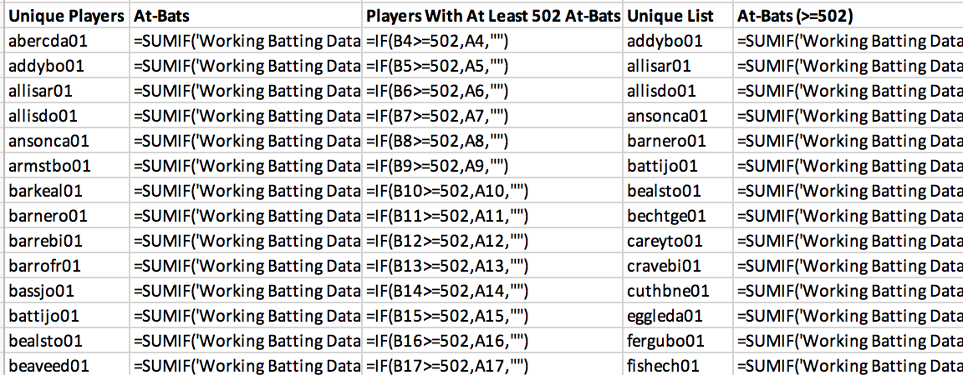
Cleaning the Data
Combine CSV files into single spreadsheet
Unknown country of birth
Not Available
Large number of players
18,659 Unique Players
Trim by number of at-bats (≧502)
5,093

Slide 6
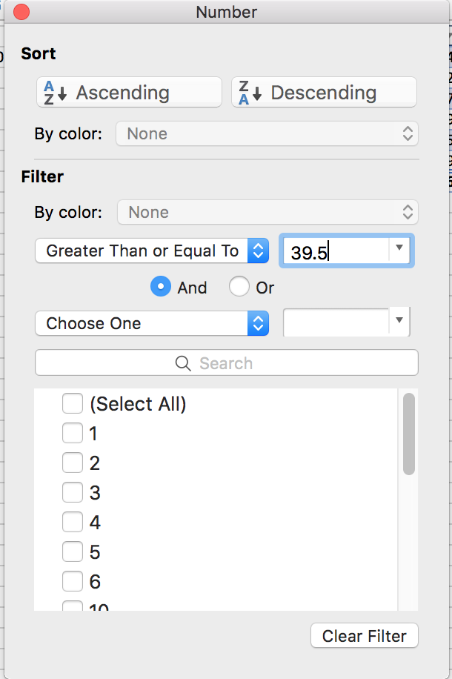
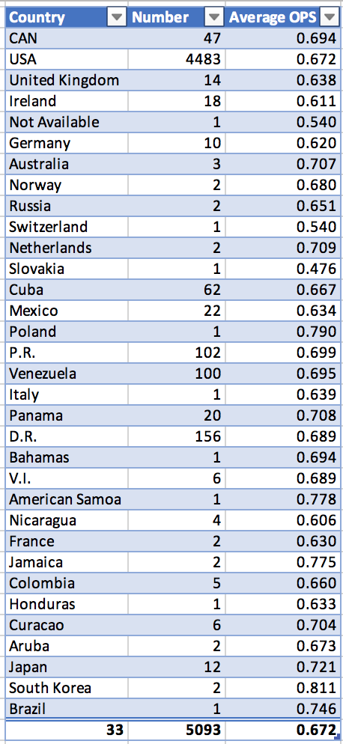
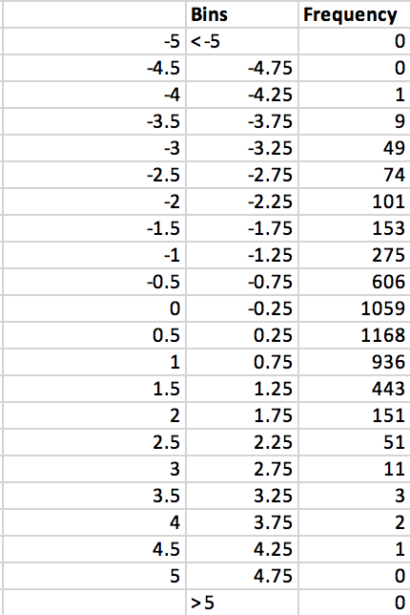
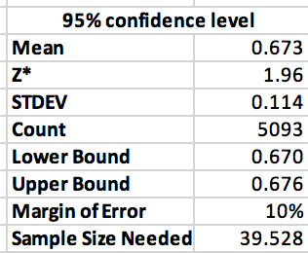
Analyzing the Data
On-Base Plus Slugging Percentage
On-Base Percentage
Slugging Percentage
Normal Distribution
Notes:
z-score is the number of standard deviations from the mean a data point is
Critical value of Z

Slide 7
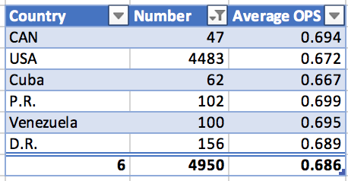
Findings
USA – 4,483 Players
Puerto Rico with the highest average OPS
World Baseball Classic

Slide 8
Future Work
More comprehensive statistics to use
WAR
OPS+
Break down by state
USA 4,483 players out of 5,093
Explore other CSV files in dataset
Best fielder on average

Slide 9
Questions?

