Slide 1
IMDB Dataset
Alex umble

Slide 2
Overview
Revenues
  Greatest
  Least
Blank Cells
Correlations

Slide 3
Overview
Most revenue?
  Star Wars: Episode VII- The Force Awakens
  Jurassic World
  The Avengers
  The Dark Knight
  Rogue One
  Least revenue?
  Into the Forest
  Love, Rosie
  Lovesong
  Wakefield
  Dead Awake

Slide 4
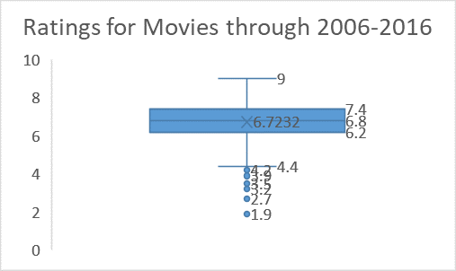
Data Overview
Blank Cells
The Ratings
Runtimes?
  191
  66
  Many lower

Slide 5
Problems?
Many problems
  Ranking?
  Too low of numbers
    Revenue
    Runtime
  Blanks

Slide 6
Technique
First- How I wanted to sort them
Find Relations?
Revenue to rating
  Correlation?
Revenue to Metascore
  Correlation?
Revenue to Runtime
  Correlation?

Slide 7
Findings
Rankings?
Averages
  Ratings
  Votes
  Revenue
  Metascore

Slide 8
Future Work
Personal Financial Planning Major
Documents for clients
  Where money is going
  How retirement plan works
Spreadsheets
  Stocks
  Retirement plans
  Ect.

Slide 9
Questions?

