Slide 1
Rolling Stone’s Top 500 Greatest Albums of All Time
By: Monica Tocimak

Slide 2
PROJECT OVERVIEW
Question: According to the Rolling Stone’s Top 500 Albums of All Time, who is the “best artist” ?
Who has the most albums?
What genres are included?

Slide 3
Introduction to Dataset
Found on Kaggle
6 columns, 501 rows
Made in 2012

Slide 4
Problems with data
Not easy to edit
Graphs and tables
Cleaning data

Slide 5

Discoveries
What years were involved
What genres were involved

Slide 6
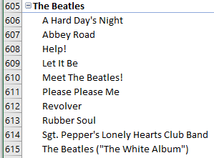
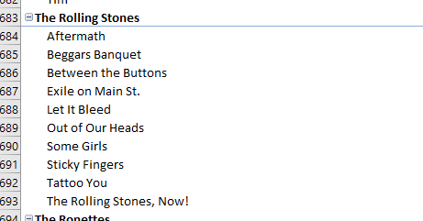
discoveries
Answer to the question
PivotTable
The Beetles and The Rolling Stones

Slide 7
Conclusions
The Beetles and The Rolling Stones
Years included in the list
Genres included in the list

Slide 8
Future work
Updating the list
Tables and charts

