Slide 1
Zoo Animals
Loren Tate
DSCI 101
Fall 2018

Slide 2
Zoo Animal Dataset
My project is on the different animals in the world, mainly zoo animals.
This dataset explains the different characteristics of animals and what they can or cannot do.

Slide 3
The Dataset
Zoo Animal differences.
This dataset was obtained from kaggle.com.
Information on 101 different animals.
17 different fields.

Slide 4
My Data
17 different fields
I explored the correlation between these two fields.
Legs
The amount of legs an animal has.
Flight
Whether or not the animals can fly.

Slide 5
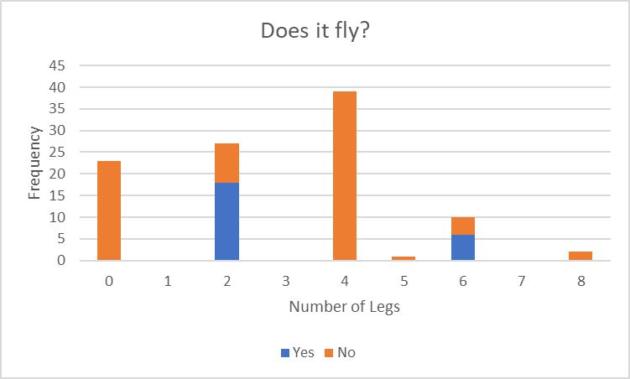
My Methods
I used the Vlookup function to change the numbers 1 and 0 to yes and no.
After doing so I used the frequency function of both the leg and fly fields to form a table.

Slide 6
Cleaning the Data
I used the =vlookup function for all of my data to change the 1 to yes and 0 for no.
When I wasn’t using one of the fields I would “hide” it.

Slide 7
Discoveries
Most animals that can fly will have either 2 legs or 6 legs.
The animals with 6 legs were classified as insects.
The animals with 2 legs were classified as birds.
If it had any different amount of legs it could not fly.

Slide 8
Problems with the Dataset
There were several spelling errors.
None of the titles were capitalized or bold.
There wasn’t much data to work with.
There wasn’t much that I could do to the data.

Slide 9
Conclusions
Most animals that can fly have either 2 legs or 6 legs.
Animals that didn’t have 2 or 6 legs could not fly.

Slide 10
Questions and Comments
Thank you for your time!

