Slide 1
Suicide In The United States And Germany
Caroline Strayer
DSCI 101
Tuesday/Thursday

Slide 2
What Demographic Is Most At Risk?
Looking at Data from the World Health Organization from 1990 to 2015, what group of people is most at risk?
Factors
Age
Gender
Country

Slide 3
Data
Where was everything found?
Suicide Data from Kaggle
Originally found in the World Health Organization Mortality Database
Contained Data from 141 countries
CSV File

Slide 4
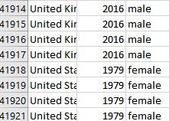
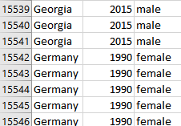
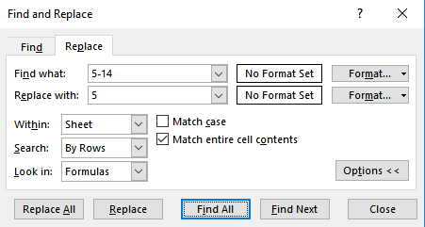
Cleaning
Determine what countries to analyze
Fix timing issues
Data time ranges between The United States and Germany (Indicated by orange arrows)
Change the Age field
Changed Age field from containing age ranges to singular age values that implied the range (Blue arrow)
Changed by using the Find and Replace feature of Excel

Slide 5
What Did the Dataset look like?
Six Fields
Country: Text Field
The Country on Earth where data is found
Year: Integer
Year in which data took place
Sex: Text Field
Female or Male
Suicide Number: Integer
The number of suicides committed in relation to the Year, Sex, and Age fields
Population: Integer
number of total living people.
Age: Integer Range
there are 6 age ranges
Ages 5-14 years
Ages 15-24 years
Ages 25-34 years
Ages 35-54 years
Ages 55-74 years
Ages 75+ years

Slide 6
Derived Field
% of Population: Integer
The percentage of a certain demographic that committed suicide
Derived to complete analysis

Slide 7


Comparison of Sex
Females In The United States
Rate was stable from 1990 to 2000
28.7% increase from 2000 to 2015.
0.006% maximum percent of the population that committed suicide
Used SUMIF function.
Added together the total population for each year and the total number of suicides for each year to complete
Males In The United States
Rate decreased from 1990 to 2004
2004 to 2015 rates increased by 16.316%.
0.0229% maximum Percent of the population that committed suicide
Used SUMIF function
Added together the total population for each year and the total number of suicides for each year to complete

Slide 8
Comparison of Sex
Females In Germany
Rate fell over time
40.71% decrease from 1990 to 2015.
0.0113% maximum percent of the population that committed suicide
Used SUMIF function
Added together the total population for each year and the total number of suicides for each year to complete
Males In Germany
Rates rose and fell frequently
27.17% decrease overall from 1990-2015
0.0266% maximum percent of the population that committed suicide
Used SUMIF function
Added together the total population for each year and the total number of suicides for each year to complete

Slide 9
Comparison of Country
Males in The United States
Started lower and ended higher
Added together the total population for each year and the total number of suicides for each year to complete
Males in Germany
Started higher and ended lower
Added together the total population for each year and the total number of suicides for each year to complete

Slide 10
Comparison of Country
Females in The United States
Started lower and ended higher
Added together the total population for each year and the total number of suicides for each year to complete
Females in Germany
Started higher and ended lower
Added together the total population for each year and the total number of suicides for each year to complete

Slide 11
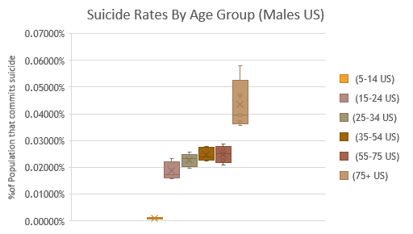
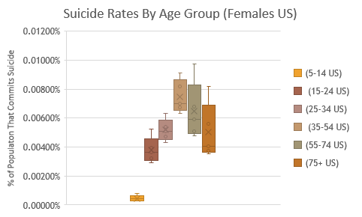
Comparison of Age
The United States
Most at risk females
Ages 35-54
Used the MAX, MIN, and Quartile functions to complete
Most at risk males
Ages 75 and older
Used the MAX, MIN, and Quartile functions to complete

Slide 12
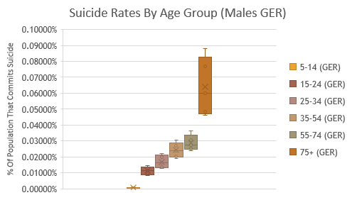
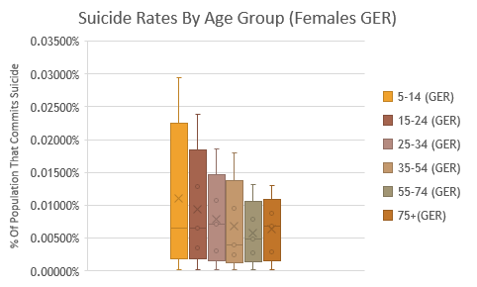
Comparison of Age
Germany
Most at risk females
Ages 5-14
Used the MAX, MIN, and Quartile functions to complete
Most at risk males
Ages 75 and older
Used the MAX, MIN, and Quartile functions to complete

Slide 13
An Answer To The Question
So what group of people are affected by suicide the most?
Males Aged 75 and older are more at risk than any other demographic in both The United States and Germany

Slide 14
Future Works
more than two countries in the world.
Are males the most affected in most countries?
What about age?
Do poverty levels, economy, and government play a role?

Slide 15
Bibliography
(n.d.). Retrieved from http://apps.who.int/healthinfo/statistics/mortality/whodpms/
Szamil. (2018, August). WHO Suicide Statistics. Retrieved from Kaggle: https://www.kaggle.com/szamil/who-suicide-statistics/version/1

Slide 16
Question Time!
Thank you all for your time and attention.

