Slide 1
Ethnicity and Vietnam
An Exploration of u.s. casualties during the Vietnam war

Slide 2
Dataset Overview
The dataset was retrieved from Kaggle.com, but originated from the Defense Manpower Data Center (DMDC), of the Office of the Secretary of Defense.
The dataset originally consisted of 58,221 records divided into 31 fields, for a total of 1.8 million data points. The entire dataset came to about 7mb of data.
The dataset contains records only for U.S. service members, and only fatal casualties.
A partial sample of the original unedited data:

Slide 3
Data Cleaning
The data was mostly clean, with the primary issue being several thousand blank cells. Still, considering the size of the dataset, it still amounted to a fairly small number.
The blank cells were replaced with “UNKNOWN”
The field “BIRTH_YEAR” contained a full date, and the year was isolated using a simple “=LEFT” function for easier referencing. The new field was labeled “BIRTH_YEAR_YEAR”.
The data was already sanitized by the original uploader on Kaggle (Username “0rangutan”), and no randomization or elimination of identifying information was needed.

Slide 4
The Goal
To determine if any racial biases were present that could be inferred from the casualty data, primarily in reference to cause of death and what that might indicate about the different roles assigned to soldiers based on their race.
Ultimately, the comparison focuses on the designations “WHITE” and “BLACK OR AFRICAN AMERICAN”. Data for other ethnicities totaled only 800 of 58,221 entries, and provided too little data for a meaningful comparison.
Other fields of comparison, such as “MARITAL_STATUS” were explored as well, but were not the focus of the study.

Slide 5
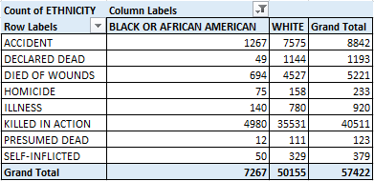
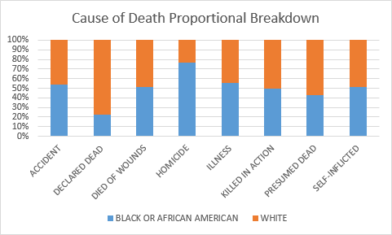
Comparison I: Cause of Death
When looking at cause of death, the data is, proportionally very even except for in two notable categories:
  “DECLARED DEAD”: Where African Americans make up only 4% of the total
  “HOMICIDE”: Where African Americans make up 32% of the total.
However, total % isn’t the most useful way to examine the data. What does this look like when proportions of the total are taken into account?
Here we can see that African Americans were murdered at far higher rates than Whites, and were declared dead at a much lower rate.

Slide 6
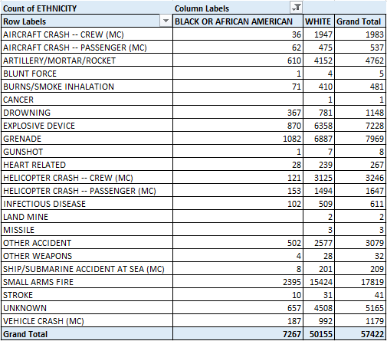
Comparison II: Method of Death
Can any further questions be answered by looking more closely at the causes of death between both groups?
Data that stands out: “AIRCRAFT CRASH – CREW”, “HELICOPTER CRASH – CREW”, “SHIP/SUBMARINE ACCIDENT AT SEA”.
Inference: White service members were employed far more often in the Airforce and Navy than African American service members.
Does this explain the “DECLARED DEAD” discrepancy?

Slide 7
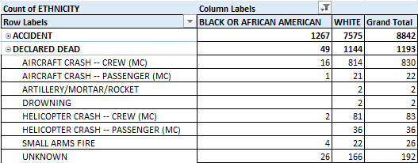
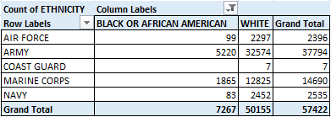
Comparison II: Method of Death II
By combining our Cause of Death field with the more detailed version, we can see that the difference in the “DECLARED DEAD” field was largely due to the prominence of White casualties in aircraft and helicopter crashes.
Does that indicate a divide in service branches by race?
Only 4% of Air Force casualties were African American, and similarly only 3% of Navy casualties were Black.
Without looking at enlistment records it is impossible to prove, but a compelling conclusion.

Slide 8
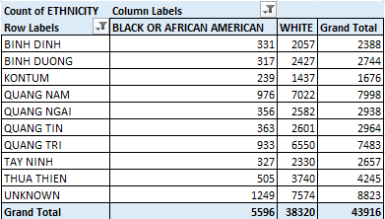
Exploration: Deployment Province
Did this difference in service branches result in any notable deployment differences based on race?
A look at the top ten provinces of deployment indicated that, no, deployment was fairly proportional across all categories.

Slide 9
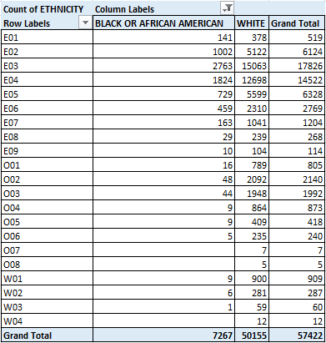
Comparison III: Pay Grade
A final question: Were African Americans discriminated against when it came to rank and pay?
Yes and no.
For enlisted ranks (E01-E09), there is little evident discrimination when it comes to rank and pay.
For officer ranks (O01-O08) there is a clear difference between the two, with the proportion of white officers to black reaching ratios of 50:1 or more.
African Americans are almost entirely absent from Warrant Officer ranks (W01-W04, usually indicating specialists in a given field).

Slide 10
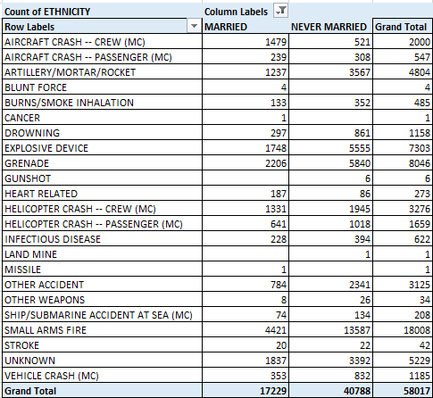
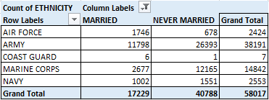
Additional Comparisons I: Marital Status
Can a difference in deployment between married and unmarried soldiers be determined by looking at their Cause of Death?
Three times as many married soldiers died in aircraft crashes (as crew) as their unmarried counterparts. Only one-third as many married individuals died due to small arms fire
A quick look at branches of service confirms a difference in enlistment makeup.

Slide 11
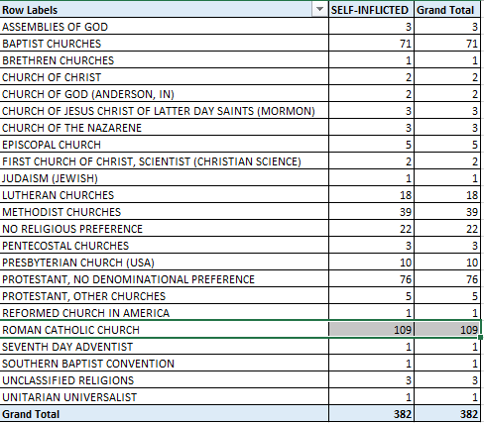
Additional Comparisons II: Religion
A quick comparison between religions did not show any meaningful difference between them.
Still, one bit of data did stand out:
Apparently Roman Catholics committed suicide at higher rates than other soldiers.

Slide 12
Summary and Future Plans
Discrimination against African American soldiers is very evident in a variety of different categories
An exploration of different parts of the dataset, such as a deeper look at the briefly mentioned “MARITAL STATUS” and “RELIGION”.
A comparison between actual enlistment records would confirm or refute many observations, such as differences in which branch of the military each race was deployed in.

