Slide 1
FIFA WORLD CUP ATTENDANCE
Richson Nguyen
Dsci 101
Fall 2018

Slide 2
Attendance in Stadiums during FIFA World Cup Tournament
Is there any way to identify causes that contribute to total attendance?
Factors investigated
Year
Stadium
City
Attendance

Slide 3
My Data
FIFA WORLD CUP MATCHES from Kaggle.com
Information from tournament matches
1930- 2014
CSV File
234 KB Size

Slide 4
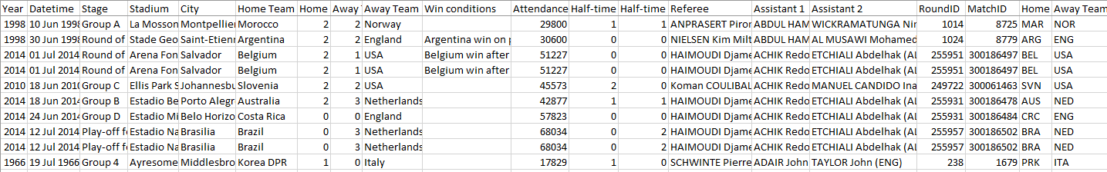
Raw Ugly Data

Slide 5
Fields in Dataset
Six Fields
Date & Time
31 May 1986 12:00
Stadium
Estádio do Maracanã
Estadio Azteca
Attendance Field: Numeric value
173,850
Home Team & Away Team: Text value
Brazil
Mexico
Argentina
Record Example
15 Jun 1986 12:00 Estadio Azteca Mexico City Mexico Bulgaria 114580

Slide 6
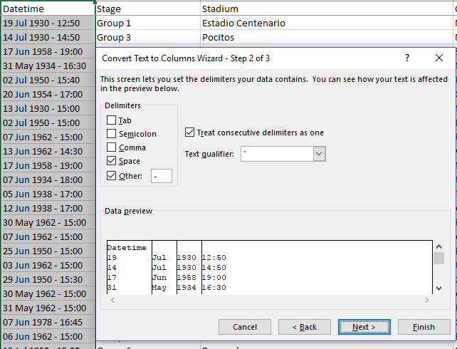
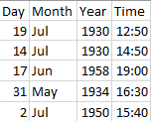
Derived Field
Datetime
Split the field from one into four separate fields
Day
Month
Year
Time
Text to Columns Tool used
Delimited

Slide 7

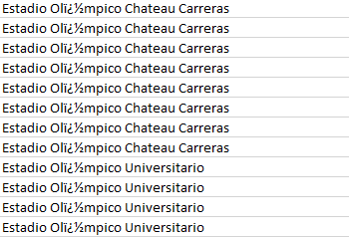

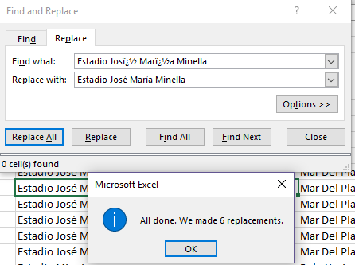
Stadium Field
Inconsistencies
Unknown characters
Find and Replace
Google Search
Stadium Name
Replace

Slide 8
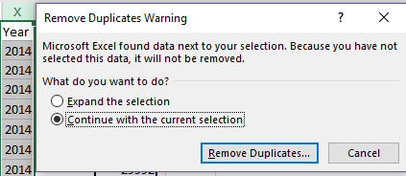
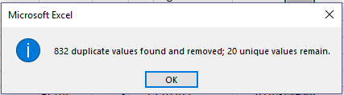
Total Matches per Year
Find unique values
Year Column
Done with the Remove Duplicates Tool

Slide 9
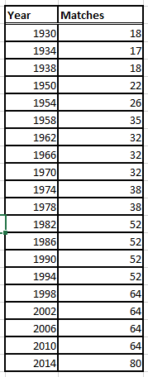
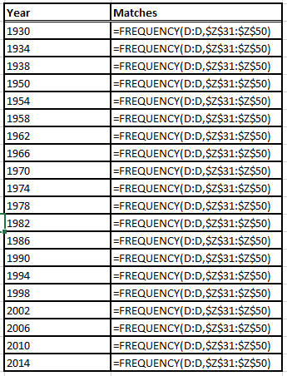
Total Matches per Year
Create a Table
Total Games per Year
Done with Frequency Distribution

Slide 10

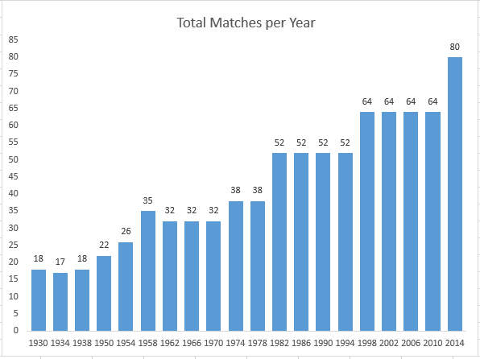
Total Matches per Year
Increase per Year
Growth
Expansion

Slide 11

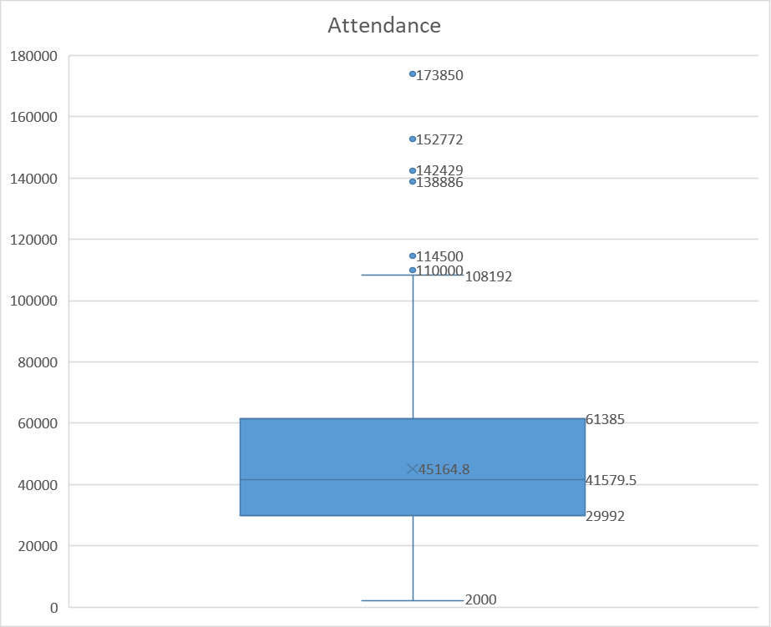



Average Attendance
Record Attendance
173,850
1950
Uruguay vs. Brazil
City: Rio De Janeiro, Brazil
Population: 6.32 million
Lowest Attendance
2,000
1930
Chile vs. France
City: Montevideo, Uruguay
Population: 1.381 million

Slide 12
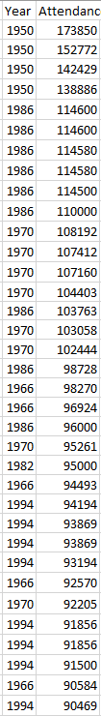

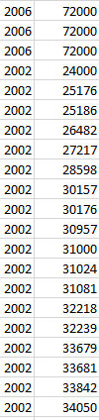
Discoveries
More attendance at earlier dates
Technology influence

Slide 13
Problems with Data
Very few problems
Minor patch work
Text errors
Very consistent and clean

Slide 14
Is there any way to identify causes that contribute to total attendance?

Slide 15
Future Research
Technology Advancements = Attendance
Access to technology
TV
Internet
Phone
Tablet

Slide 16
Thank You!

