Slide 1
Analyzing Super Bowl Teams
By: Steven Myers

Slide 2
“Offense Wins Games, but Defense Wins Championships”
Quote by Paul “Bear” Bryant (College football player and coach)
Does the team with a better defense really win championships?
Data to look at:
Defensive Rankings
Offensive Rankings
Point Differential

Slide 3
Super Bowl Dataset
Dataset was obtained from Data.World
Defensive and Offensive Rankings were from the Pro Football Reference and was added to the dataset manually
XLSX File
Originally 18 KB

Slide 4
Data Dictionary
Winner Offensive/Defensive Rank
Rank of the offense and defense of the Super Bowl winning team
Loser Offensive/Defensive Rank
Rank of the offense and defense of the Super Bowl losing team
Point Difference
The difference from the winning teams score and the losing teams score

Slide 5
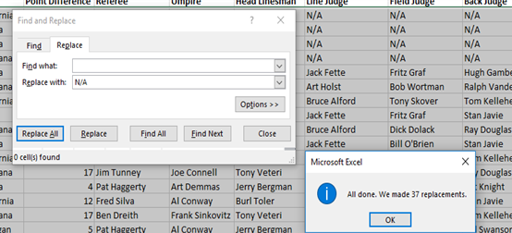
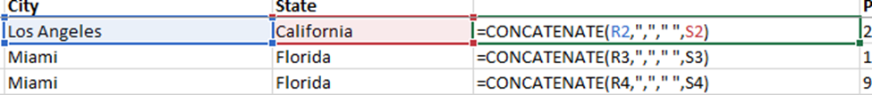

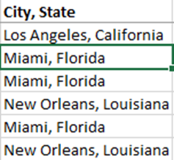
Cleaning the Data
Replace any blank cells within the dataset with “N/A”
Merging the City and State field

Slide 6
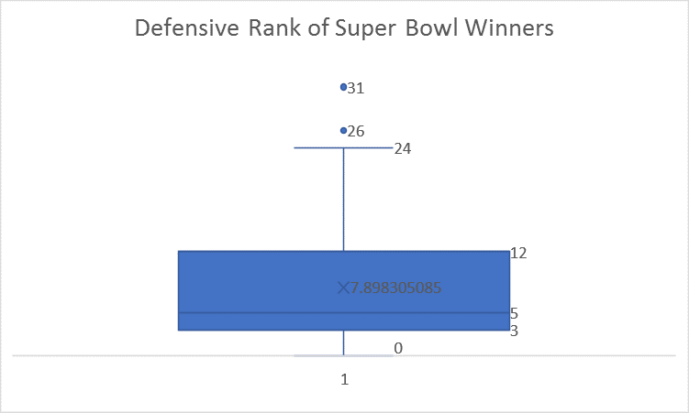
Summary Statistics
Average ranking of 7-8
Two outliers of 31 and 26
50% of Super Bowl winning teams had a top 5 defense

Slide 7
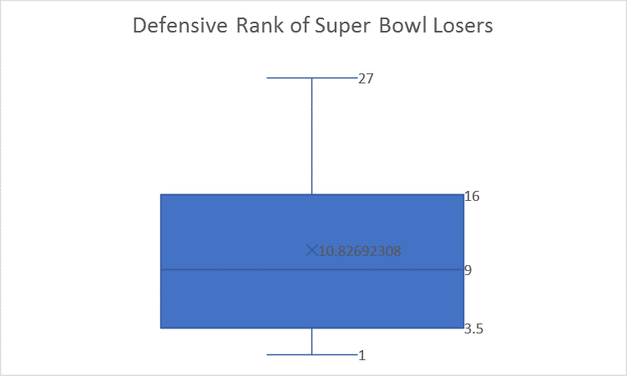
Summary Statistics
Average ranking of 10-11
Larger range than Super Bowl winners
50% of Super Bowl losers had a rank of 9 or worse

Slide 8
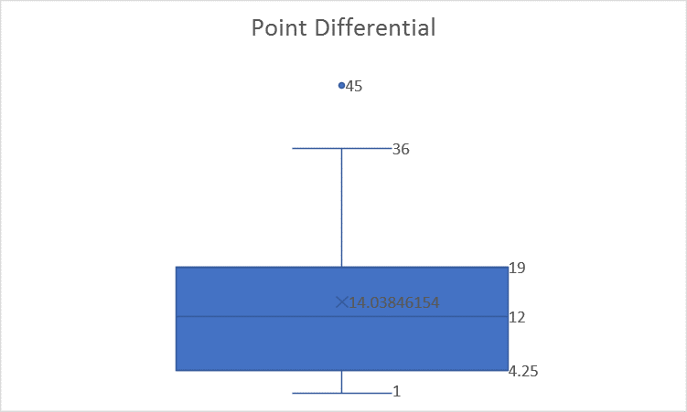
Summary Statistics
Average Super Bowl was won by 14 (or 2 touchdowns)
75% of games were decided by more than a field goal

Slide 9
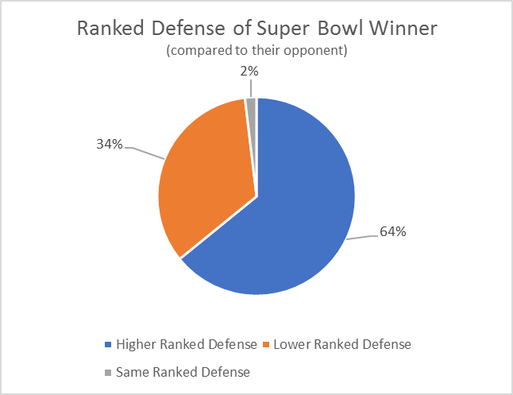
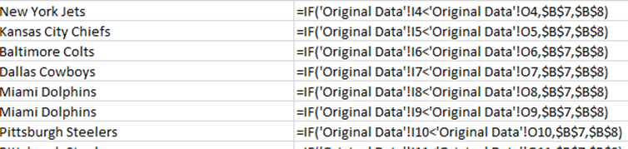
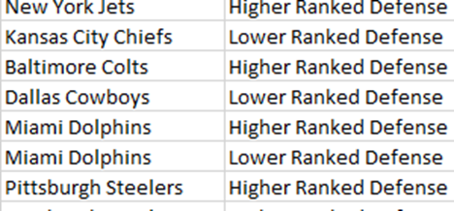
Defensive Ranking Analysis
Higher Ranked Defense | 34
Lower Ranked Defense | 18
Same Ranked Defense | 1

Slide 10
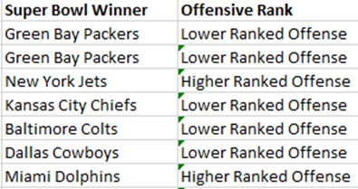
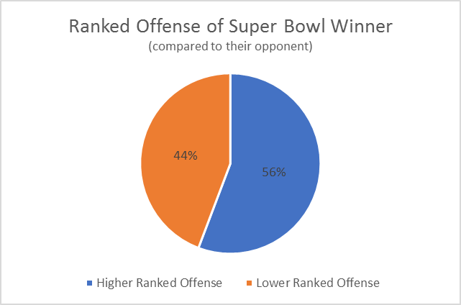
Offensive Analysis
Higher Ranked Offense | 29
Lower Ranked Offense | 23

Slide 11
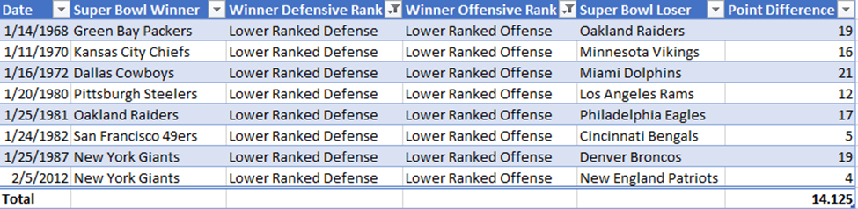
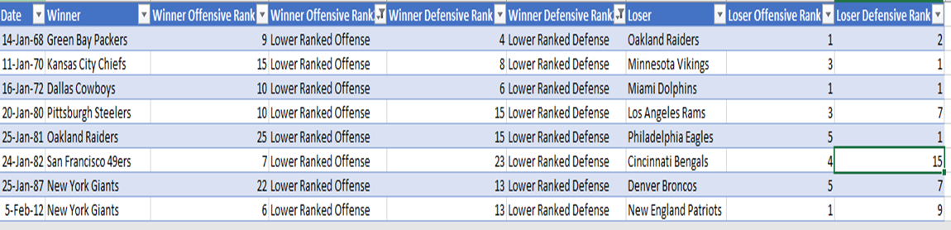
Lower Offensive and Defensive Rankings

Slide 12
Conclusions
The team with the better defense has won ~ 2/3 of Super Bowls (regardless of their offensive ranking)

Slide 13
Future Work
Dig deeper into the specific rankings of each teams’ offenses and defenses
Location, Location, Location

Slide 14
Questions? Comments?
Thank you for your attention

