Slide 1
Arizonna Moghalu Data Analysis
Fantasy Premier League Statistics

Slide 2
PROJECT OVERVIEW
QUESTION: Does the value of a soccer player determine the amount of point the player receives each week?
In this project we’ll be discussing if the FPL (fantasy premier league) value of a Soccer player can determine the amount of points the player receives each week.

Slide 3
DATA
From Kaggle.com
34KB

Slide 4
DATA OVERVIEW
This data is about Premier League players in England, and Wales. In this dataset we have the Name of the players, the club they play for, there age, there position, the players real time market value, there FPL value, there FPL selection rate, which is the rate at which other users select these players, also there’s the FPL points that is the amount of points they earn in a week depending on how they play that week. And lastly we have the players nationality.

Slide 5
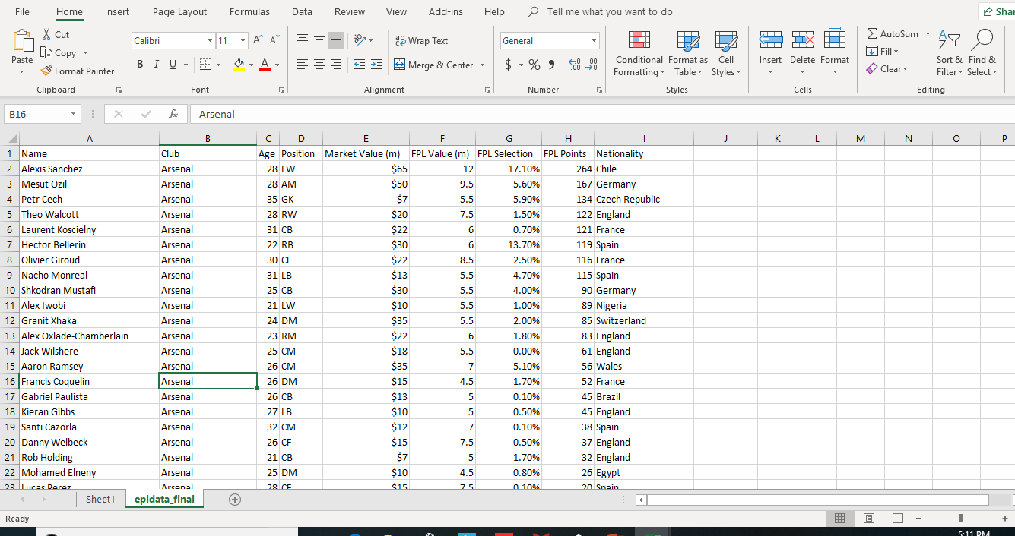
DATA

Slide 6
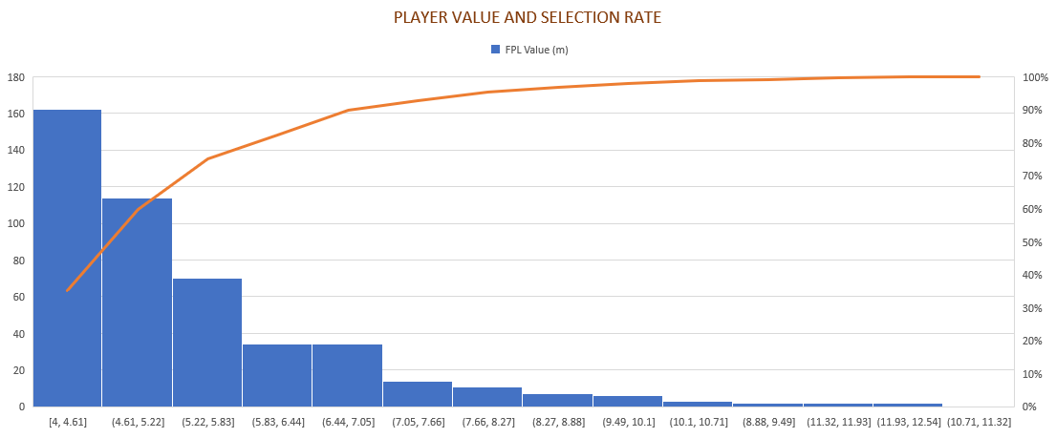
DATA CONT.

Slide 7
PROBLEMS WITH THIS DATA
This data came with errors like most datasets. I had to replace + with “ “ yes, with an empty space. For example Manchester United came in as Manchester+United so I had to replace it with one space.
Furthermore, the titles of each column were in lower case so I capitalized the first letter of each title.
In the market value column I formatted it to have $ in it.
N’golo Kante’s name came up as N%27golo so I replaced the N%27 with N’.
Also, I replaced Marko ArnautoviÃ„â€¡ with Marko Arnautović
Same applies for Bojan KrkiÃ„â€¡ with Bojan Krkić
Ã…Âukasz FabiaÃ…â€žski replaced with Łukasz Fabiański
Ãƒâ€°tienne Capoue replaced with Étienne Capoue
YounÃƒÂ¨s Kaboul replaced with Younès Kaboul

Slide 8
DATA ANALYSIS TECHNIQUES
Does the value of a soccer player determine the amount of point the player receives each week?
First, to determine the answer to this, a table needs to be created to sort this data out
Secondly, we need to sort the FPL value from largest to smallest, then determine the top 5 most expensive players then do the same for the Smallest to largest then determine the top 5 cheapest players then compare all the variables to FPL points to answer the question

Slide 9
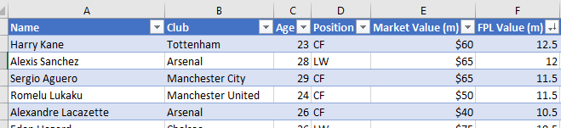
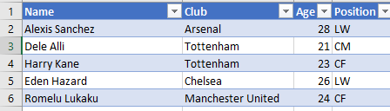
FINDINGS
The top 5 most expensive players are:
Harry Kane - 224
Alexis Sanchez - 264
Sergio Aguero - 175
Romelu Lukaku - 221
Alexander Lacazette - 224
Top 5 players with the most points
Alexis Sanchez - 264
Dele Alli - 225
Harry Kane - 224
Eden Hazard - 224
Romelu Lukaku – 221

Slide 10
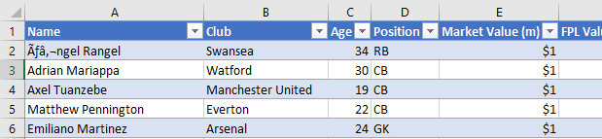
FINDINGS CONT.
Cheapest players
Angel Rangel
Adrian Mariappa
Axel Tuanzebe
Matthew Pennington
Emiliano Martinez
Players with least points
Grant Hanley – 0
Jonjoe Kenny - 1
Asmir Begovic - 2
Kristoffer Nordfeldt - 3
Brad Smith – 4

Slide 11
CONCLUSION
In conclusion, the more valuable a player is the more he would provide, Except for Dele Alli and Eden Hazard who aren’t in the top 5 most expensive and have more points.
Q: Does the value of a soccer player determine the amount of points the player receives each week?
A: No.

