Slide 1
NFL Quarterbacks
HUNTER king

Slide 2
Quarterbacks in 2016
What makes a quarterback “elite”?
Why are these statistics important?

Slide 3
My Dataset
NFL Quarterback Stats
Statistics originally gathered from Espn.com
Secondary source Kaggle.com
40.2 KB
File Type
CSV file
Converted to Microsoft Excel Worksheet file
Info on the entire 2016 regular season
8455 unique records

Slide 4
The Dataset-Fields
Quarterback-The player represented
Yards- Total yards gained throughout the game
Longest Gain-Longest pass of the game
Total Points- Points scored in the game
Location- Home or away

Slide 5
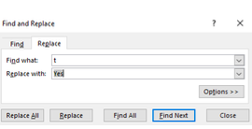
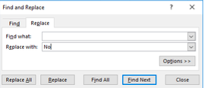
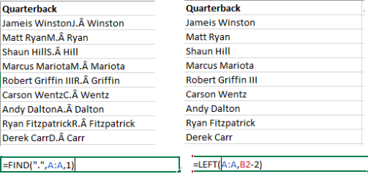
Cleansing
Longest Gain Field
Split the Column
Find and replace to clean the data
Quarterback Field
Remove all charters except for the first and last name
Allowed for an easier representation of the data

Slide 6
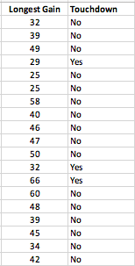
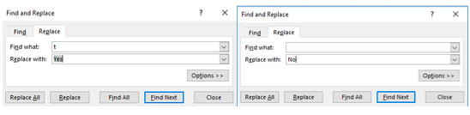
Derived Field
Created the “Touchdown” field
Determined if the longest gain for the game resulted in a touchdown
Used find an replace to create

Slide 7
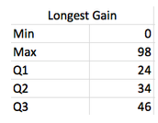
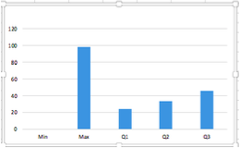
Longest Gain
Longest gain of entire season was 98 yards
Drew Brees of the New Orleans Saints
Shortest gain was 0 yards
Non quarterbacks who attempted a pass

Slide 8
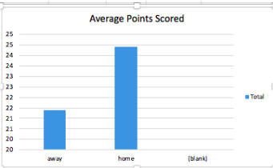
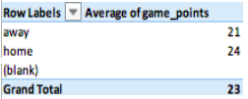
Discoveries
I was curious as to what team averaged more points
Home or away team?
I used a pivot chart to help determine this
Home team-24 points
Away Team-21 points

Slide 9
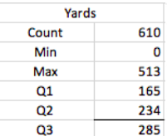
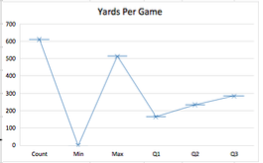
Conclusion
Average yards per game
5 number summary and chart
This helped answer my original question about what makes a quarterback ”elite”
To classify as elite, an average of 285 yards/game meets this criteria

Slide 10
Future Work
Attempt to match every game with their opponent
Who had the best season?
Of regular starters, who had the worst season?

Slide 11
Problems
No problems were found
Data was usable

Slide 12
Questions?
Thank you for your time!

