Slide 1
Top Spotify Records

Slide 2
Overview
19 fields
1229 Records
How does the tempo of the song affect the energy of the song?
How does the Instramentalness affect the speechiness?
How does the key of a song affect the danceability?

Slide 3

Intro
Music Records
Kaggle
Spotify

Slide 4
Problems
Spotify ID’s
Loudness
Unknown

Slide 5
Discoveries
The key does affect the danceability.
The tempo has no correlation to the energy.
The instramentalness is low the speechiness is low.

Slide 6
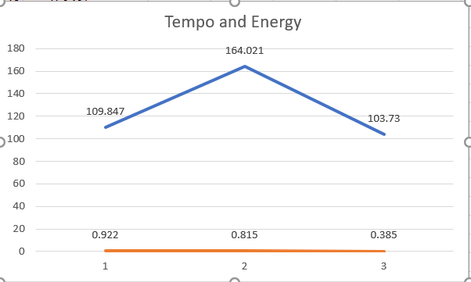
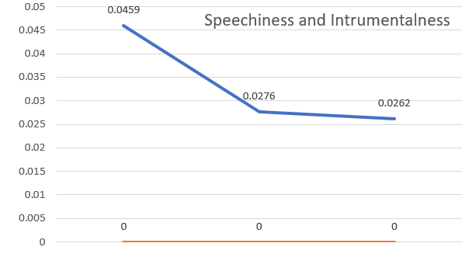
Work

Slide 7
Conclusion
Problems
Key affects Danceability
Tempo does not affect Energy
Instramentalness and Speechiness

Slide 8
Future Work
Volume Number and Mode
Time Signature and Key
Eliminate Records

Slide 9

Questions

