Slide 1
Toronto’s best captain
Jordan Gregor
Data Science 101

Slide 2

The Toronto maple leafs
NHL hockey team
Founded in 1917
Play in Eastern Conference, Atlantic Division
Located in Toronto, Ontario
https://www.nhl.com/mapleleafs

Slide 3

Research questions
Which captain was the best?
An in-depth look at past Toronto captains’ stats

Slide 4
Source file information
Downloaded from data.world
CSV format
90 records total
Records are listed by season

Slide 5
Relevant Statistics
“GP” –Number of games played per season
“G” – Number of goals per season
“A” – Number of Assists per season
“PTS” – Number of points per season, Goals and Assists added together
“PIM” – Number of penalty minutes per season

Slide 6
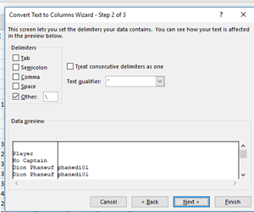
Data Cleaning
Several non-relevant fields
Goalie statistics
“No Captain” records
Deleted
Player ID’s
Text to column function
Delete ID column

Slide 7
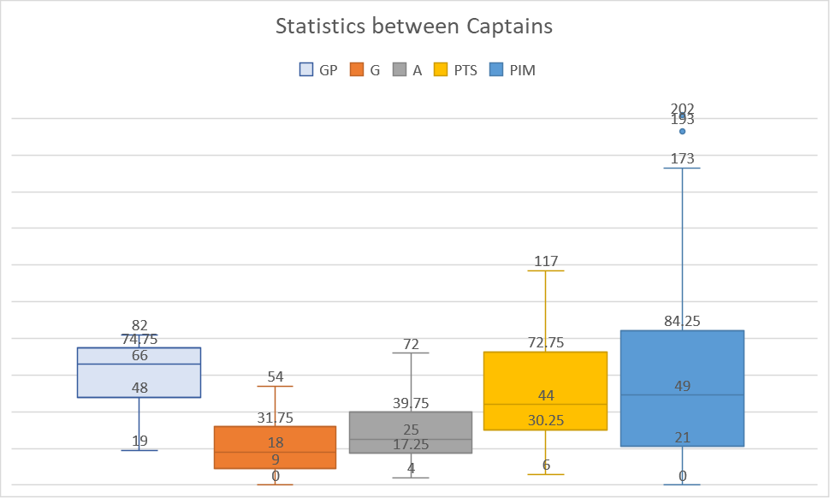
Analysis By season

Slide 8
Analysis By season
Highest Statistics
Games Played
2011-12 | Dion Phaneuf | 82
1998-99 | Mats Sundin | 82
2001-02 | Mats Sundin | 82
2000-01 | Mats Sundin | 82
1997-98 | Mats Sundin | 82
Goals
1981-82 | Rick Vaive | 54
Assists
1977-78 | Darryl Sittler | 72
Points
1977-78 | Darryl Sittler | 117
Penalty Minutes
1989-90 | Rob Ramage | 202

Slide 9
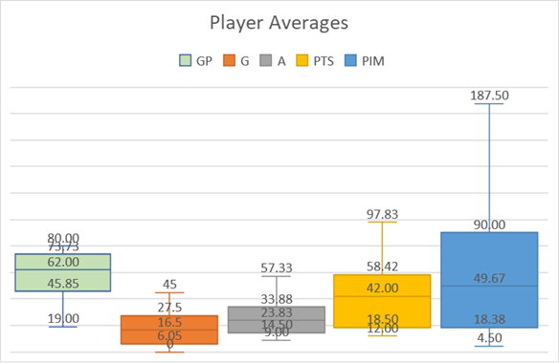
Analysis by player average

Slide 10
Analysis by player average
Games Played
Rob Ramage | 80
Goals
Rick Vaive | 45
Assists
Darryl Sittler | 57.33333
Points
Darryl Sittler | 97.83333
Penalty Minutes
Rob Ramage | 187.5

Slide 11
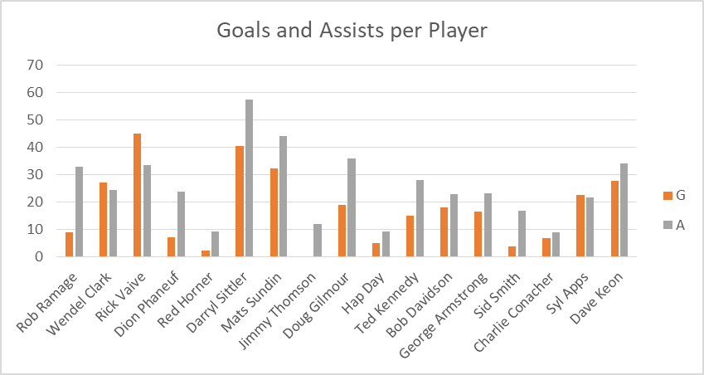
Goals and Assists

Slide 12
Analysis methods
Player averages breakdown
Spreadsheet per player
Table format
Averages from these spreadsheets were transferred
Tables
Filter for each statistic

Slide 13
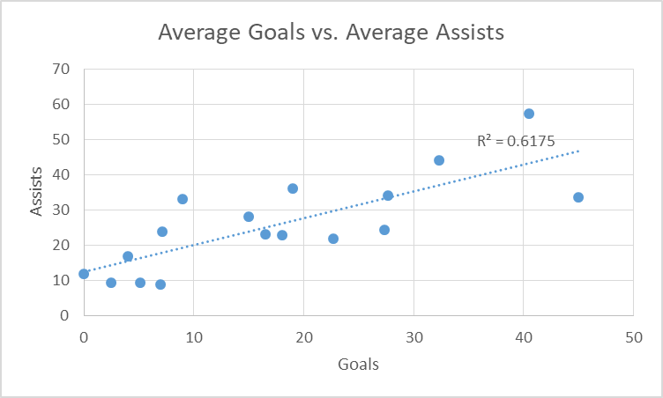
Goals or assists? Both.

Slide 14
Problems with the data
No listing of Player position
Defenseman vs. Forward
No comparison to yearly average

Slide 15

Future work
Combine with franchise success data
Apply player position
Compare stats to season averages
Factor in Stanley Cup wins

Slide 16
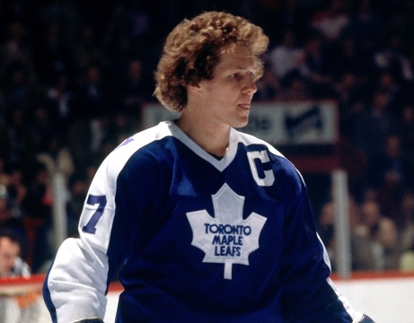
conclusion
Best Player?
Difficult to tell
Several different factors
Darryl Sittler
Goals vs. Assists
Lots of goals?
Likely lots of assists

Slide 17
Bibiography
Hockey Reference. (n.d.). Retrieved from Sports Reference: https://www.hockey-reference.com/
Scuttlemonkey. (2017, April 7). scuttlemonkey/ nhl-hockey-stats. Retrieved from Data World: https://data.world/scuttlemonkey/nhl-hockey-stats/workspace/file?datasetid=original-six-hockey&filename=TOR-captains.csv

