Slide 1
The Winter Diets of Foxes and Coyotes
By Kevin Cox

Slide 2
The Dataset
Found on Dryad
  Originally published in Oikos
XLXS File
41.7 kb
471 records with 19 fields each

Slide 3

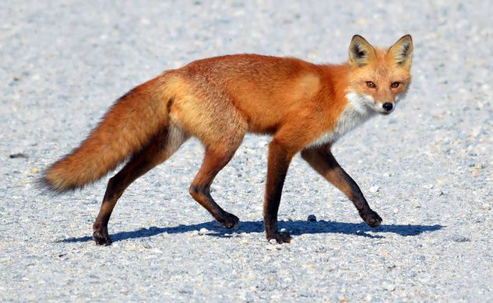
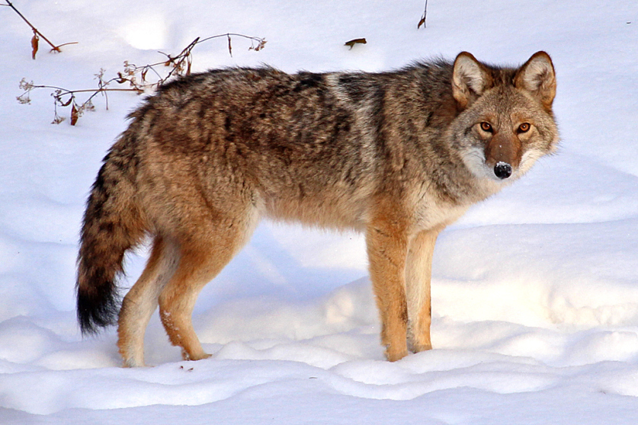
The Dataset
fox and coyote scats found in Alaska
  Scat Number
  Species
  Study Area
  Various food items
https://pgcpsmess.files.wordpress.com
https://bybio.wordpress.com

Slide 4
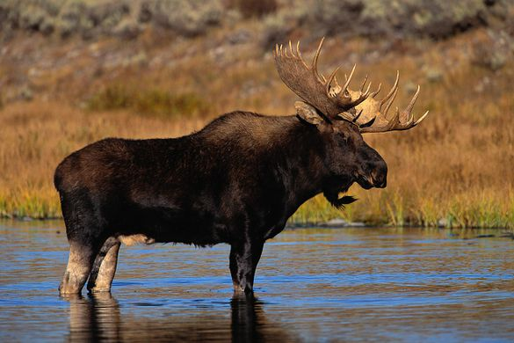
Moose/Caribou
Carrion
  Size compared to mesopredators
  Left by apex predators
    Wolves
http://shuswappassion.ca

Slide 5
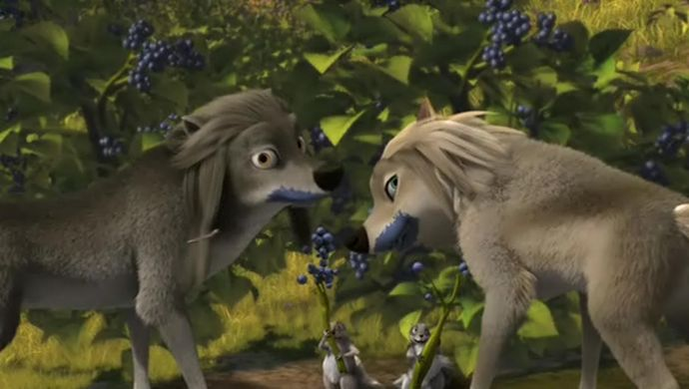
Vegetation & Berries
https://fanpop.com/

Slide 6
General Comparison
General similarities and differences
  Trends not mentioned before

Slide 7
Issues With Raw Data
No critically messy data
But it could be improved
  Numbers were decimal
  Not sorted by species

Slide 8
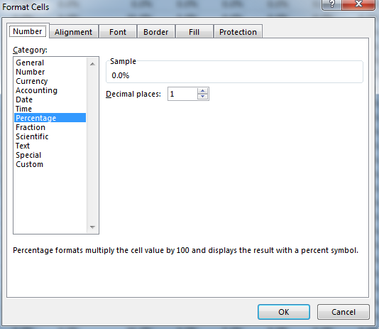
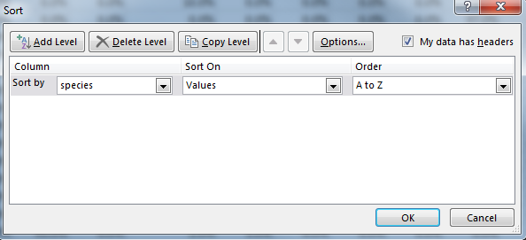
Methods (Cleaning)
Change decimals to percentages
Sort data by species

Slide 9
Methods (Five number summary)
Value | Excel Function
Min | =MIN('Clean Data'!D2:D148)
Q1 | =QUARTILE.INC('Clean Data'!D2:D148,1)
Median | =MEDIAN('Clean Data'!D2:D148)
Q3 | =QUARTILE.INC('Clean Data'!D2:D148,3)
Max | =MAX('Clean Data'!D2:D148)
Value | Excel Function
Min | =MIN('Clean Data'!D149:D472)
Q1 | =QUARTILE.INC('Clean Data'!D149:D472,1)
Median | =MEDIAN('Clean Data'! D149:D472)
Q3 | =QUARTILE.INC('Clean Data'!D149:D472,3)
Max | =MAX('Clean Data'! D149:D472)

Slide 10
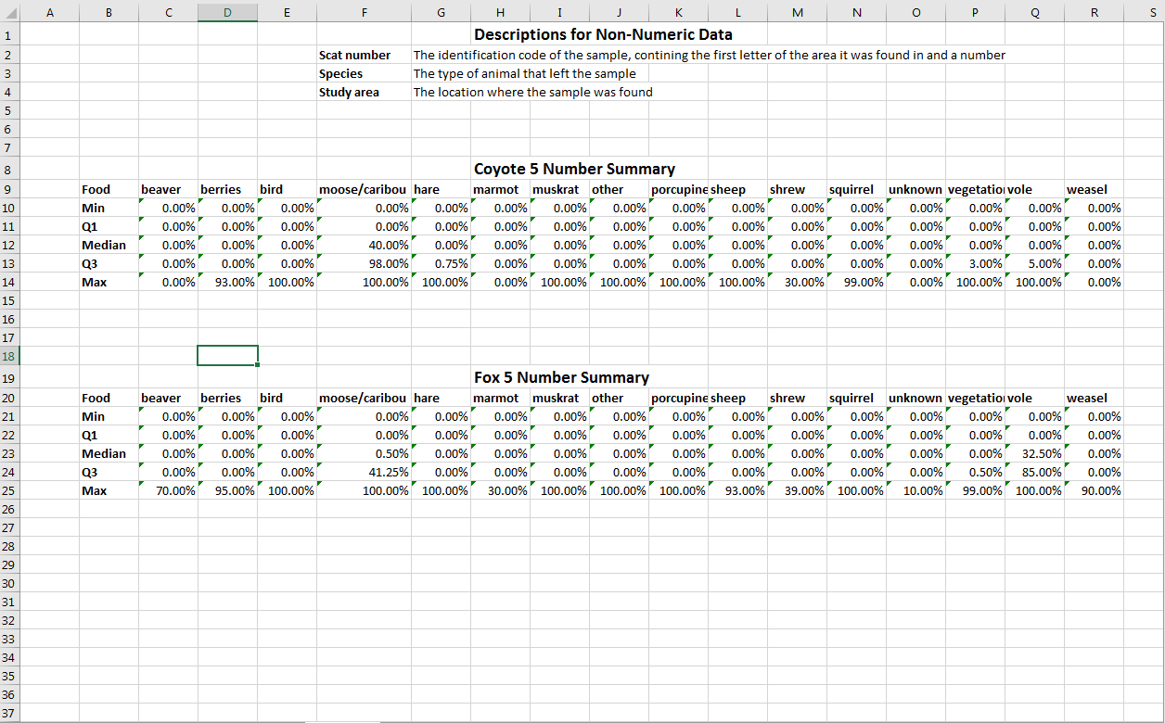

Slide 11
Methods (Averages)
=AVERAGE(*cell1*:*cell2*)
  D2:D148 for coyotes
  D149:D472 for foxes

Slide 13
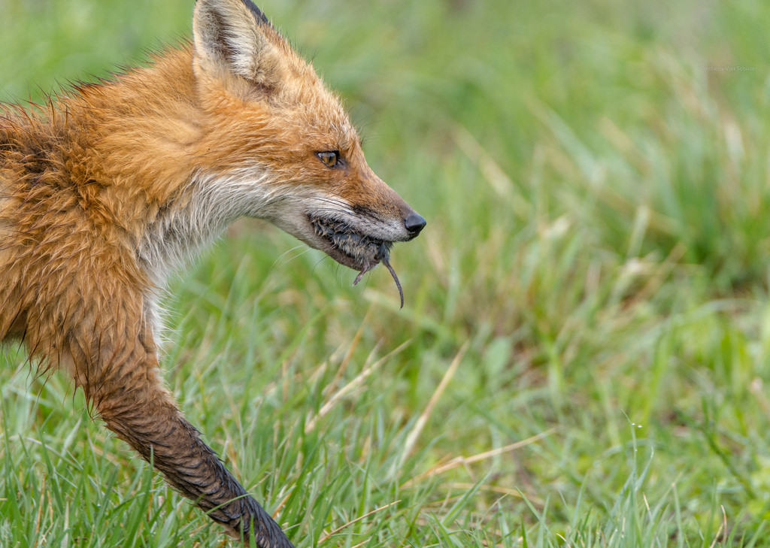
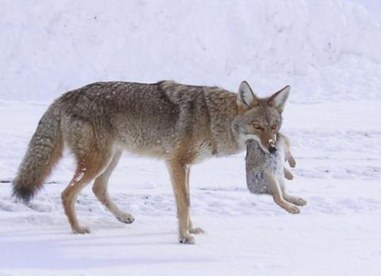
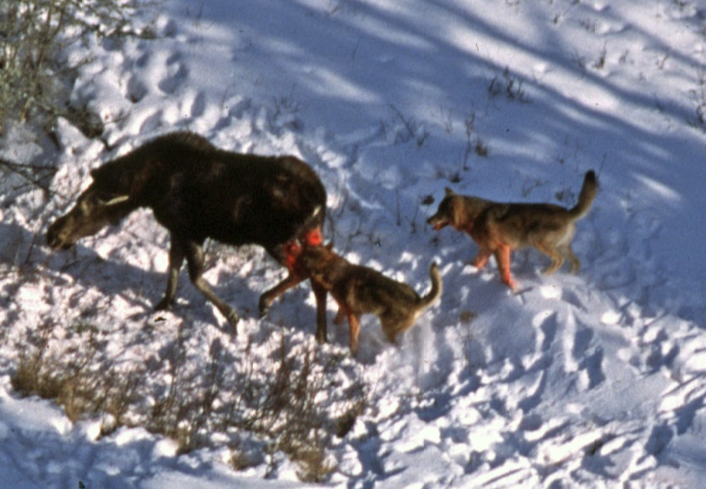
Conclusions
Moose/caribou
  Importance of apex predators
Vegetation and berries
Voles
Hares
Low counted animals
https://hiveminer.com/
https://en.wikipedia.org/
gardenofeaden.blogspot.com/

Slide 14
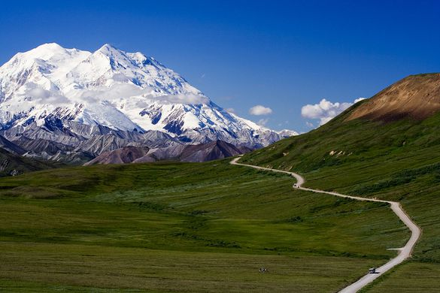
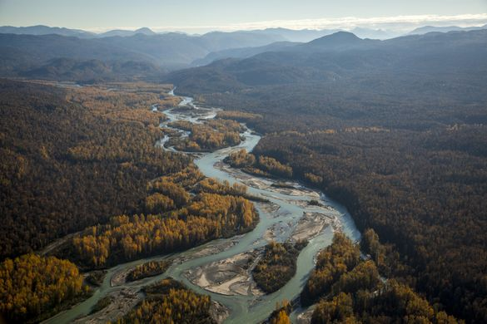
Future Work
Location
  How do fox and coyote winter diets compare in the two locations?
  Further examine Wolves’ role
https://en.wikipedia.org.org/
https://www.tu.org/

Slide 15
Questions

