Slide 1
2016 Worlds Happiness Report
Hector Colom
DSCI 101
Fall 2018

Slide 2
Health and Worlds Happiness score
Factors that can identify apart of both scales.
Possible Factors investigated
  Region
  Health rank
  Health score
  Life expectancy

Slide 3
My DATA
Worlds Happiness report taken from kaggle.com
Originally taken from the United Nations annual report.
Information on 157 countries
  2016 Happiness Report
  A CSV file
  64.7 KB

Slide 4
The Dataset
There are 13 fields
  Region
  Found average amount
  Happiness score
  Found the happiness region being New Zealand and Australia on average
  Also found western Europe happiest top ten region

Slide 5
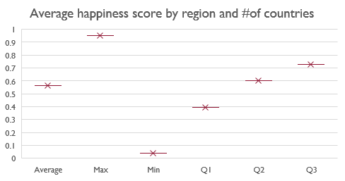
Average life span
Max life expectancy
  95years old
  Hong kong China
  Minimum life expectancy
  4years old
  Chad South Africa

Slide 6
Average life span
Most life expectancy was over 40 years old
Very few nations had lower than a 20-year-old life expectancy

Slide 7
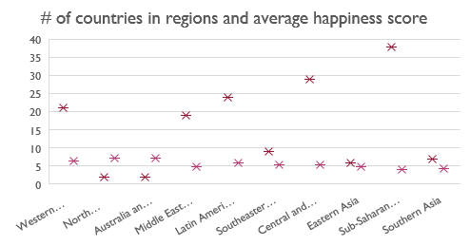
Average happiness score by region and #of countries
There were 157 countries
Broke down with region
Took average happiness of each region

Slide 8
Average happiness score by region and #of countries
There were 10 regions
With 157 countries
Showing the average happiness score

Slide 9
Problems With Data
There was no problems with the data
  All fields were present
  All data appeared to be clean

Slide 10
Discoveries
New Zealand and Australia is the happiest region
Western Europe is the region with most countries in the top ten
Found average life span along with min and mac life expectancy.

Slide 11
Future Work
Try to get data for every country.
Try to get data for
  Dystopia residual
  Upper and lower confidence columns.
  To find average happiness rank between the region and there averge

