Slide 1
Avengers Dataset
Sarah Baskey
DSCI 101.002

Slide 2
Avengers Dataset
I hoped to pull interesting statistics and uncommonly known details about the Avengers characters.

Slide 3
The Dataset
This dataset was obtained from data.world, specifically https://data.world/fivethirtyeight/avengers.
It was collected and contributed from @fivethirtyeight, who pulled it from marvel.wikia.com.
The data consists of 173 records each containing 12 fields.
Originally downloaded as a “.csv” file
26.99KB file

Slide 4
My Data
Appearances
The number of comic books that character appeared in as of April 30, 2015
Gender
The recorded gender of the character
Status
The status of the avenger, if they were given "Honorary" Avenger status, if they are simply in the "Academy," or "Full" otherwise
Year
The year the character was introduced as a full or reserve member of the Avengers
Years since joining
2015 minus the year
Current
Is the member currently active on an avengers affiliated team
Death
Yes if the Avenger died, No if not
Return
Yes if the Avenger returned from their first death, No if they did not, blank if not applicable

Slide 5
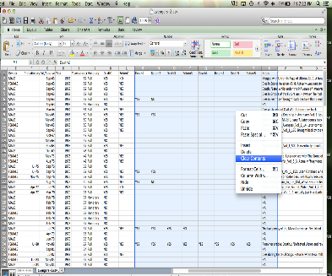
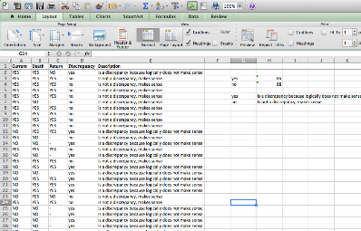
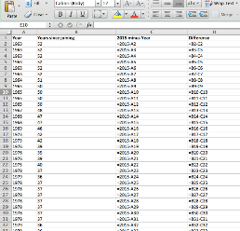
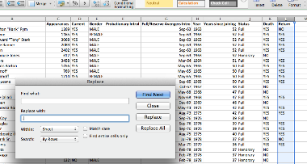
Cleaned Data

Slide 6
Methods - Appearances
Five Number Summary Appearances
Min | 2
Max | 4333
Q1 | 58
Q2 | 132
Q3 | 491

Slide 7
Methods - Gender
MALE | 115
FEMALE | 58

Slide 8
Methods - Status
Academy | 17
Full | 138
Honorary | 16
Probationary | 2

Slide 9
Methods - Years
Five Number Summary of Year
Min | 1900
Max | 2015
Q1 | 1979
Q2 | 1996
Q3 | 2010
Five Number Summary of Years Since Joining
Min | 0
Max | 115
Q1 | 5
Q2 | 19
Q3 | 36

Slide 10
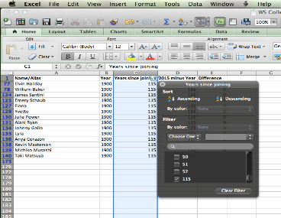
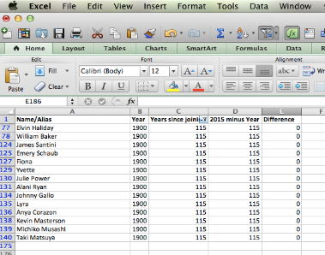
Analysis

Slide 11
Problems with Data
Don’t waste time on the probationary introl and full/reserve avengers intro columns.
There is not much to pull from these two columns of data.
I could not figure out a formula or function to find the discrepancy between the current, death and return columns, so I did that entire column by typing in each cell individually.

Slide 12
Conclusion
I found that 104 out of 173 characters have died at least once during their appearances.
I found there were 115 male characters verse 58 female characters.
I found that the most amount of characters have been introduced between 2005 and 2015.
Furthermore, fourteen characters were introduced in 1900.
Another interesting statistics is most of the Avenger characters have made 500 or less appearances over the years.

Slide 13
Future Work
If I had more time and skill I would work with the data I originally deleted; death and returns 2 through death and returns 5.
Even though that data is sparse, it could be used to pull something interesting together.
I would also have tried to figure out a way to add in a pivot table to the data.
I didn’t leave anything unfinished that I started.

Slide 14
Questions or Comments?
Thank you!

