Slide 1
Afc north Comparison
Kaytee Bartley
DSCI 101
Fall 2018

Slide 2



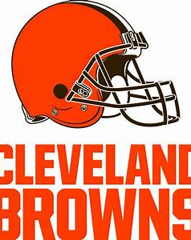

AFC North

Slide 3
Project overview
Do individual team statistics have any correlation to win percentage? In this project, I will compare the AFC North teams to figure out if the team with the best statistic has the winning record with offense and defense.

Slide 4
Data overlook
The data consists of 187 records each containing 11 fields on offense and 7 fields for defense.
Offense
Player: The name of the football player and position
GP: Games Played
CMP/CAR/REC/: Completions, Carries, Receptions
ATT/ YDS: Attempts, Yards
CMP%/ YPG: Completion percentage/ Yards Per Game
YPC: Yards Per Carry
LNG/ TD: Long/ Touchdown
INT/ FUM: Interception/ Fumble
LST: Lost Fumbles
Defense
TOT: Total Tackles
SOLO: Solo Tackles
AST: Assists
SACK: Sack
FF: Forced Fumble
INT: Interception

Slide 5
Dataset
This dataset was obtained from https://herosports.com/rankings/nfl .
This dataset is 84.4 KB

Slide 6
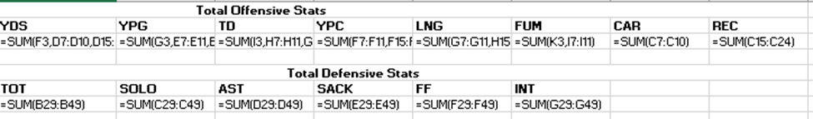
Cleaning Data
I used the =sum formula to get all the totals for offense and defense.
I separated all of the datasets into different spreadsheets to organize it better.

Slide 7
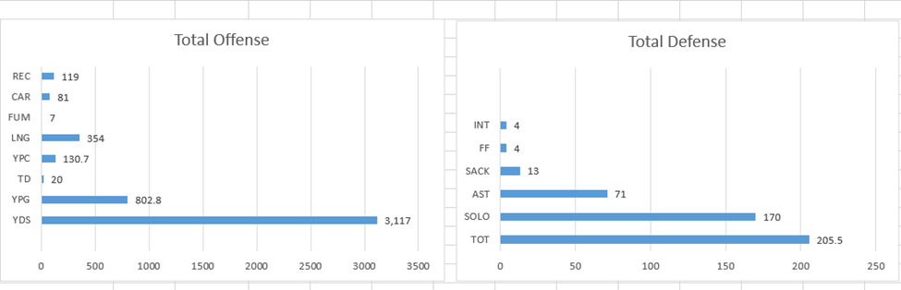
Cleaning data cont.

Slide 8
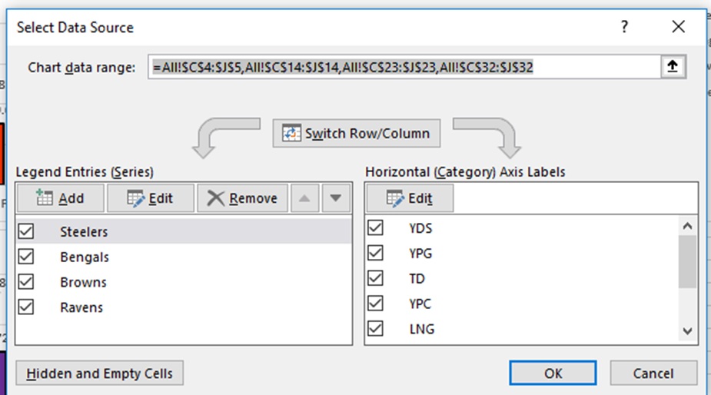
Data organization

Slide 9
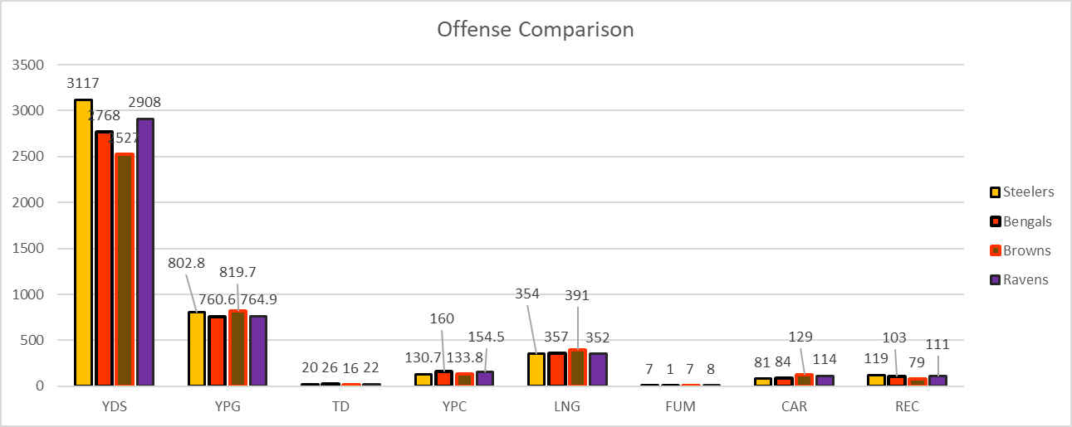
Offense comparison

Slide 10
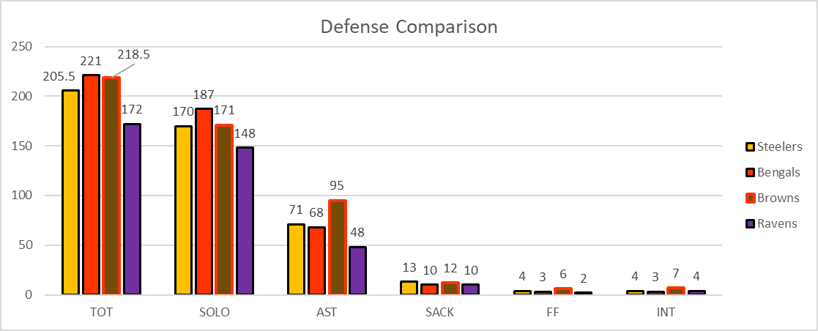
Defense comparison

Slide 11
Conference records
Steelers
3-1-1
Ravens
2-3
Bengals
1-3
Browns
2-1-1
From studying the graphs, the comparison of fields do not match up according to the records of the teams.
The Steelers have the most amount of yards offensively but mostly in every other category, they are the underdogs of the conference.

Slide 12
Conclusion
Defense wins games
Steelers are #1 in the conference, but they have better defensive statistics than any other team and lower offensive statistics.
Do individual team statistics have any correlation to win percentage?
No, just because they have a bad offense doesn’t mean they are going to lose, and vise versa.
For example, the Browns and Bengals have the best statistic according to the graphs, but they are 2 of the worst teams in the league.

Slide 13
Problems/ future work
This dataset only contained the first couple games of the season.
In future work, I would do the whole season, not just part of it.
Also, do a data set on all the divisions to see who is the best team offensively or defensively in the entire NFL.
Last, do a dataset comparing all players to see who is the best player in the NFL offensively and defensively, same with best kicker in the NFL.

Slide 14
references
https://herosports.com/rankings/nfl
http://www.espn.com/nfl/standings
https://1000logos.net/steelers-logo/
http://imagesmode.blogspot.com/2013/01/bengals-dec-30-2012-102528.html
https://www.underconsideration.com/brandnew/archives/new_logos_for_the_cleveland_browns.php
https://royaghorbani.wordpress.com/2013/01/22/my-love-for-the-baltimore-ravens/

