Slide 1

Video Game Sales
Daniel Barker

Slide 2
Overview
I am a nerd. What do nerds do?
Play video games
What is my dataset about?
Video games, particularly sales in the US, Europe, Japan, and the world since 1980-2017
Is there anyway to find out what the most popular games and game publishers are?

Slide 3
Goals
To Discover most widely sold game
Discover most widely sold Publisher
Find out what the most profitable publisher is

Slide 4
Data Overview
My data came from Kaggle.com
Originally Vchartz.com
Original format: CSV file
Current format: Excel Workbook
Transformed entire dataset into Table for analysis

Slide 5
This data contains 16599 records with 11 rows each.
Rank: Sales rank
Name: Name of game
Platform: Release platform for the game
Year: Year of release
Genre: Game genre
Publisher: Company which released the game
NA Sales: North American sales in millions
EU Sales: European sales in millions
JP Sales: Japan sales in millions
Other Sales: Sales in other countries in millions
Global Sales: Sales around the world in millions

Slide 6
Fields Used
Name
Platform
Year
Genre
Publisher
NA_Sales
EU_Sales
JP_Sales
Other_Sales
Global_Sales

Slide 7
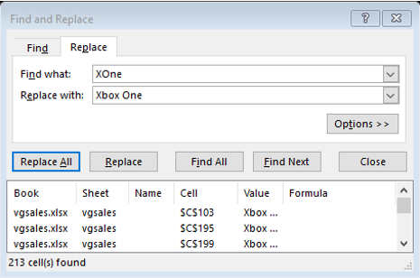
Problems
Some console names spelled oddly
Not really a problem, but could confuse some people
Manually changed some names
One game years release date listed as 2020
Game release year only up to 2017
Googled release date. Date listed at 2009
Changed date to 2009

Slide 8

Other Issues
Numerous N/As for certain games
Total count of N/A 271 out of the 16,327 units
Maybe google game info individually or find place of reference with better info on all the games with missing info
N/As such a small percent of dataset that they were ignored

Slide 9
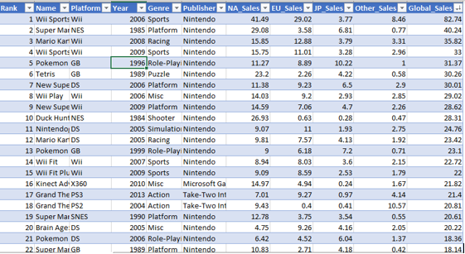
Continued
The most sold game out of all the years was Wii Sports

Slide 10
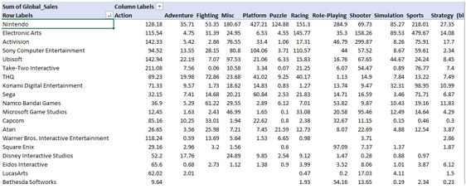
Findings
Created a pivot table in order to discover what Publisher profited the most

Slide 11
Continued
In terms of most sold however, electronic arts had the most sales over the years.

Slide 12
Conclusions/ Future work
Most sold game: Wii Sports
Most sold games by console: Electronic Arts
Most profitable games by console: Nintendo
Would like to discover what games sold the most within certain years.
What games may be more popular with different countries
Deal with N/As as complete the dataset

