Slide 1
Board Games!
Jacob Simmons

Slide 2
Question???
What makes a good board game?
Why do Some board get rated higher than others?

Slide 3
THE DATA
Retrieved from Kaggle.com
Originally from Board Game Geek https://boardgamegeek.com/
  “Board Game Geek (BGG) is a board game database - a collection or catalog of data and information on traditional board games”
Collected in March of 2017

Slide 4
Relevant Data Fields
Rank
Name
Min and Max Players
Min and Max Time
Year
Average Rating
Geek Rating
Category
Weight

Slide 5
Derived Fields
Average Players
  Average function
  Round Function
Average Play Time
  Average function

Slide 6
Problems with Data
Irrelevant data fields (deleted)
  Url of game on Board Game Geek
  Image Url
  Game Id
  Original Average time (was same as max time)

Slide 7
Problems with Data Continued
Time and Player fields
  Zeros: filler for lack of data
    Not that many to effect data drastically
    Ignored for certain analysis
  Outliers: Really absurd numbers
    Discovered they were accurate numbers
Year Field
  Negative years and really low years
  looked at 1850 – present for analysis

Slide 8


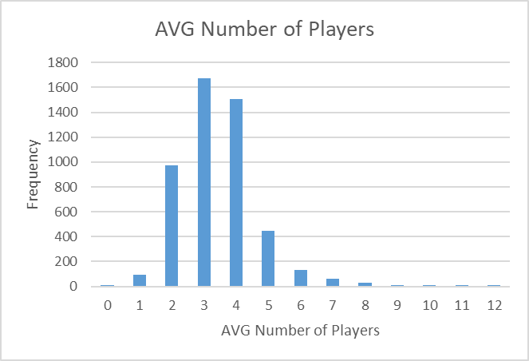
Player
5 number summaries for Min, Max, Average players
Graphed Average Players
Generally 2 – 5 players

Slide 9
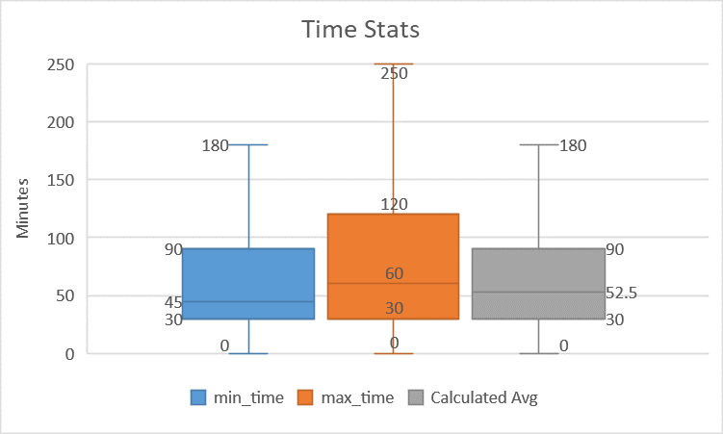
Play Time Analysis

Slide 10
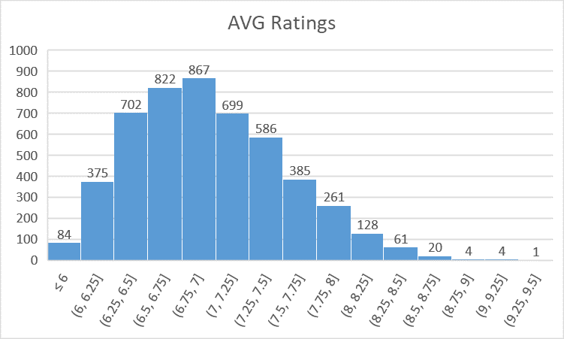
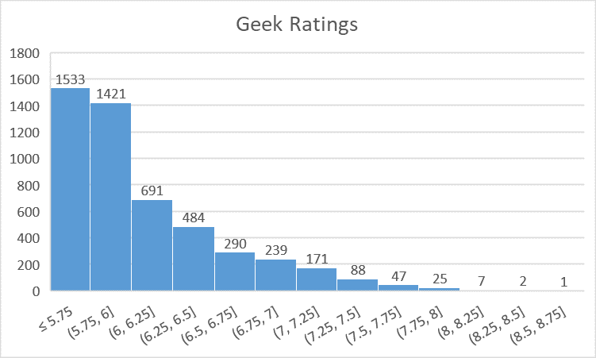
Ratings
Made a frequency table
Created histograms for both ratings
Geek ratings tend to be lower

Slide 11
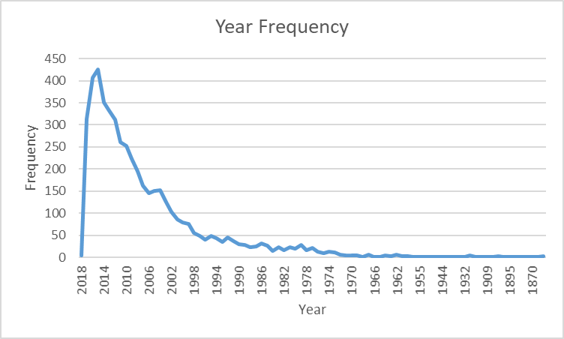
Year ANALysis
Looked at 1850 – 2018
Most games made in 2000’s

Slide 12
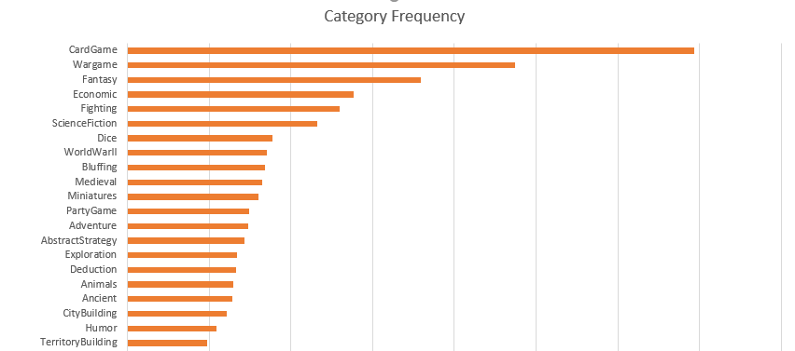
Categories
Found category frequencies
Graphed frequencies
Top Categories
  Card games
  War games
  Fantasy games

Slide 13
Conclusions
5 most popular categories: Card Game, War Game, Fantasy, Economic, Fighting
On average of 2-6 players
Most popular games made in recent years
popular games average from 30 minutes to 90 minutes
Much harder to get a high geek rating compared to a standard rating
Higher rated games are marked for age 12 and up

