Slide 1
True Randomness: QRNG
Exploring Quantum Superposition for Secure Random Numbers
Cole Vaughn
10/8/2024

Slide 2
Overview
Random Number Generators
-generate a sequence of numbers that cannot be easily predicted
Entropy
- degree of disorder, or randomness in a system

Slide 3
Introduction: types of RNG's

Slide 4
Introduction: types of RNG's
PRNG

Slide 5
Introduction: types of RNG's
PRNG
TRNG

Slide 6
Introduction: types of RNG's
PRNG
TRNG
HRNG

Slide 7
Introduction: types of RNG's
PRNG
TRNG
HRNG
QRNG

Slide 8
Introduction: Why TRNG's

Slide 9
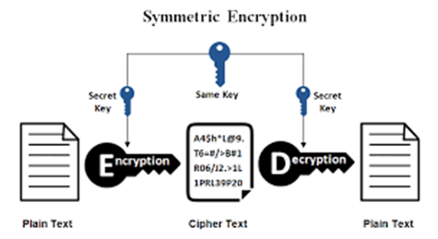
Introduction: Why TRNG's

Slide 10
Introduction: Why TRNG's
Cybersecurity
-keys needed for communication over an unsecure network

Slide 11
Introduction: Why TRNG's
Cybersecurity
-keys needed for communication over an unsecure network
-the more random the key the more secure it is

Slide 12
Introduction: Previous methods

Slide 13
Introduction: Previous methods
Voltage Fluctuation

Slide 14
Introduction: Previous methods
Voltage Fluctuation
Radioactive Decay

Slide 15
Introduction: Previous methods
Voltage Fluctuation
Radioactive Decay
Lava Lamp Fluid Dynamics

Slide 16
Introduction: Physics
Quantum Superposition
-A particle can exist in multiple states at once until it is observed

Slide 17
Area of Investigation
Construct a QRNG using quantum superposition

Slide 18
Methods: Theoretical
Use superposition to generate bit sequence

Slide 19
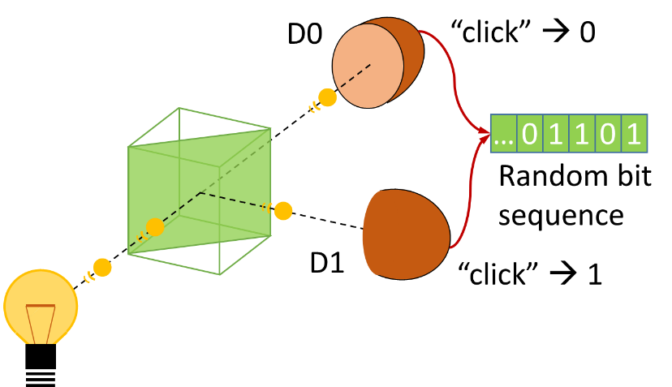
Methods: Physical

Slide 20
Results: Preliminary findings
Able to generate a bit sequence
Bit sequence is visibly not random due to bias

Slide 21
Sources
[1] Z. Hu, S. Gnatyuk , T. Okhrimenko, S. Tynymbayev, and M. Iavich, “High-speed and secure PRNG for cryptographic applications,” International Journal of Computer Network and Information Security, vol. 12, pp. 1–10, 2020.
[2] C. Holbrow, E. Galvez, and M. Parks, “Photon quantum mechanics and beam splitters,” American Journal of Physics, vol. 70, no. 3, pp. 260–265, 2002.
[3] X. Ma, X. Yuan, Z. Cao, B. Qi, and Z. Zhang, “Quantum random number generation,” NPJ Quantum Information, vol. 2, no. 1, pp. 1–9, 2016.
[4] J. Kaur and K. Ramkumar, “The recent trends in cyber security: A review,” Journal of King Saud University-Computer and Information Sciences, vol. 34, no. 8, pp. 5766–5781, 2022.

Slide 22
Questions

