Slide 1
Testing AI Image Generators Against AI Image Detectors
By: Dylan Mitchell

Slide 2
Introduction
AI is big right now

Slide 3
Introduction
AI is big right now
Many advancements made

Slide 4
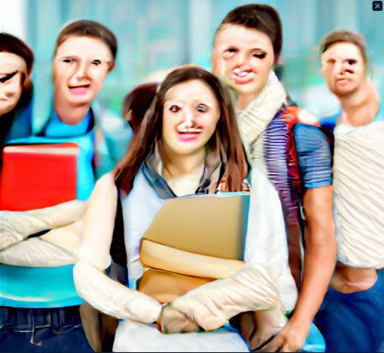
Introduction
Craiyon V1
AI is big right now
Many advancements made
AI image generation went from this to this

Slide 5
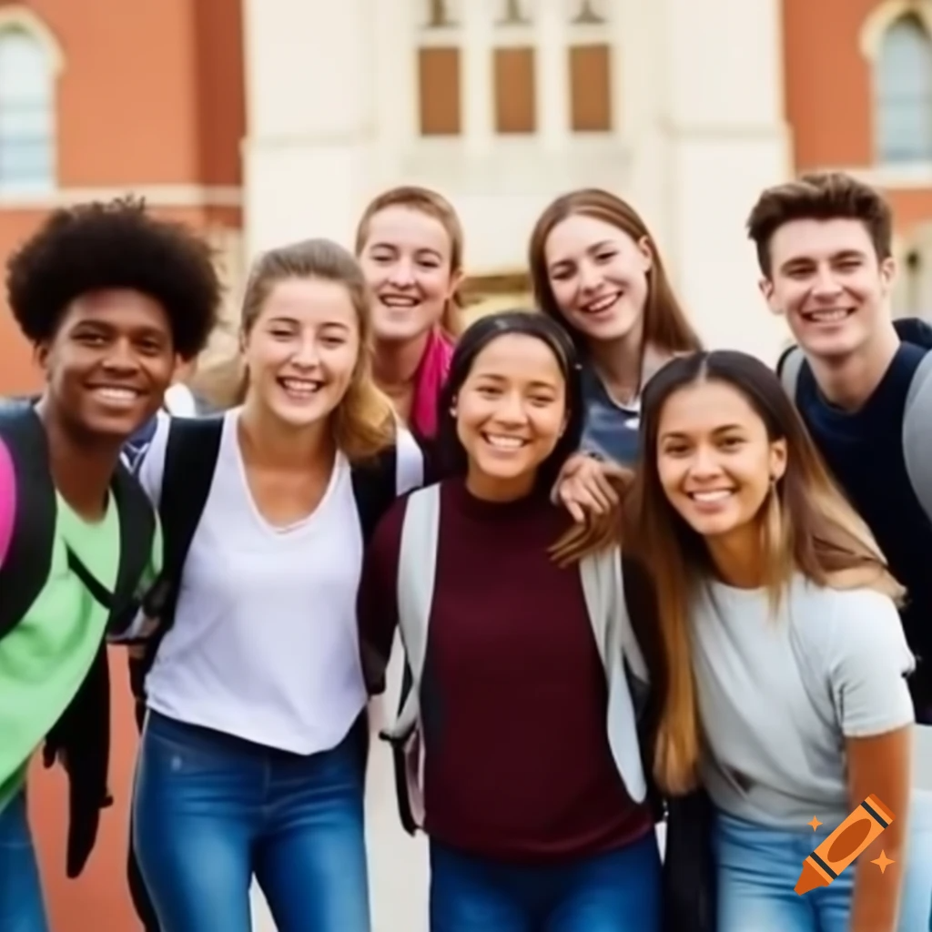
Introduction
Craiyon V1
Craiyon V4
AI is big right now
Many advancements made
AI image generation went from this to this

Slide 6
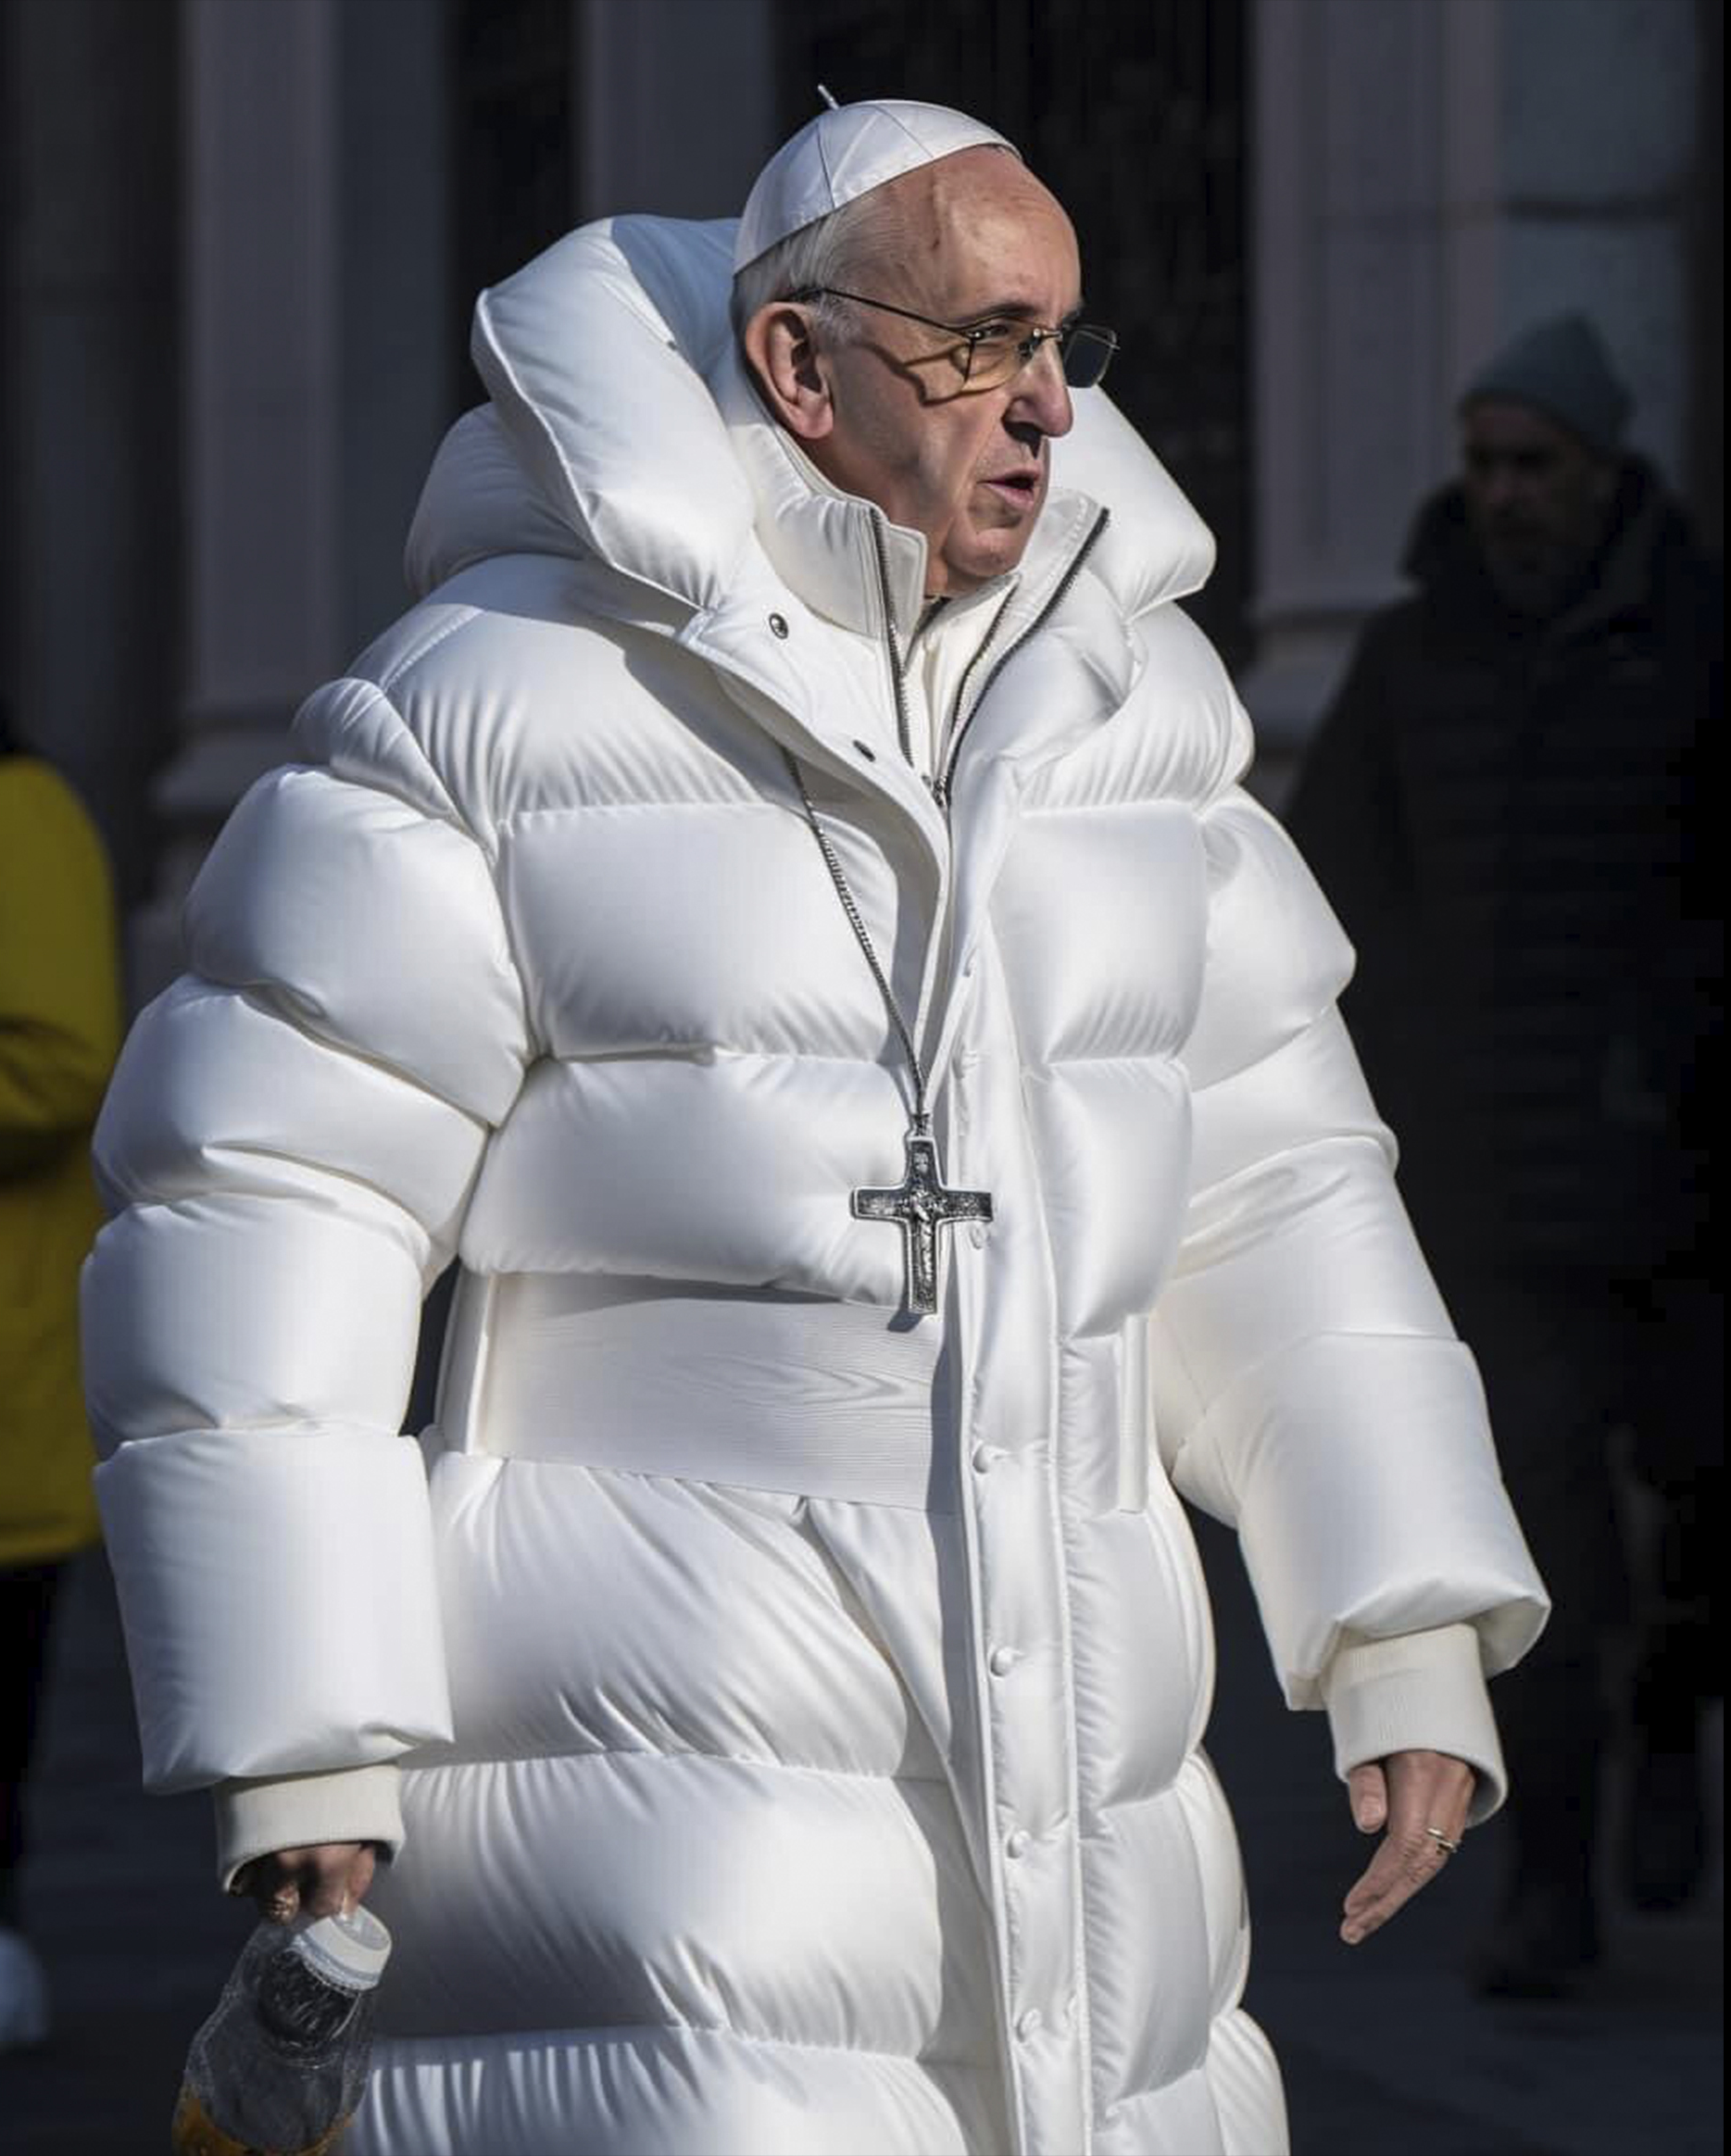
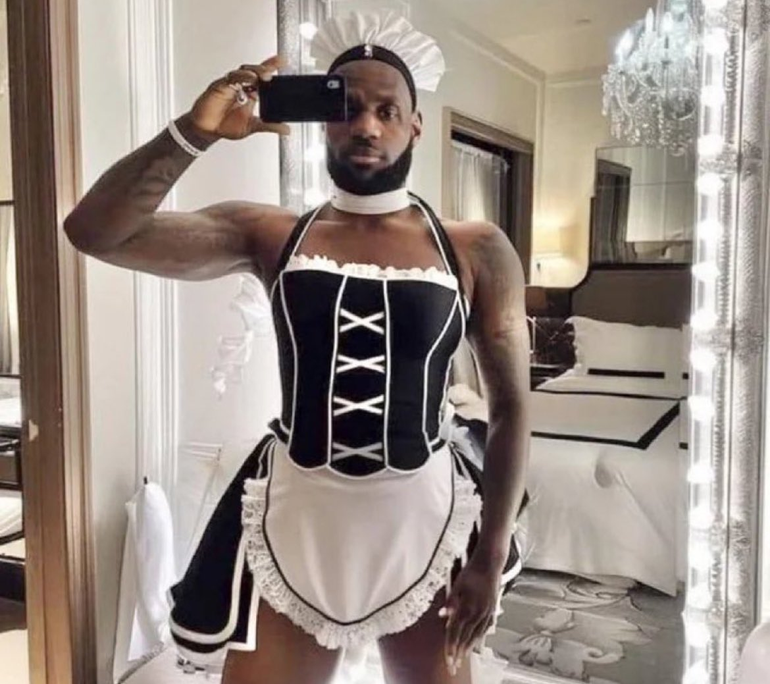
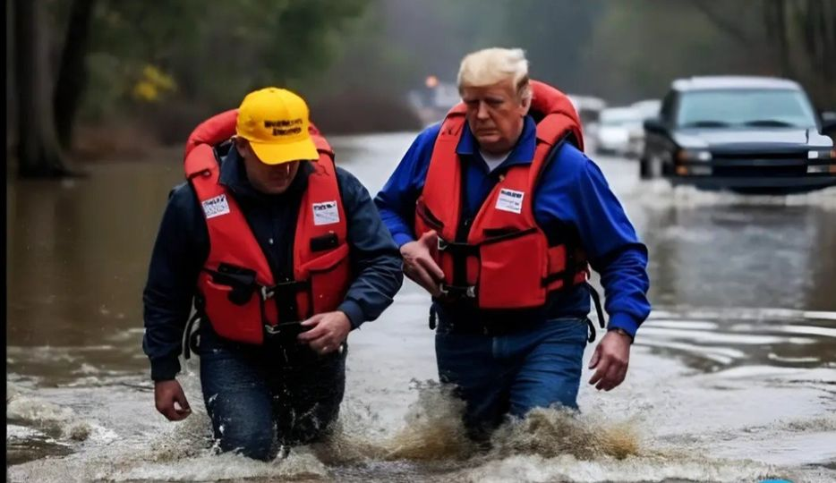
Introduction
Can AI images be distinguished from real images?

Slide 7
Introduction
Can AI images be distinguished from real images?
Major problem

Slide 8


Introduction
Can AI images be distinguished from real images?
Major problem
This is why AI image detectors were made

Slide 9
Introduction
Can AI images be distinguished from real images?
Major problem
This is why AI image detectors were made
Question: How capable are AI image detectors?

Slide 10
General terms
Generative AI: “artificial intelligence that can create original content—such as text, images, video, audio or software code—in response to a user’s prompt or request” (from IBM)
Text-to-Image: Given a text prompt, the AI model produces an image

Slide 11
Methods
4 Image Generators Used: DALL-E, Craiyon, Google Imagen, & DeepAI
3 Prompts: “Red number 2 on a white background”, “The word ‘Hello’”, and “A straight line”
2 Image Detectors Used: Hive Moderation & A.I. or Not
Run each prompt two times in each generator
Run all resulting images through the detectors
Map results to each generator and detector
Compare results with real images

Slide 12
Existing Research
Considerable research has been done in AI image generation & detection
Each text-to-image model tends to have unique method of generating images
However, there still exists anomalies in AI generated images which can be detected
“Artifacts” exist which make AI images detectable (tend to be visible to naked eye)

