Slide 1
How do different AI tools compare in their ability to detect vulnerabilities in C++ code?
Andrew Marcy

Slide 2

Bugs always exists
Many exploits
Which AI minimizes risk?

Slide 3

What is Artificial Intelligence?

Slide 4
Existing Research
Lack of Datasets
Unrealistic Examples
Improving

Slide 5
Methods
Speed
Features
Easy of use
False readings
Hidden vulnerability

Slide 6


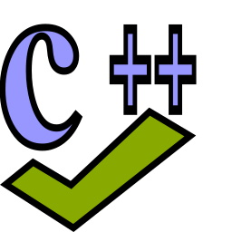
Tools
Snyk
Codiga
CppCheck

Slide 7

Buffer Overflow

Slide 8
Demo
https://github.com/andrew0225/Buffer-Overflow
https://app.snyk.io/

