Slide 1
MOTION SICKNESS AND VR
Exploring Strategies for Reducing Motion Sickness in Virtual Reality Environments
By Christian McCauley

Slide 2
Overview

Slide 3
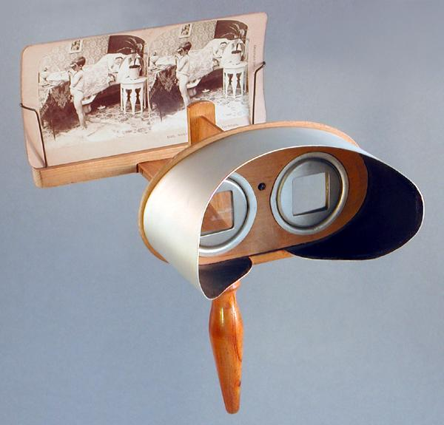
Overview
Virtual Reality (VR)

Slide 4
Overview
Virtual Reality (VR)
Virtual Reality Motion Sickness (VRMS), Cybersickness

Slide 5
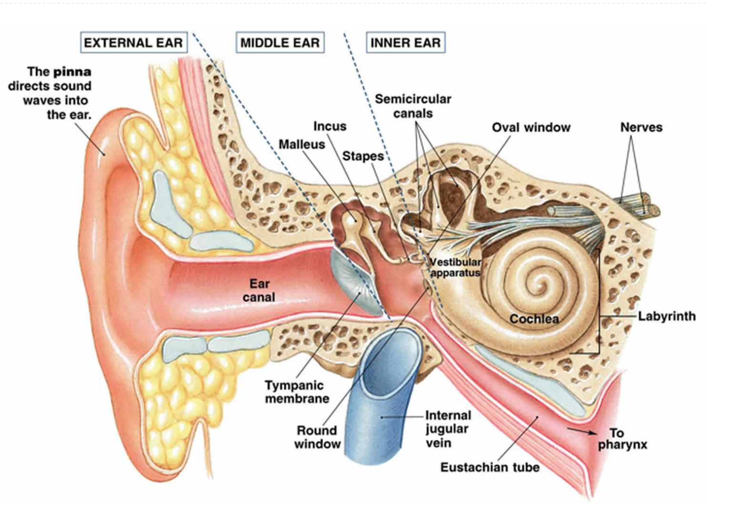
Overview
Virtual Reality (VR)
Virtual Reality Motion Sickness (VRMS), Cybersickness
Why does VR cause motion sickness in the first place?

Slide 6
Overview
Virtual Reality (VR)
Virtual Reality Motion Sickness (VRMS), Cybersickness
Why does VR cause motion sickness in the first place?
What’s being done about it?

Slide 7
Introductions!
The Plan: Using the Unity game engine, test a variety of different software based solutions for reducing Virtual Reality Motion Sickness (VRMS).

Slide 8
Introductions!
The Plan: Using the Unity game engine, test a variety of different software based solutions for reducing Virtual Reality Motion Sickness (VRMS).
The Goal:
Identify the most effective, unobtrusive, and effective methods.

Slide 9
METHODS OF MOTION SICKNESS MITIGATION

Slide 10
Viewpoint Snapping
Using a physical input to move your virtual perspective left or right, without physically moving your body either direction.

Slide 11
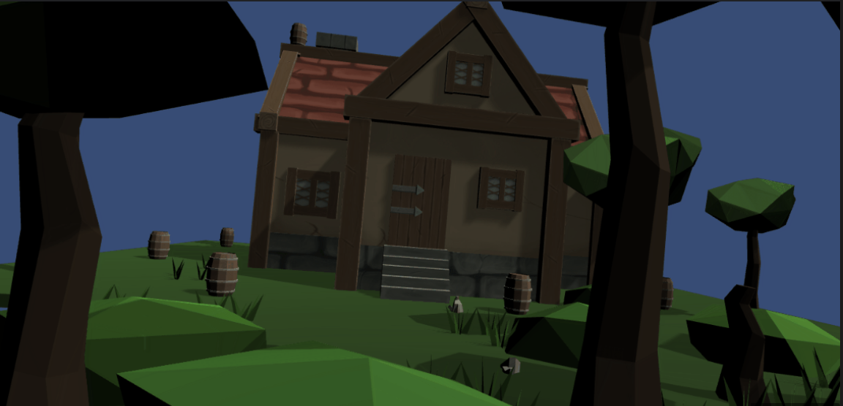
Viewpoint Snapping
Using a physical input to move your virtual perspective left or right, without physically moving your body either direction.

Slide 12
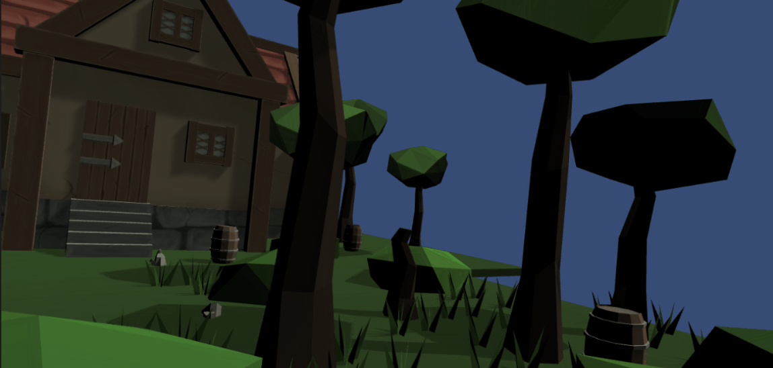
Viewpoint Snapping
Using a physical input to move your virtual perspective left or right, without physically moving your body either direction.

Slide 13
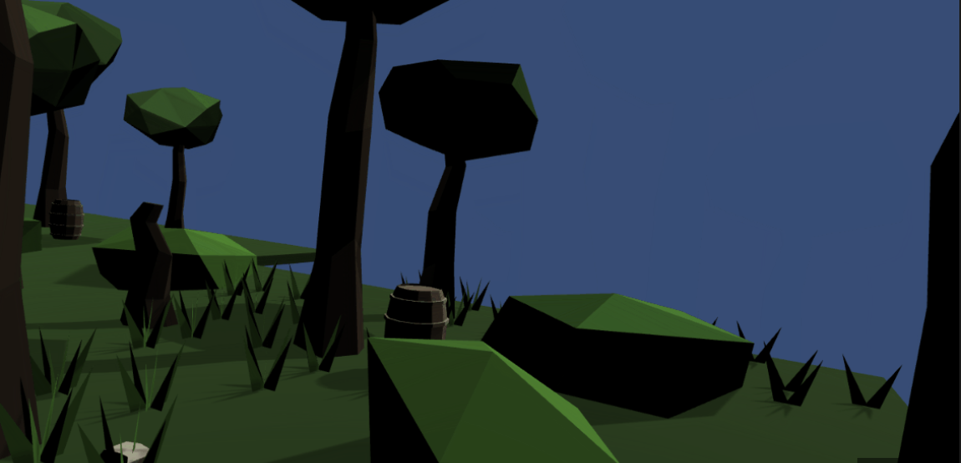
Viewpoint Snapping
Using a physical input to move your virtual perspective left or right, without physically moving your body either direction.

Slide 14
2. Peripheral Vignettes
Darkening or blurring of your peripheral vision to reduce the amount of visual input required to process.

Slide 15
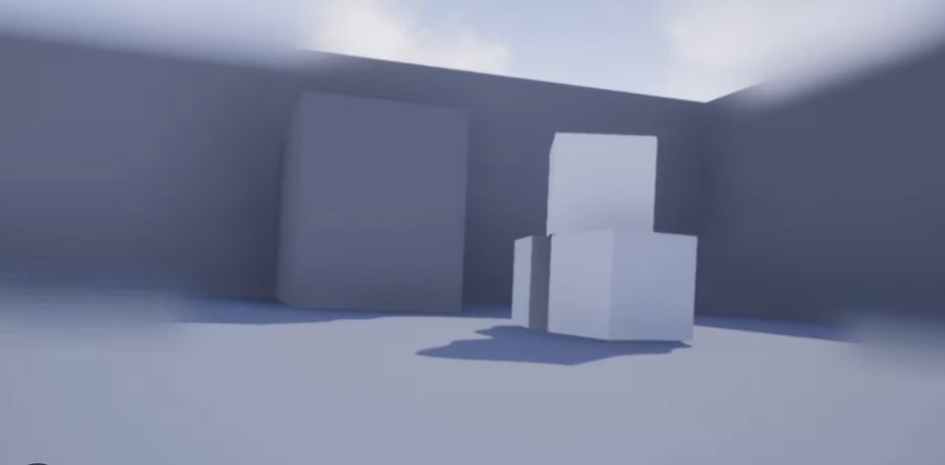
2. Peripheral Vignettes
Darkening or blurring of your peripheral vision to reduce the amount of visual input required to process.

Slide 16
3. Peripheral Geometry Simplification
Similar to Peripheral Vignettes, but uses a simplified version of the surrounding geometry in place of the vignette.

Slide 17
3. Peripheral Geometry Simplification
Similar to Peripheral Vignettes, but uses a simplified version of the surrounding geometry in place of the vignette.

Slide 18
4. World In Miniature (WIM)
This is a locomotion method designed to help you move through the virtual environment (VE) with less motion sickness. It utilizes a miniature 3D version of your VE, where you move an icon that represents the player.

Slide 19
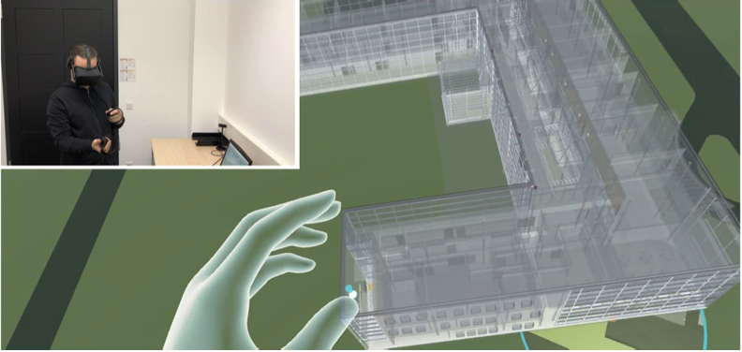
4. World In Miniature (WIM)
This is a locomotion method designed to help you move through the virtual environment (VE) with less motion sickness. It utilizes a miniature 3D version of your VE, where you move an icon that represents the player.

Slide 20
5. Additional Shooting/Aiming Task
Giving the player a secondary task to focus on, especially one that involves focusing on certain points in space, like aiming, can help reduce VRMS

Slide 21
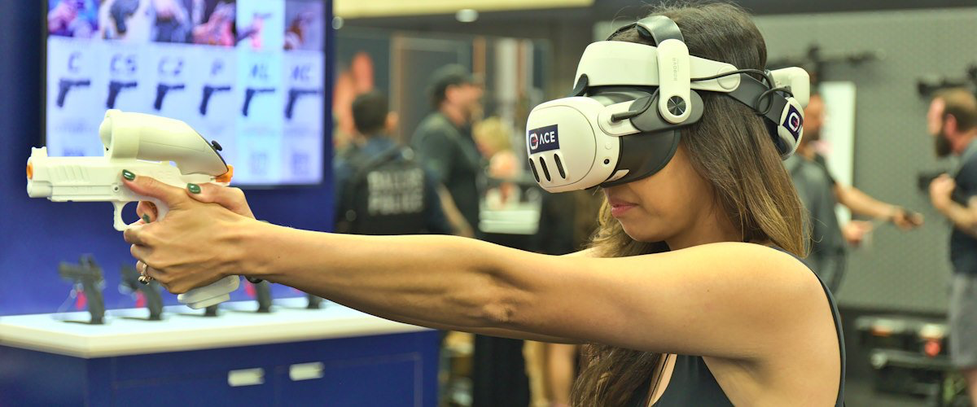
5. Additional Shooting/Aiming Task
Giving the player a secondary task to focus on, especially one that involves focusing on certain points in space, like aiming, can help reduce VRMS

Slide 22
6. Rest Frames
Similar to the aiming task, giving users a static point to focus on in space, sometimes called a rest frame, also helps reduce VRMS. A popular version of this is the “Virtual nose.”

Slide 23
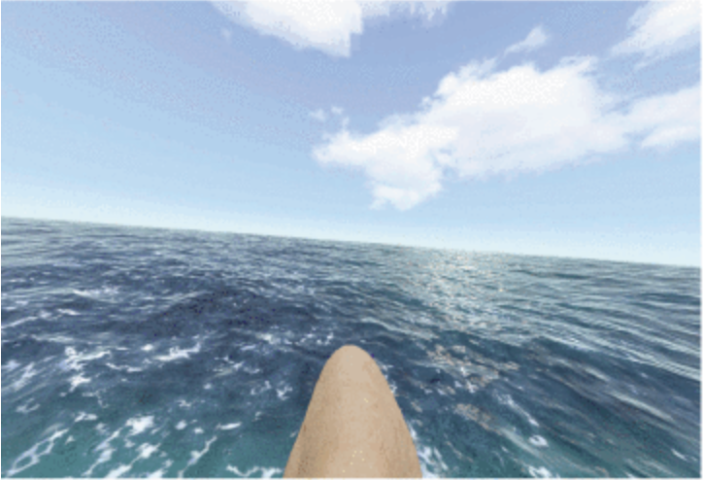
6. Rest Frames
Similar to the aiming task, giving users a static point to focus on in space, sometimes called a rest frame, also helps reduce VRMS. A popular version of this is the “Virtual nose.”

Slide 24
Summary!
Using Unity, test the six aforementioned methods for reducing VRMS.

Slide 25
Summary!
Using Unity, test the six aforementioned methods for reducing VRMS.
Viewpoint Snapping
Vignettes
Geometry simplification
World in miniature locomotion
Additional Aiming Tasks
Rest frames

Slide 26
Summary!
Using Unity, test the six aforementioned methods for reducing VRMS.
Viewpoint Snapping
Vignettes
Geometry simplification
World in miniature locomotion
Additional Aiming Tasks
Rest frames
Identify which methods offer the best reduction in VRMS while maintaining accessibility and in game immersion.

Slide 27
Sources:
Lou, Ruding, Frédéric Mérienne, and Dominique Bechmann. "General Framework of Geometric Simplification for Mitigating Cybersickness." 2022
International Conference on Future Trends in Smart Communities (ICFTSC), Kuching, Sarawak, Malaysia, 2022, pp. 1–5. IEEE, doi:10.1109/ICFTSC57269.2022.10040068.
Park, M.-H., K. Yun, and G. J. Kim. "Reducing VR Sickness by Directing User Gaze to Motion Singularity Point/Region as Effective Rest Frame." IEEE
Access, vol. 11, 2023, pp. 34227–34237. IEEE, doi:10.1109/ACCESS.2023.3263544.
Farmani, Yasin, and Robert J. Teather. "Viewpoint Snapping to Reduce Cybersickness in Virtual Reality." Proceedings of the 44th Graphics Interface
Conference (GI '18), Canadian Human-Computer Communications Society, 2018, pp. 168–175. doi:10.20380/GI2018.23.
Hua, Chengcheng, Jianlong Tao, Lining Chai, and Zhanfeng Zhou. "The Effect of Additional Shooting Task on Alleviating Virtual Reality Motion
Sickness." Proceedings of the 2023 3rd International Conference on Robotics and Control Engineering (RobCE '23), Association for Computing Machinery, 2023, pp. 172–177. doi:10.1145/3598151.3598180.
Page, David, et al. "Identifying Strategies to Mitigate Cybersickness in Virtual Reality Induced by Flying with an Interactive Travel Interface." Multimodal
Technologies and Interaction, vol. 7, no. 5, 2023, p. 47,
Ranasinghe, Nimesha, Pravar Jain, David Tolley, Shienny Karwita Tailan, Ching Chiuan Yen, and Ellen Yi-Luen Do. "Exploring the Use of Olfactory
Stimuli Towards Reducing Visually Induced Motion Sickness in Virtual Reality." Proceedings of the 2020 ACM Symposium on Spatial User Interaction (SUI '20), Association for Computing Machinery, 2020, Article 12, pp. 1–9. doi:10.1145/3385959.3418451.
Berger, Laurenz, and Katrin Wolf. "WIM: Fast Locomotion in Virtual Reality with Spatial Orientation Gain & Without Motion Sickness." Proceedings of
the 17th International Conference on Mobile and Ubiquitous Multimedia (MUM '18), Association for Computing Machinery, 2020. doi:10.1145/3282894.3282932.

