Slide 1
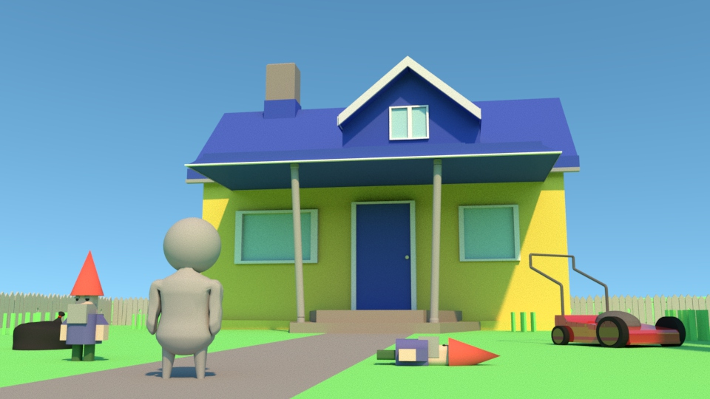
Do the Lawn Before Mom Gets Home!
Dylan Whitehead

Slide 2
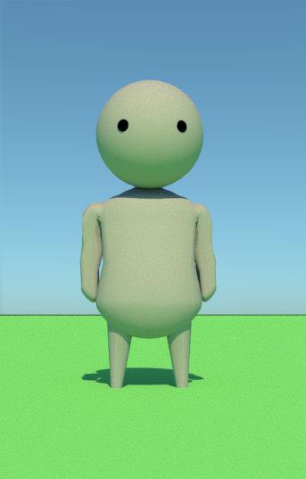
You!

Slide 3
So What’s the Game?
High Intensity Lawn Based Action
Strict time limit
Random Objectives
Random Hazards/Events
Completion Percent

Slide 4
Hazards/Events
Acts of God
Loving neighbors
Just plain unlucky

Slide 5
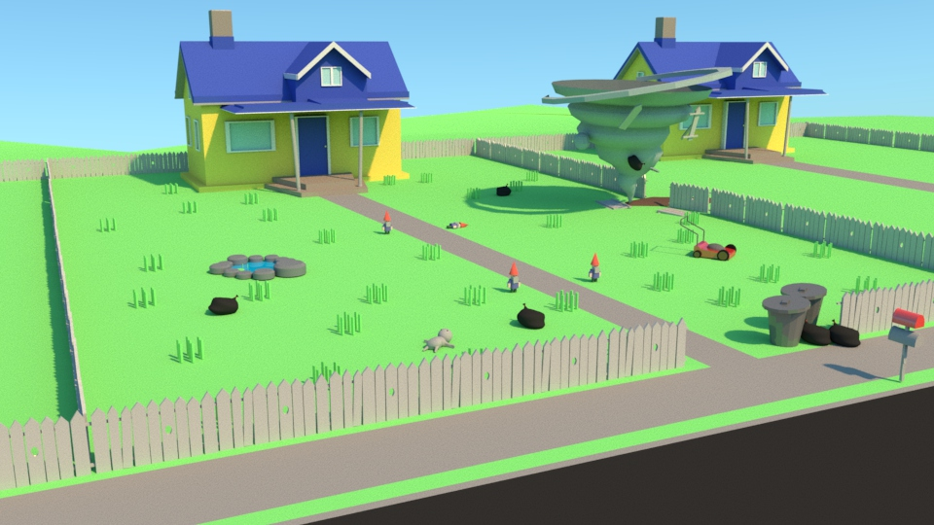
Let’s see how it looks!

Slide 6
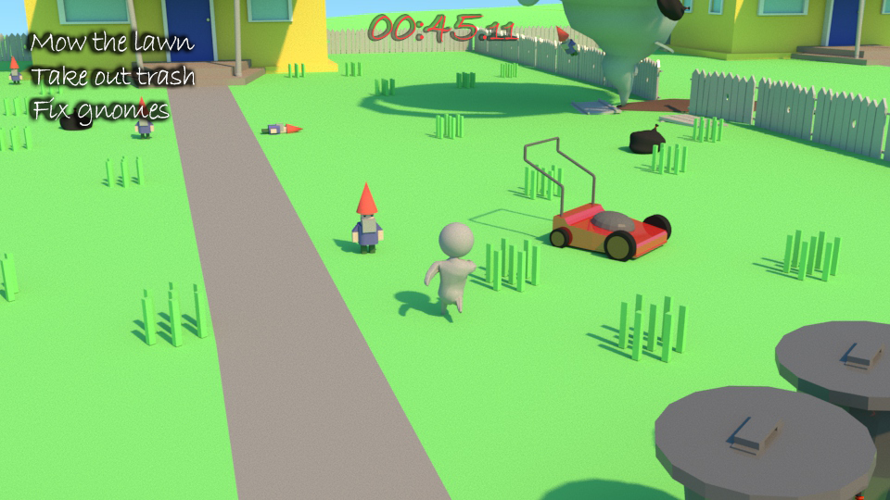

Slide 8
What all needs to be done?
Functionality
Assets
Audio/Animation
Simple player movement
Objective/Timer UI
Item pick-ups
Player behavior
Random event triggers
Player
House/Yard
Grass/Road
Various Objective Props
Various Hazard Props
Player
Interactable Props
Random objectives/hazards

Slide 9
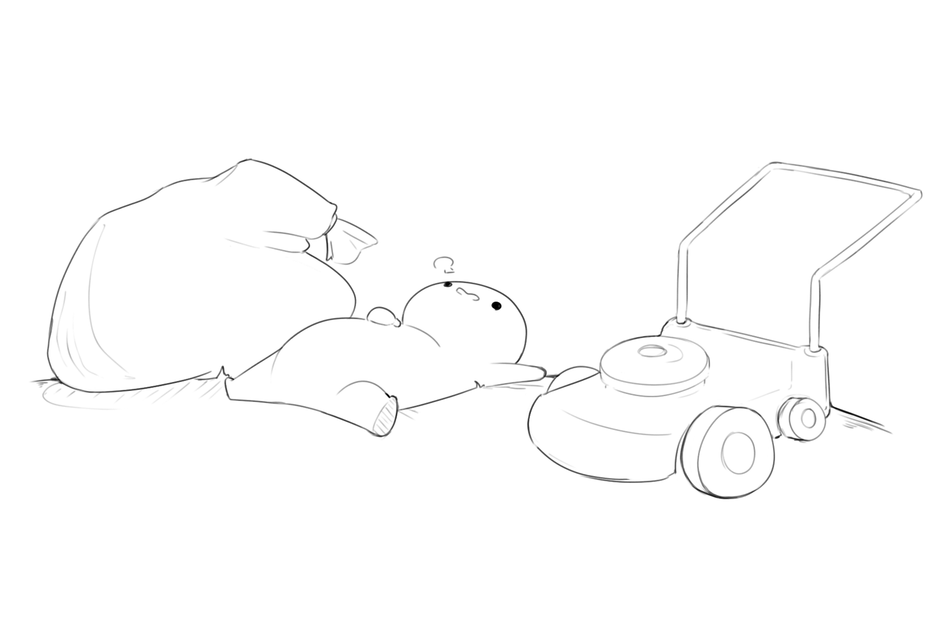
That sounds like a lot of work…
Design
Implementation
Testing
Asset Creation

Slide 10
Why Would I want to work on that?
Presentable Portfolio Piece
Completed Project
Experience

Slide 11
To summarize

Slide 12
That’s all, thanks!

