Slide 1


Untitled Adventure Game
Presented by Alex Miller

Slide 2
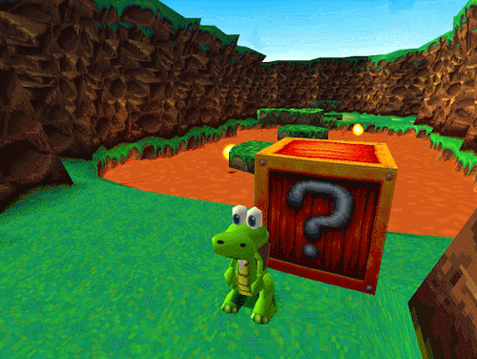
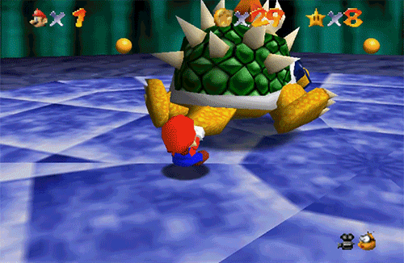
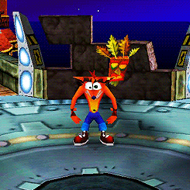
Overview of UAG
As a homage to the nostalgic era of video games, UAG will strive to recapture the wonder and excitement of collect-athons of old. Games like Crash Bandicoot, Banjo-Kazooie, Spyro, Conker’s Bad Furday and Super Mario 64; are cemented in my brain (and hopefully yours) as some of the best 3-D games of my childhood.

Slide 3

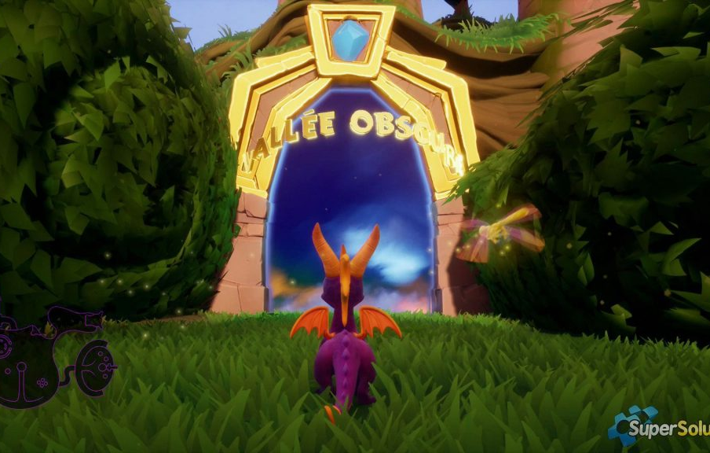
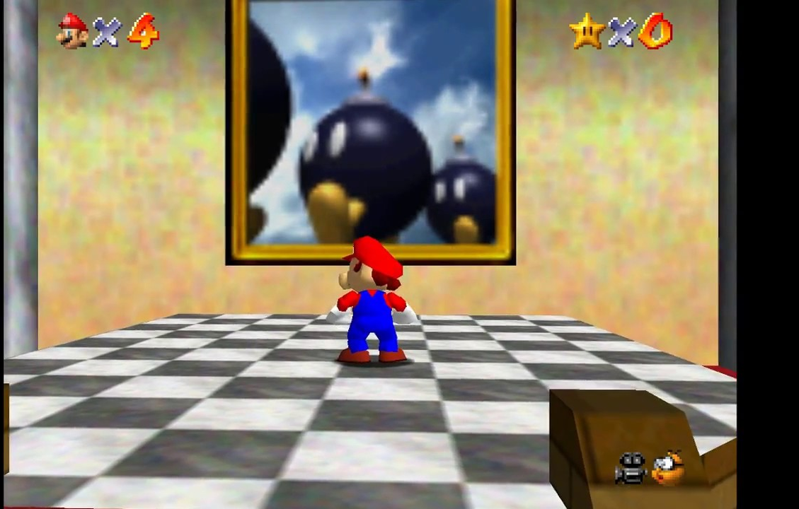
Overview of UAG
The player would start off in a “Hub World”. From here, they can get to every level at any point of time. There’s nothing stopping them from jumping into the last level. The only catch would be that to fully complete a level you need to have either a special ability or item from a previous levels completion to finish it.

Slide 4
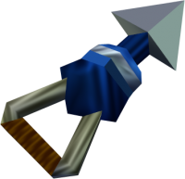
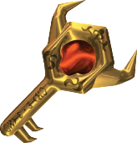
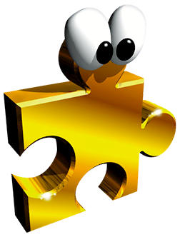
Gameplay
A third person open-world adventure game that involves platforming, collecting items and disposing of enemies to complete a level.
At the completion of each level you’re granted that levels “reward”, which is used to complete another level. It’s not immediately apparent which “reward” pairs to what level so a bit of exploration is in order.
Character attacks can be a charge or throwing/shooting objects.
Level 1
Defeat enemies, platforming
Granted Item/Ability on completion
Level 2
Defeat enemies, platforming
Level3
Defeat enemies, platforming
Granted Item/Ability on completion
Granted Item/Ability on completion

Slide 5
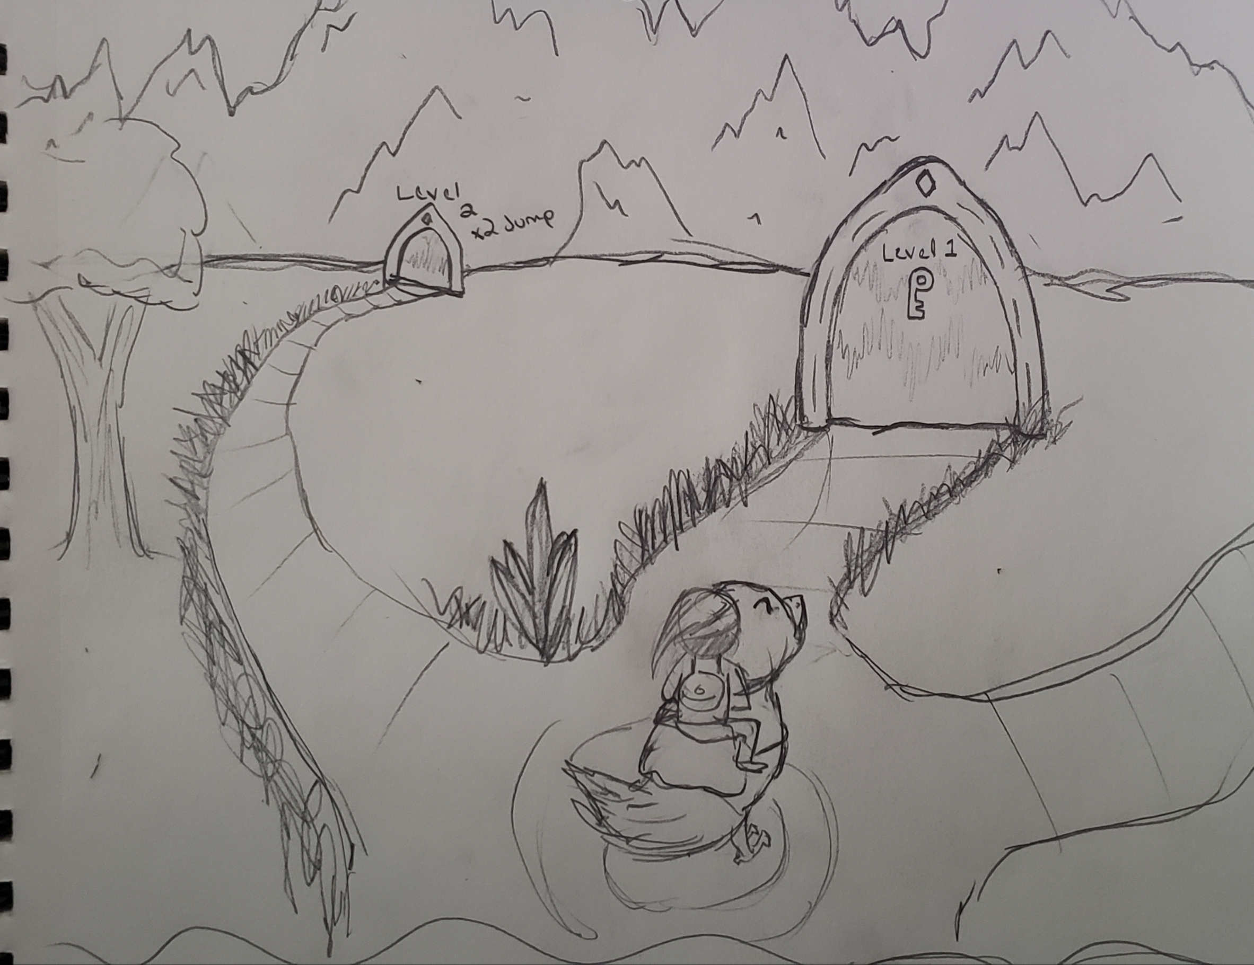
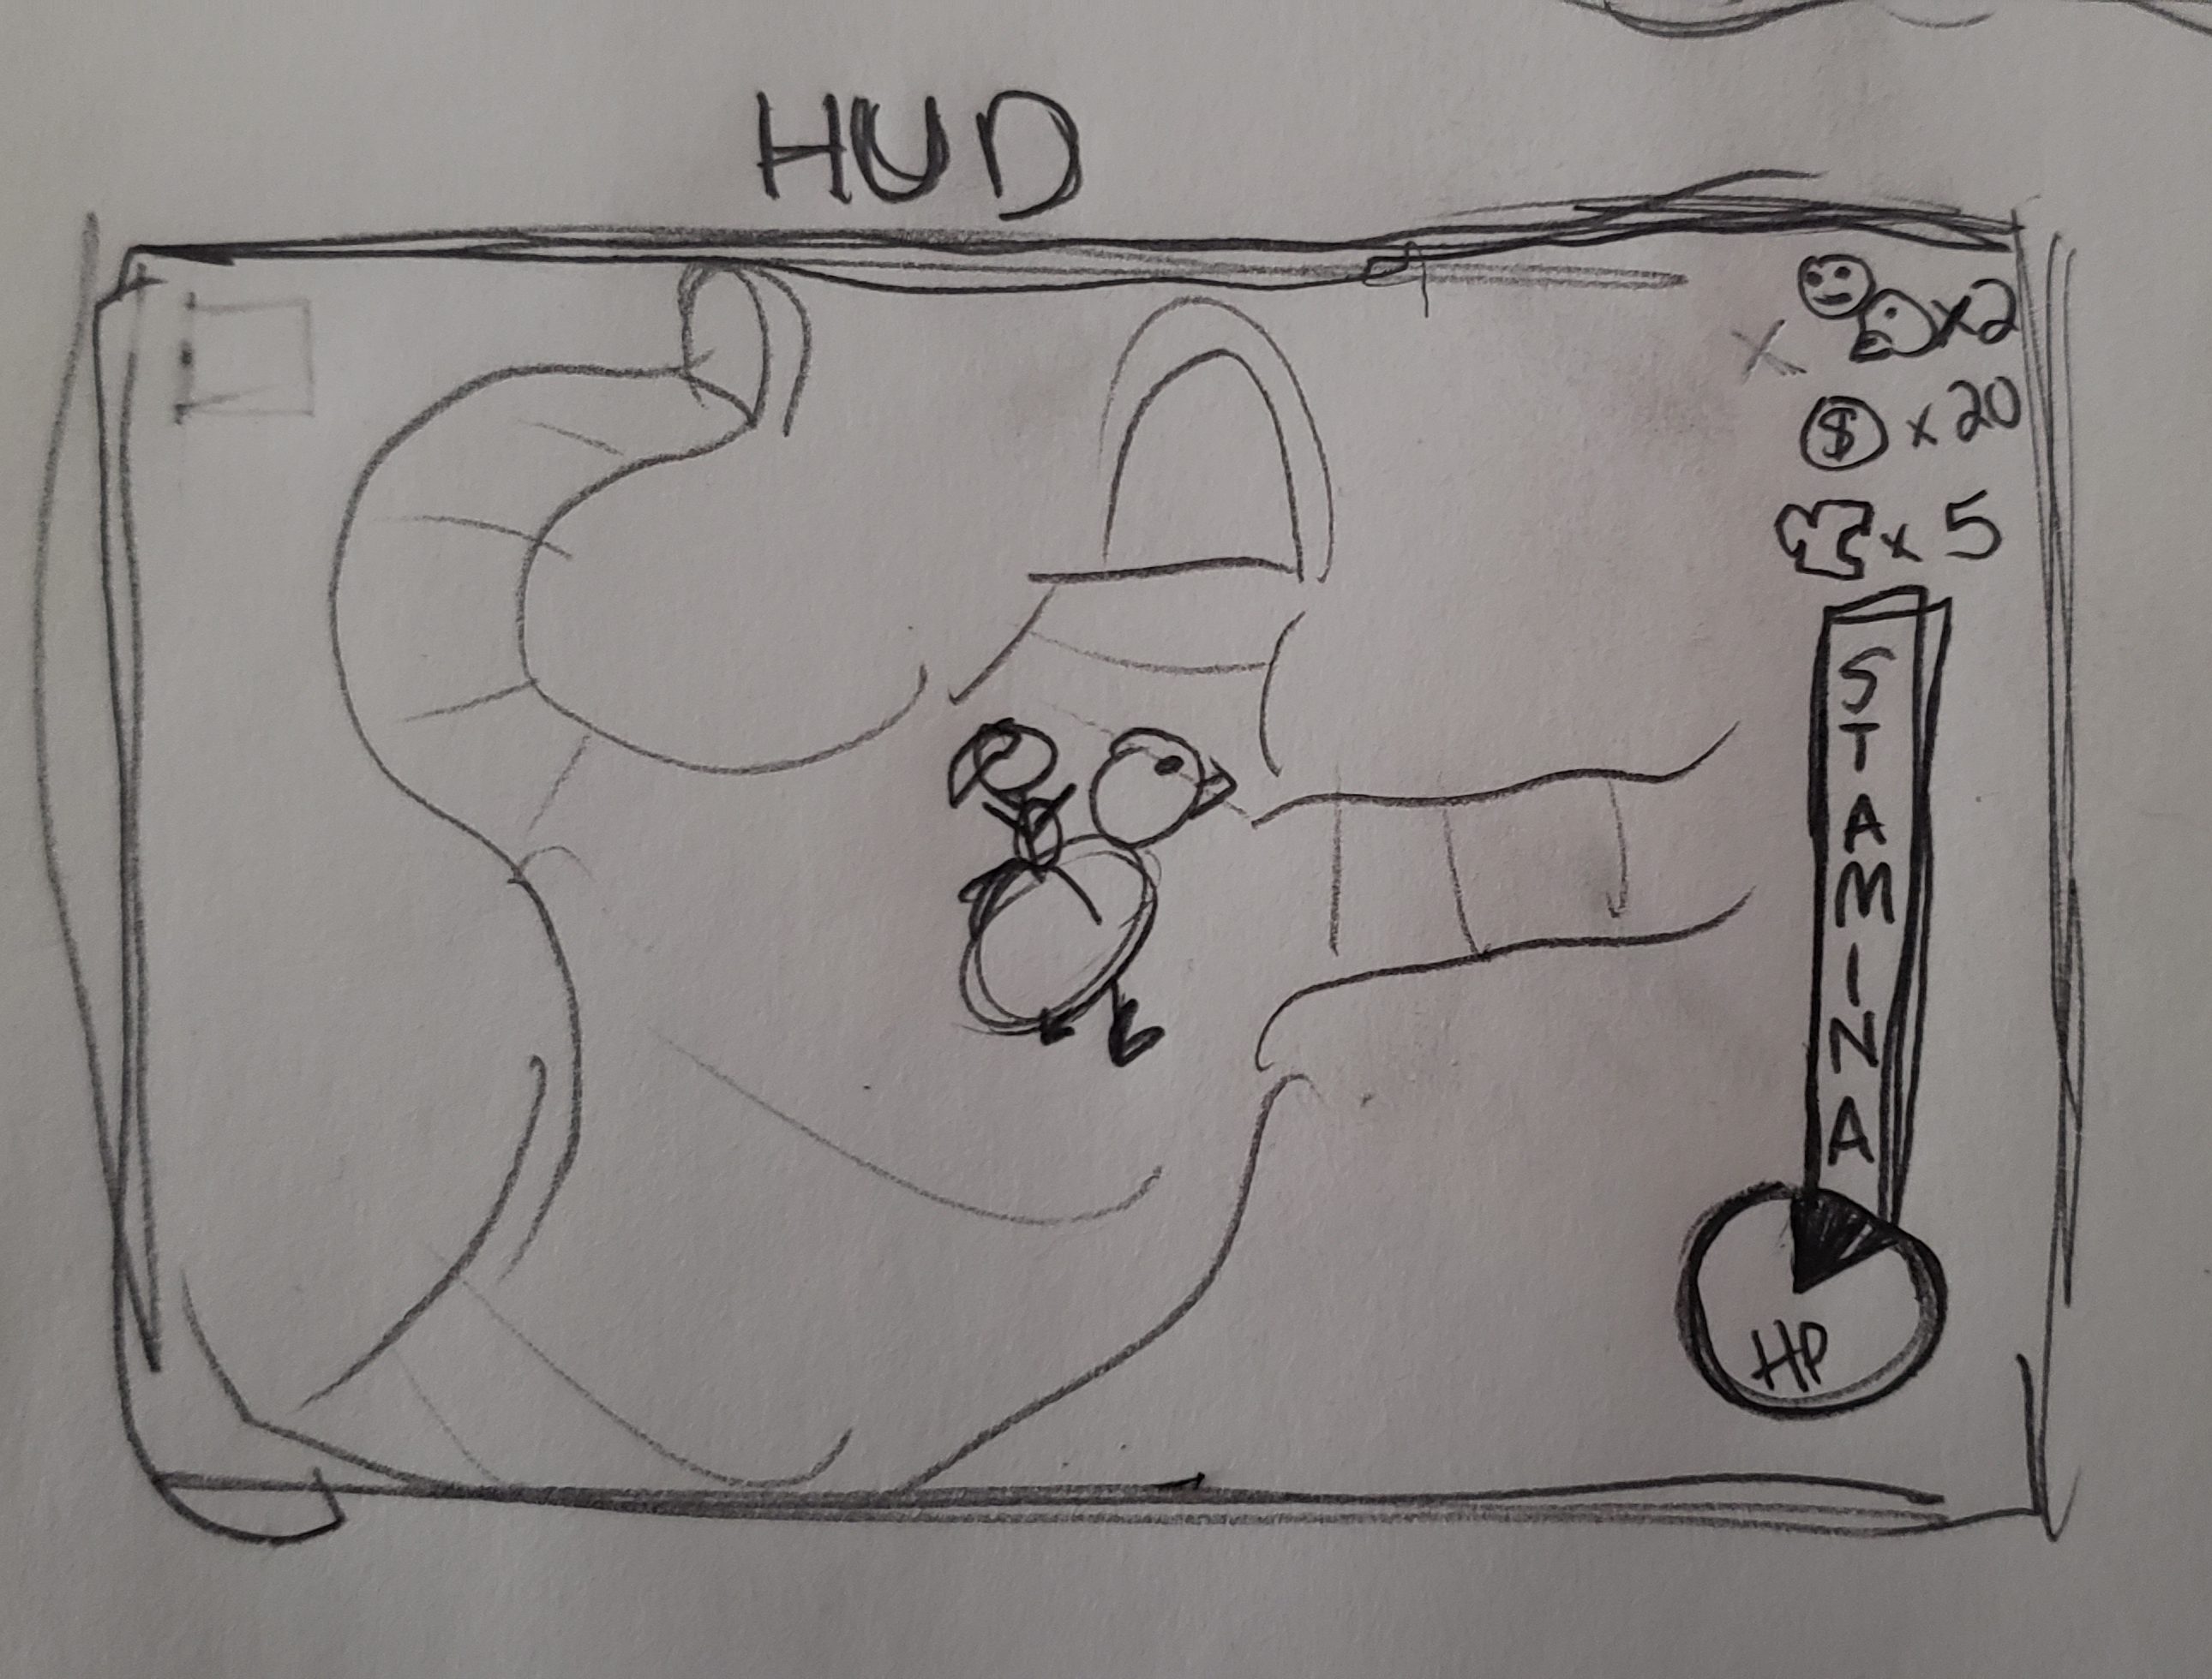
Concept Art
HUB World Sketch
Surrounded in by mountains/walls
Free to select desired level
Level name pictured on portal, as well as, item received on completion.
HUD Screen Sketch
From Top: Lives, Coin, Collectibles, Stamina, HP
Stamina Bar that depletes on charging
Health can be pie graph or color-coded circle
  Green -> Red hue to show health level

Slide 6
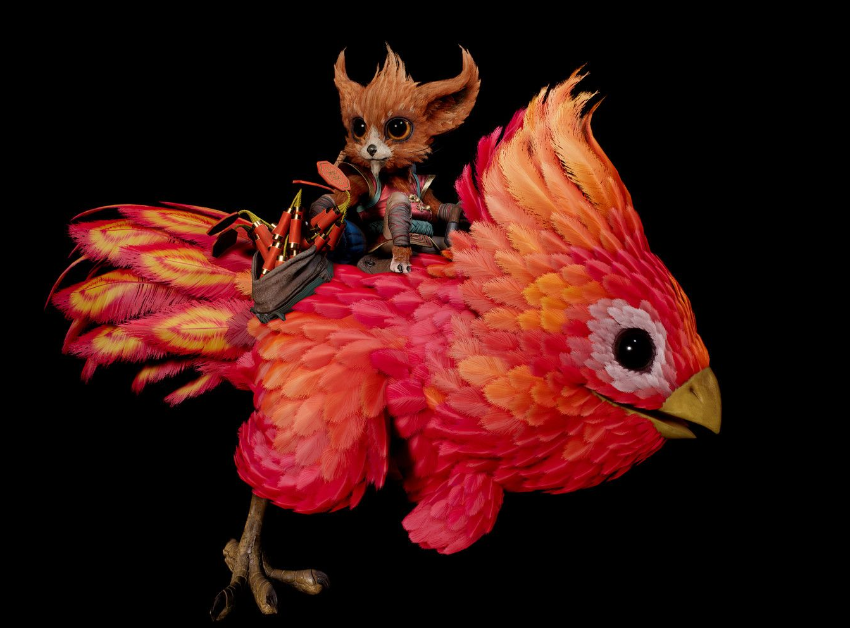
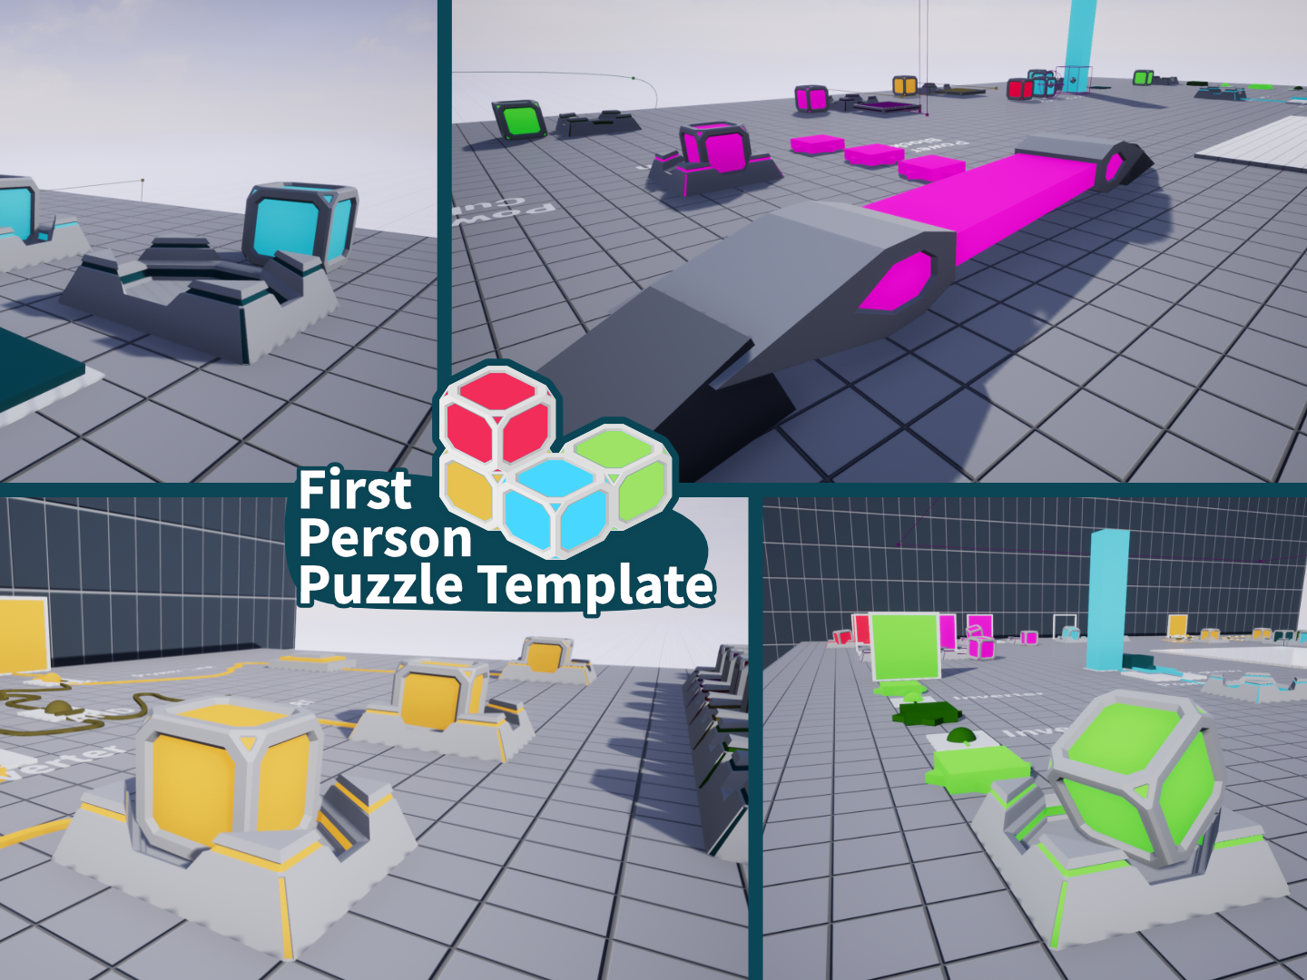
Assets We Have
“Iggy and Scorch: Phoenix” model is free on the Unreal Marketplace. This could be the character model for the main character.
Models for the collectables, the AI behavior and the UI would be easy for us to adapt to this game.
There are free materials that can cell-shade the environment for us.
Environment assets are aplenty.
There’s even a puzzle template that includes different Portal-esque cubes and cube triggers. If that would be something we wanted to implement.

Slide 7

Assets Needed / What Can You Do?
A search for enemy assets would need to commence.
What I would have each of you do is develop your own level with its own special theming. Perhaps even center it around using a certain ability or item the player got in the previous level.
I would make the Hub World, implement saving between levels and organizing the different blueprint classes.
As well as developing a single level I’d appreciate if you worked on making or flushing out a specific aspect of the game. It might be in your best interest if that thing was related to your Investigation presentation.
A certain naming convention would need to be set in place so that we don’t get our assets and variables confused when we switch levels.

Slide 8
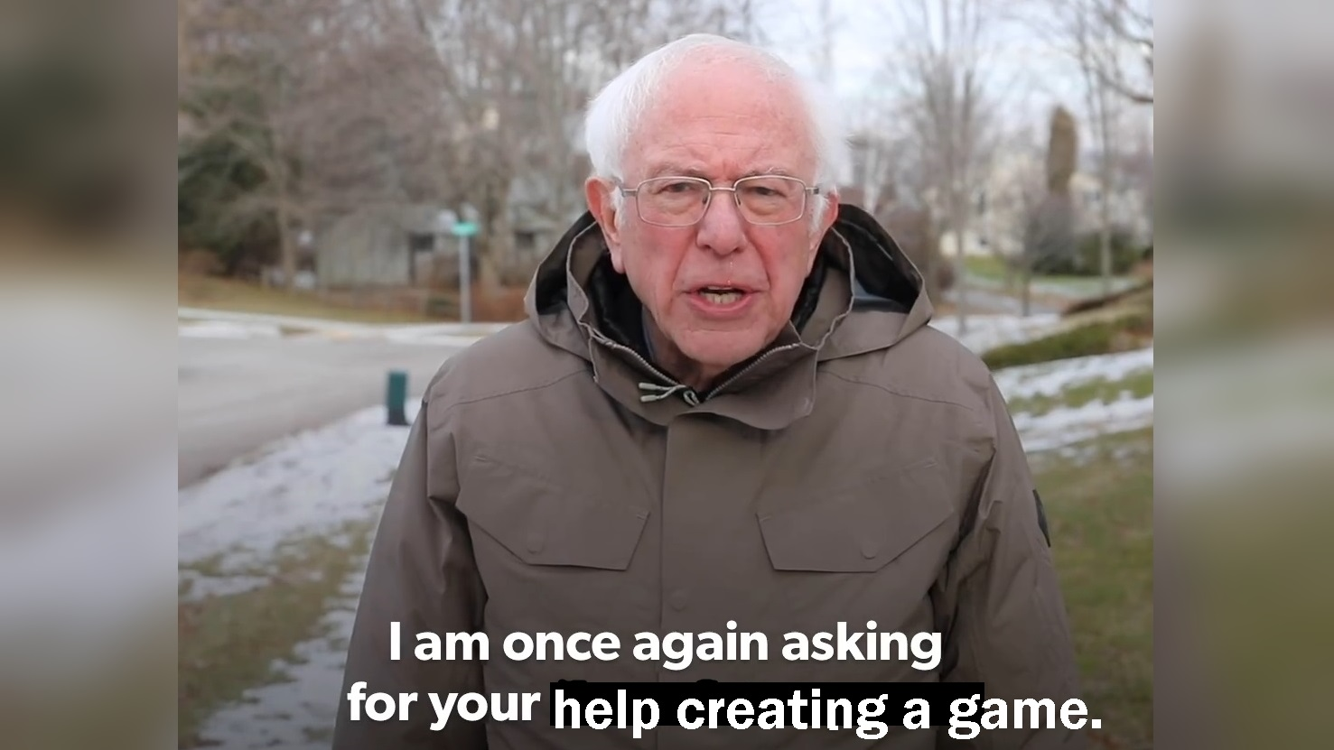
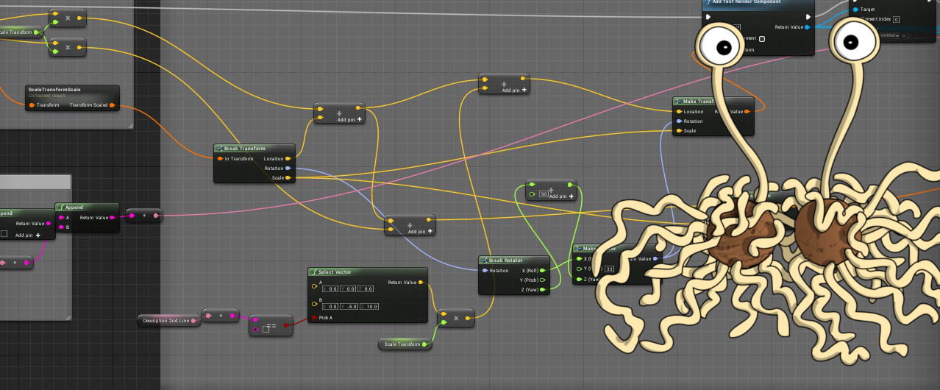
Conclusion
I’m striving to create a smaller version of the nostalgic era of video games and I would love your help in making it a reality.
You have the freedom to design your own level, level title and ability, how ever you would like if it stays relatively close to the overall theme and implements the games design as stated from before. Thank you for your time!

Slide 9
Questions?

