Slide 1
NPC Interaction With Dialogue
Alexander Thompson

Slide 2
New Unreal Components
Blueprint Interface
Data Structures
Data Tables

Slide 3
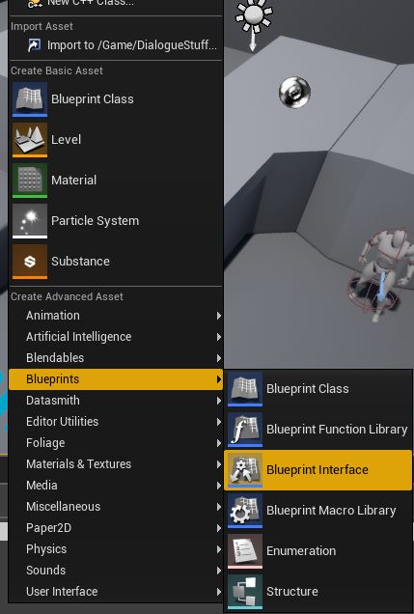
Blueprint Interface
Allows for a common functions between objects.
No implementation inside of the interface itself
Object are expected to have their own unique implementation
Name your function in the instance for easy location

Slide 4
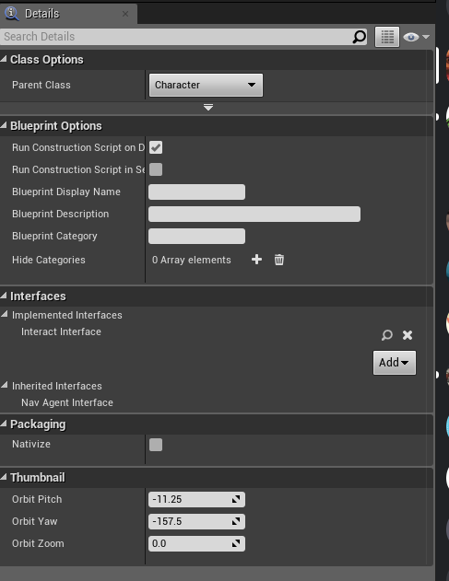
Use
Click on Class Setting after an interface has been created to add it to the class
In the Interfaces section of the details panel, click add and select your interface
In the object’s event graph set up the event to be called
All that’s left is to call the object. You will need to specify which object reference to call as many different objects may have this same function.

Slide 5
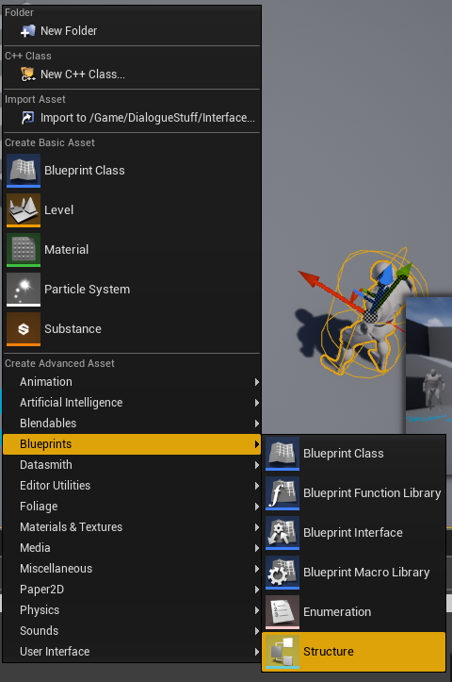
Data Structures
Data Structures allow for the creation of structs inside of unreal
They can be used to set imported data into data tables
Able to be made outside of unreal and imported in

Slide 6
Setting Up structure

Slide 7
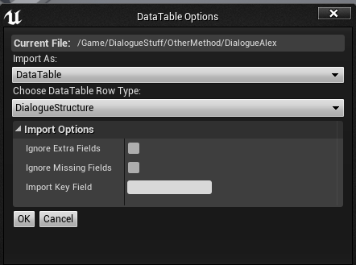
Use
The following table was made in spreadsheet
To import the top row must match exactly with the Structure
The file I used had to be saved as a CSV(comma separated values) file from spreadsheets

Slide 8
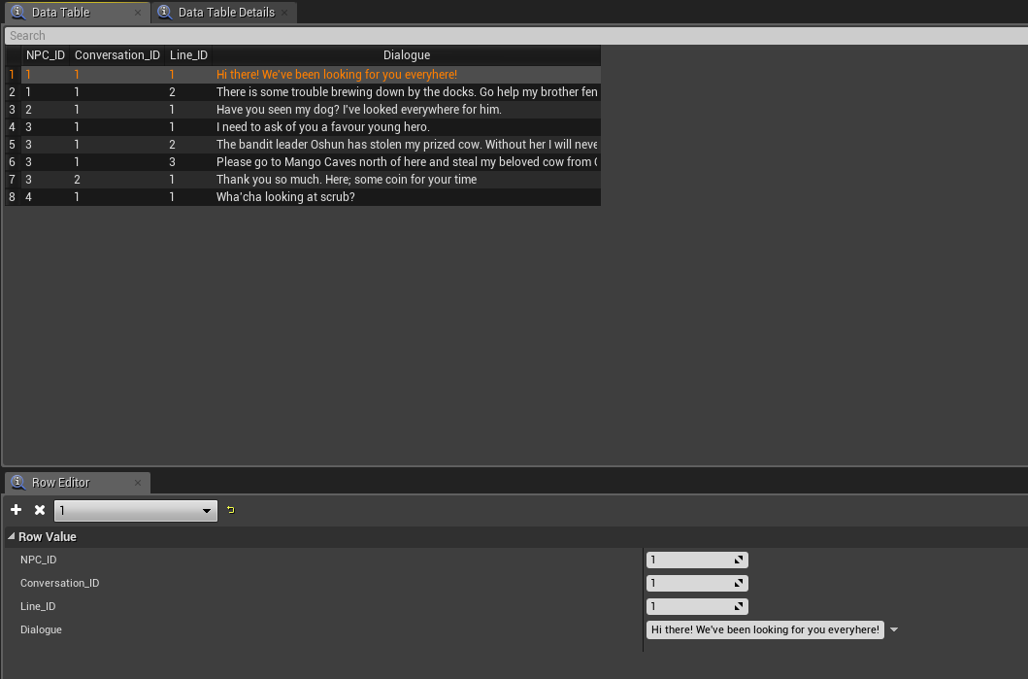
Result
Then check your new data table to make sure it was imported successfully

Slide 9
Unreal Demonstration
Widgets
Blueprint Interface
Behavior Trees
Logic
Set up

Slide 10
References
I Follow along with Ryan Laley’s YouTube playlists on Dialogue
https://www.youtube.com/playlist?list=PL4G2bSPE_8unnYOwQ4Hds62TI_0WG4sW-
https://www.youtube.com/watch?v=vho7w6rUU7A&list=PL4G2bSPE_8uliMQHui4DhdlZ1dzPk9I5Q&index=8
https://www.youtube.com/watch?v=2kHbhYn4I6E&list=PL4G2bSPE_8uliMQHui4DhdlZ1dzPk9I5Q&index=9
https://www.youtube.com/watch?v=ukx4Umhlqic&list=PL4G2bSPE_8uliMQHui4DhdlZ1dzPk9I5Q&index=10
https://www.youtube.com/watch?v=97Y8QjJDCtE&list=PL4G2bSPE_8uliMQHui4DhdlZ1dzPk9I5Q&index=11

